Slide 1
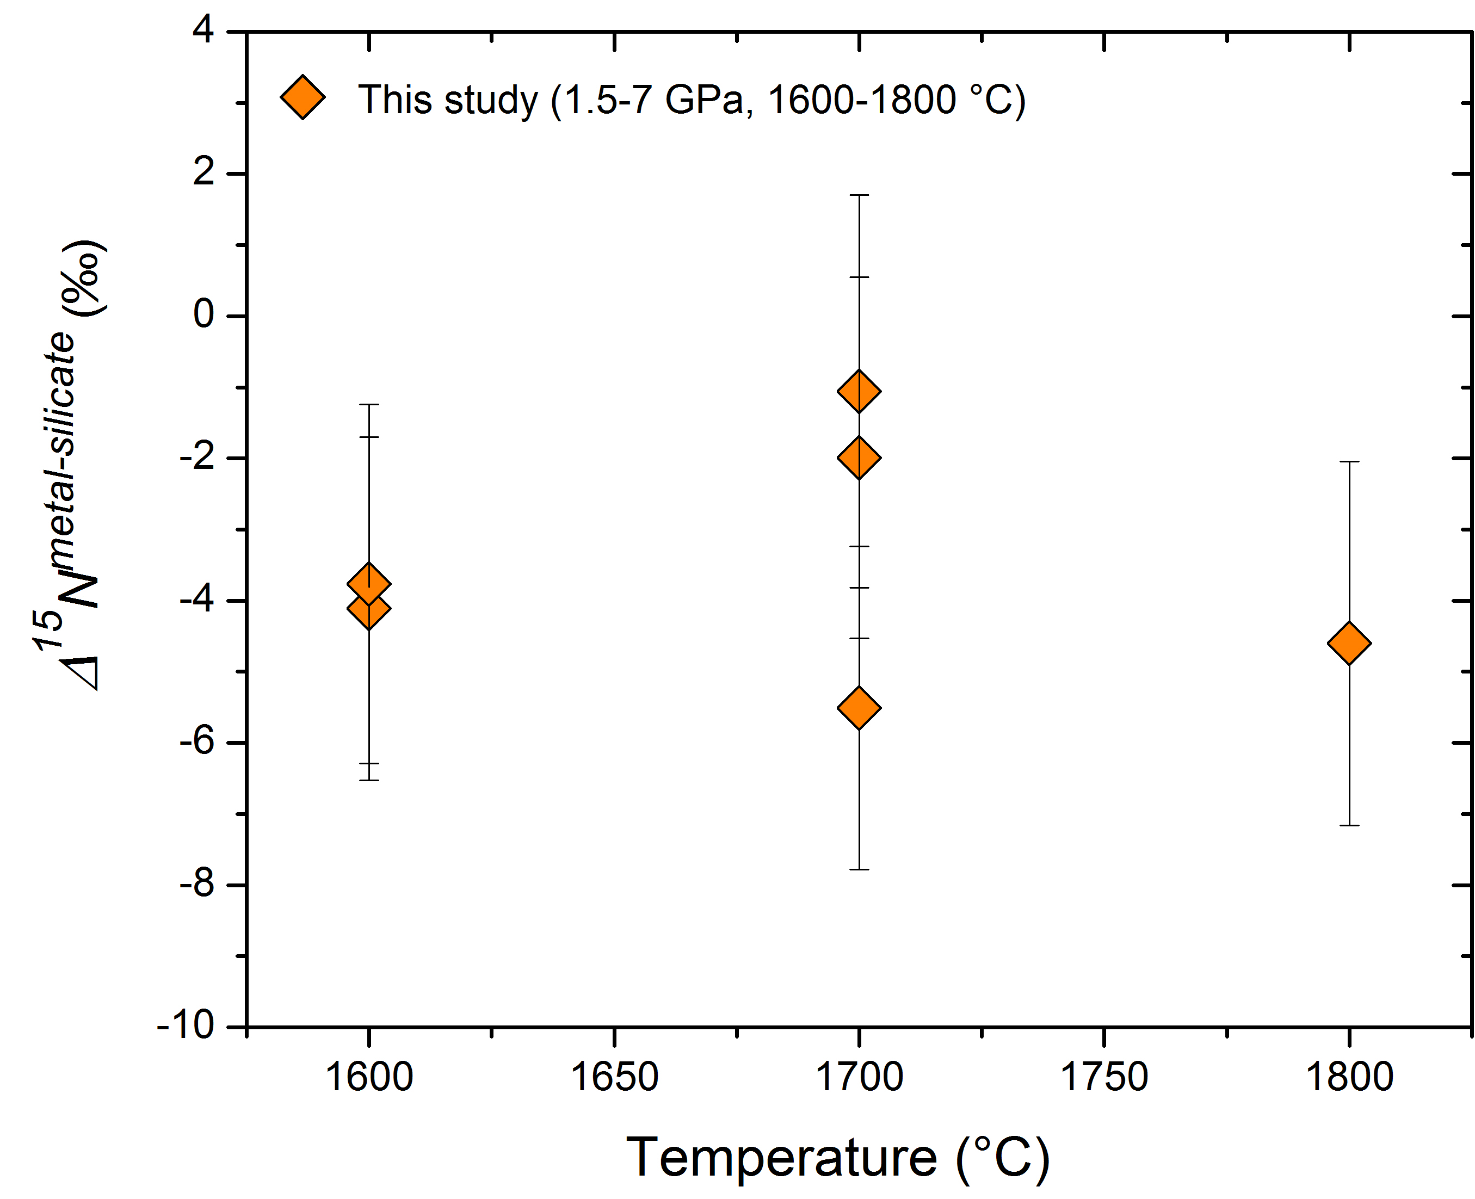
Li et al.
Nitrogen isotope fractionation during terrestrial core-mantle separation
Figure 2 Nitrogen isotope fractionation between liquid Fe-rich metal and silicate melt (Δ¹⁵N^{metal-silicate}). Temperature has a very limited effect on Δ¹⁵N^{metal-silicate}in the P-T range studied. Errors of Δ¹⁵N^{metal-silicate} are at 95 % confidence interval.
Li et al. (2016) Geochem. Persp. Let. 2, 138-147 | doi: 10.7185/geochemlet.1614
© 2016 European Association of Geochemistry
Notes:
Figure 2 Nitrogen isotope fractionation between liquid Fe-rich metal and silicate melt (Δ¹⁵N^{metal-silicate}). Temperature has a very limited effect on Δ¹⁵N^{metal-silicate} in the P-T range studied. Errors of Δ¹⁵N^{metal-silicate} are at 95 % confidence interval.

