Slide 1
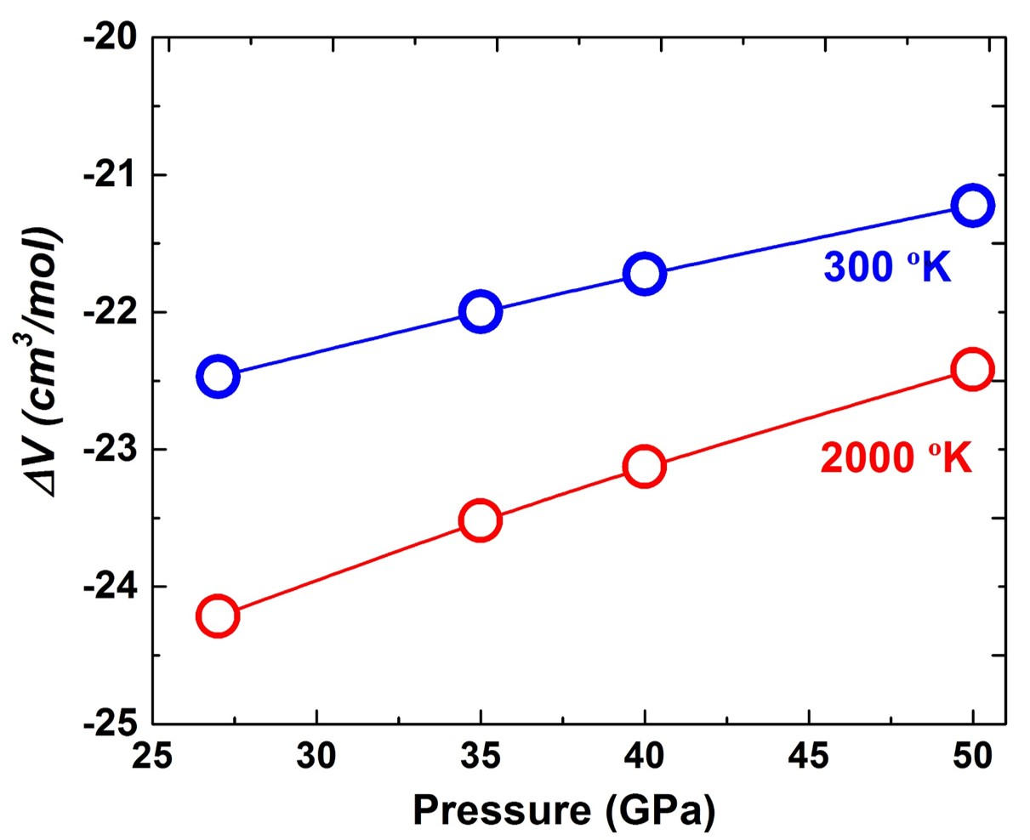
Liu et al.
Rapid decrease of MgAlO_{2.5} component in bridgmanite with pressure
Figure S-5 The calculated molar volume change of Eq. S-2 in the text along 300 and 2000 °K, respectively.
Liu et al. (2017) Geochem. Persp. Let. 5, 12-18 | doi: 10.7185/geochemlet.1739
© 2017 European Association of Geochemistry
Notes:
Figure S-5 The calculated molar volume change of Eq. S-2 in the text along 300 and 2000 °K, respectively.

