Slide 1
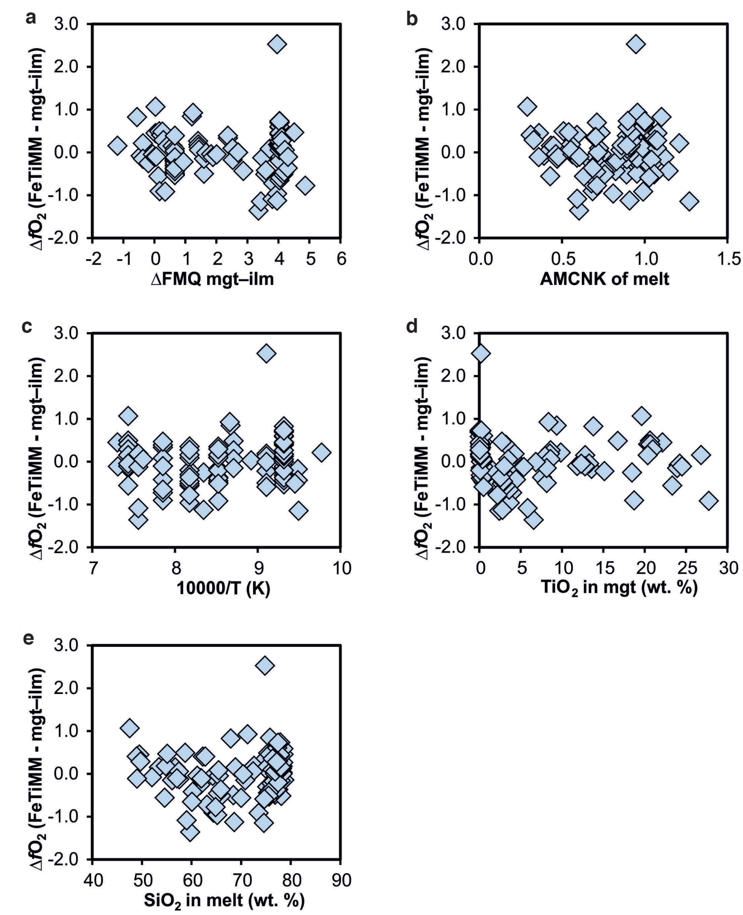
Arató and Audétat
FeTiMM – A new oxybarometer for mafic to felsic magmas
Figure S-4 Difference between the fO₂ values calculated via magnetite–ilmenite and ones calculated via FeTiMM [∆fO₂ (FeTiMM - mgt–ilm)], as a function of (a) fO₂, (b) AMCNK, (c) temperature, (d) magnetite composition, and (e) melt SiO₂ content, for the 109 data points that were used to calibrate FeTiMM.
Arató and Audétat (2017) Geochem. Persp. Let. 5, 19-23 | doi: 10.7185/geochemlet.1740
© 2017 European Association of Geochemistry
Notes:
Figure S-4 Difference between the fO₂ values calculated via magnetite–ilmenite and ones calculated via FeTiMM [∆fO₂ (FeTiMM - mgt–ilm)], as a function of (a) fO₂, (b) AMCNK, (c) temperature, (d) magnetite composition, and (e) melt SiO₂ content, for the 109 data points that were used to calibrate FeTiMM.

