Slide 1
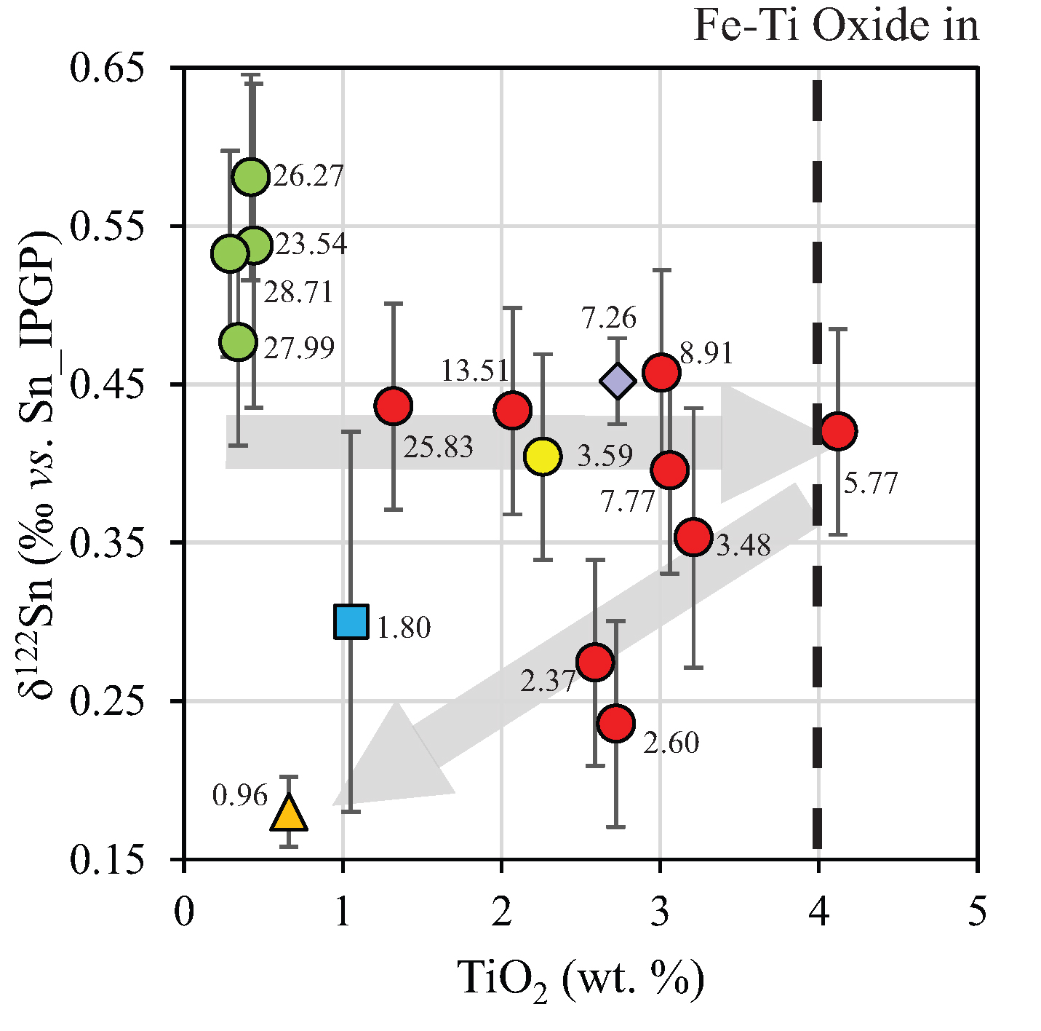
Badullovich et al.
Tin isotopic fractionation during igneous differentiation and Earth’s mantle composition
Figure 2 Variation of δ¹²²Sn with TiO₂ content, MgO (wt. %) shown next to the data point. Sn isotope fractionation occurs only after Fe-Ti oxide (ilmenite) saturation at Kilauea Iki. Symbols as per Figure 1.
Badullovich et al. (2017) Geochem. Persp. Let. 5, 24-28 | doi: 10.7185/geochemlet.1741
© 2017 European Association of Geochemistry
Notes:
Figure 2 Variation of δ¹²²Sn with TiO₂ content, MgO (wt. %) shown next to the data point. Sn isotope fractionation occurs only after Fe-Ti oxide (ilmenite) saturation at Kilauea Iki. Symbols as per Figure 1.

