Slide 1
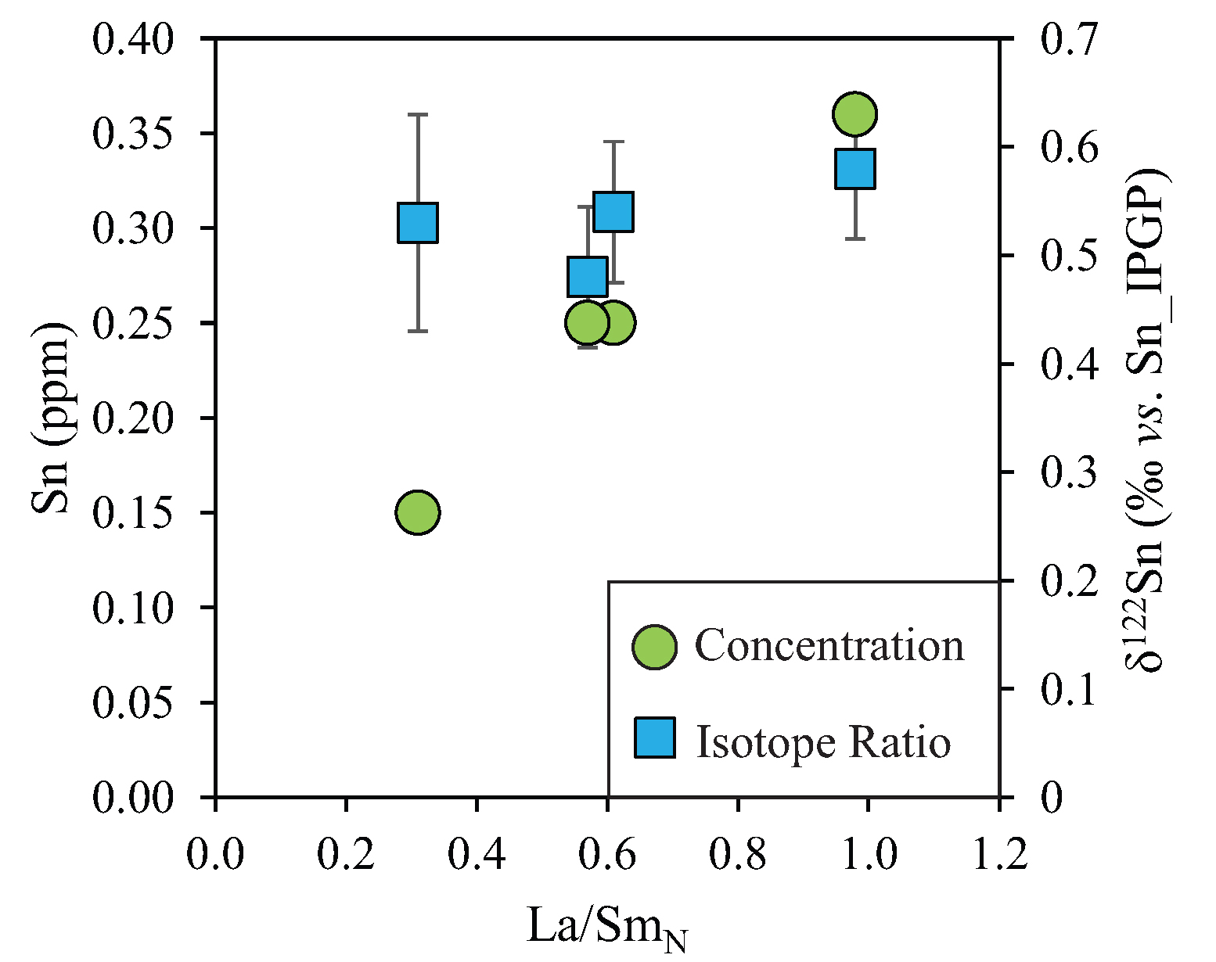
Badullovich et al.
Tin isotopic fractionation during igneous differentiation and Earth’s mantle composition
Figure 3 Depletion of komatiite source regions, quantified by La/Sm_{N}, as a function of Sn concentration (green circles) and δ¹²²Sn (blue squares). Tin contents are positively correlated with La/Sm_{N}, whereas δ¹²²Sn remains constant within uncertainty.
Badullovich et al. (2017) Geochem. Persp. Let. 5, 24-28 | doi: 10.7185/geochemlet.1741
© 2017 European Association of Geochemistry
Notes:
Figure 3 Depletion of komatiite source regions, quantified by La/Sm_{N}, as a function of Sn concentration (green circles) and δ¹²²Sn (blue squares). Tin contents are positively correlated with La/Sm_{N}, whereas δ¹²²Sn remains constant within uncertainty.

