Slide 1
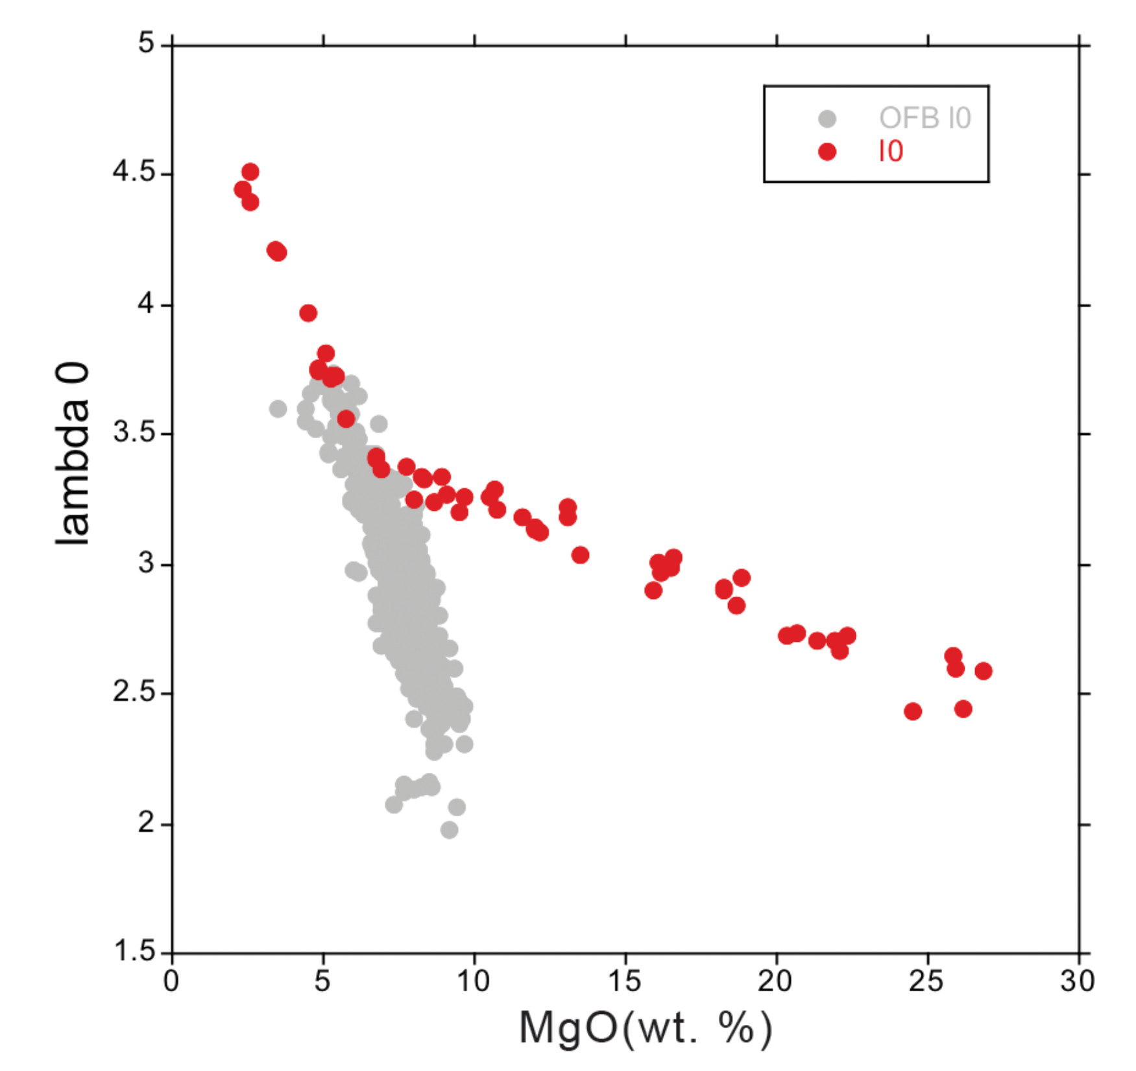
Badullovich et al.
Tin isotopic fractionation during igneous differentiation and Earth’s mantle composition
Figure S-1 Calculated λ₀, quantifying the mean abundances of the Rare Earth Elements (see O’Neill, 2016) against MgO. Red points correspond to the Kilauea Iki lava lake, and show a rapid drop in MgO and a small increase in λ₀ for 7.4 < MgO (wt. %) < 27 during olivine crystallisation/accumulation, before a rapid increase in slope at 7.4 wt. % MgO signalling a change in the crystallising assemblage to cpx + plg + ol.
Badullovich et al. (2017) Geochem. Persp. Let. 5, 24-28 | doi: 10.7185/geochemlet.1741
© 2017 European Association of Geochemistry
Notes:
Figure S-1 Calculated λ₀, quantifying the mean abundances of the Rare Earth Elements (see O’Neill, 2016) against MgO. Red points correspond to the Kilauea Iki lava lake, and show a rapid drop in MgO and a small increase in λ₀ for 7.4 < MgO (wt. %) < 27 during olivine crystallisation/accumulation, before a rapid increase in slope at 7.4 wt. % MgO signalling a change in the crystallising assemblage to cpx + plg + ol.

