Slide 1
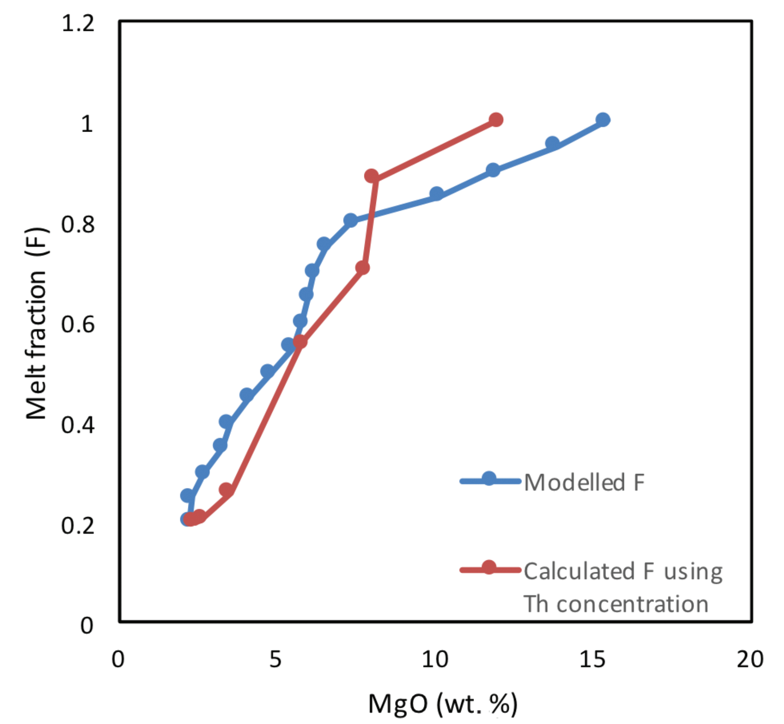
Badullovich et al.
Tin isotopic fractionation during igneous differentiation and Earth’s mantle composition
Figure S-3 Plot of melt fraction against MgO (wt. %). The maroon line represents the calculated F assuming that Th behaves as a perfectly incompatible element. The blue line represents the modelled F from the major element modelling of Kilauea Iki lava lake.
Badullovich et al. (2017) Geochem. Persp. Let. 5, 24-28 | doi: 10.7185/geochemlet.1741
© 2017 European Association of Geochemistry
Notes:
Figure S-3 Plot of melt fraction against MgO (wt. %). The maroon line represents the calculated F assuming that Th behaves as a perfectly incompatible element. The blue line represents the modelled F from the major element modelling of Kilauea Iki lava lake.

