Slide 1
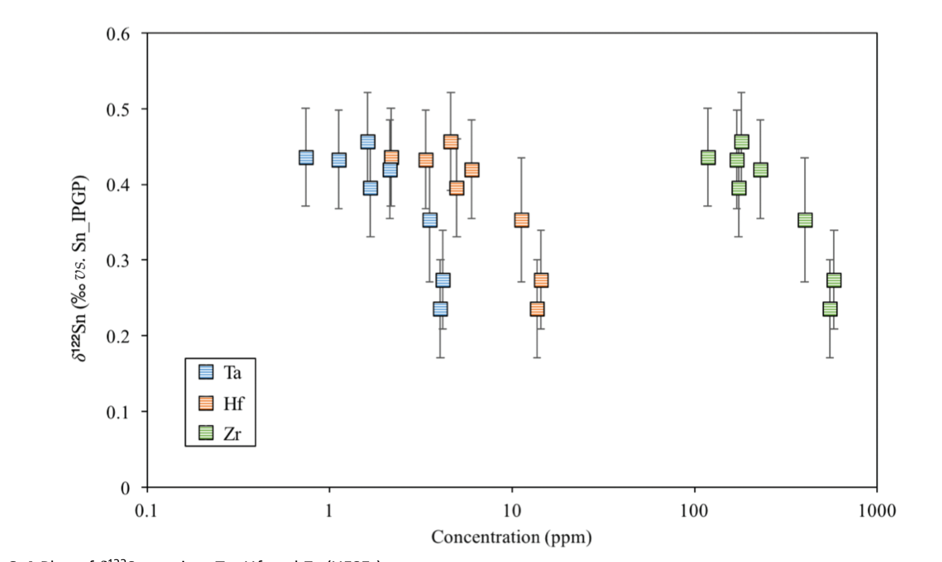
Badullovich et al.
Tin isotopic fractionation during igneous differentiation and Earth’s mantle composition
Figure S-4 Plot of δ¹²²Sn against Ta, Hf and Zr (HFSEs).
Badullovich et al. (2017) Geochem. Persp. Let. 5, 24-28 | doi: 10.7185/geochemlet.1741
© 2017 European Association of Geochemistry
Notes:
Figure S-4 Plot of δ¹²²Sn against Ta, Hf and Zr (HFSEs).

