Slide 1
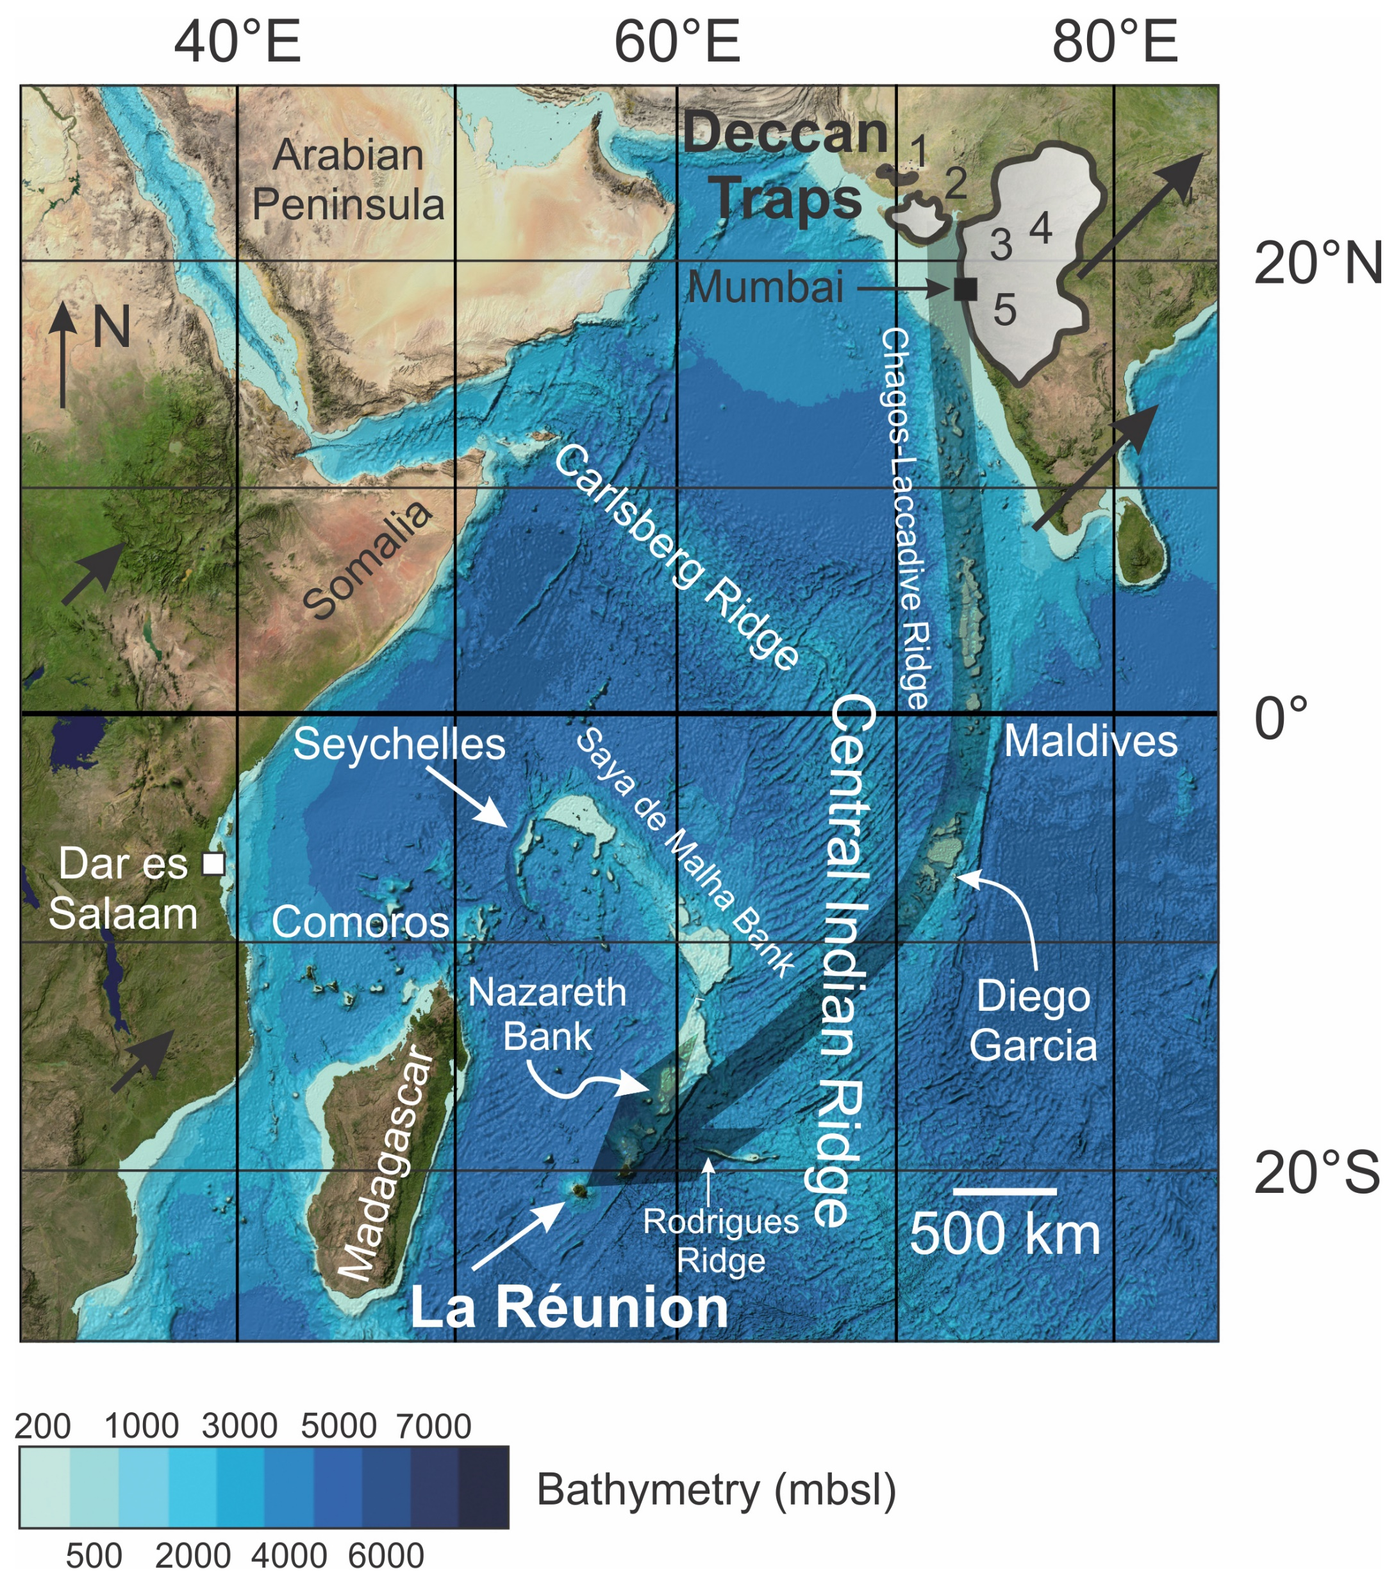
Peters and Day
A geochemical link between plume head and tail volcanism
Figure 1 Satellite bathymetry map of the western Indian Ocean basin. Approximate aerial extent of Deccan Traps lava flows are shown by the gray fields on the Indian subcontinent. Numbers in the shaded region correspond to sampling regions: 1 – Kutch (samples 1-5), 2 – Saurashtra (samples 6-46), 3 – Pavagadh, Kalsubai, Amba Dongar and surrounds (samples 48-54, 63-78), 4 – Dhule and surrounds (samples 55-62); 5 – Mumbai, Western Ghats and coastal Maharashtra (samples 79-115, MMF7). Approximate trace…
Peters and Day (2017) Geochem. Persp. Let. 5, 29-34 | doi: 10.7185/geochemlet.1742
© 2017 European Association of Geochemistry
Notes:
Figure 1 Satellite bathymetry map of the western Indian Ocean basin. Approximate aerial extent of Deccan Traps lava flows are shown by the gray fields on the Indian subcontinent. Numbers in the shaded region correspond to sampling regions: 1 – Kutch (samples 1-5), 2 – Saurashtra (samples 6-46), 3 – Pavagadh, Kalsubai, Amba Dongar and surrounds (samples 48-54, 63-78), 4 – Dhule and surrounds (samples 55-62); 5 – Mumbai, Western Ghats and coastal Maharashtra (samples 79-115, MMF7). Approximate trace of the Réunion hotspot is shown by the transparent black arrow, approximate plate motion vectors are shown by solid black arrows over land areas and are proportional to plate motions. Base map reproduced from the GEBCO world map 2014, www.gebco.net.

