Slide 1
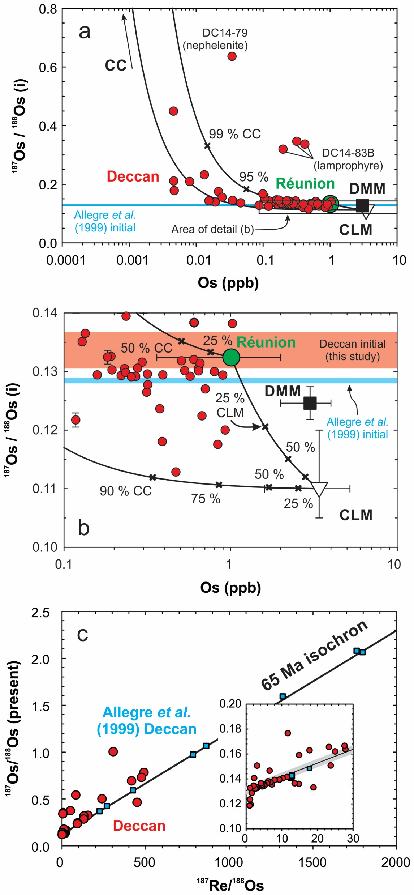
Peters and Day
A geochemical link between plume head and tail volcanism
Figure 2 (a) ¹⁸⁷Os/¹⁸⁸Os versus [Os] for Deccan lavas (red circles), with inferred compositions of the Réunion primary magma (green circle) (Peters et al., 2016), crust (CC: continental crust) and lithosphere (DMM: depleted mid-ocean ridge basalt mantle, CLM: continental lithospheric mantle) and mixing lines. Initial ¹⁸⁷Os/¹⁸⁸Os reported in literature data (Allegre et al., 1999) shown as blue. (b) Small scale view of (a) showing…
Peters and Day (2017) Geochem. Persp. Let. 5, 29-34 | doi: 10.7185/geochemlet.1742
© 2017 European Association of Geochemistry
Notes:
Figure 2 (a) ¹⁸⁷Os/¹⁸⁸Os versus [Os] for Deccan lavas (red circles), with inferred compositions of the Réunion primary magma (green circle) (Peters et al., 2016), crust (CC: continental crust) and lithosphere (DMM: depleted mid-ocean ridge basalt mantle, CLM: continental lithospheric mantle) and mixing lines. Initial ¹⁸⁷Os/¹⁸⁸Os reported in literature data (Allegre et al., 1999) shown as blue. (b) Small scale view of (a) showing end member compositions and uncertainties with initial ¹⁸⁷Os/¹⁸⁸Os calculated in this study (transparent red box with range indicated by bidirectional arrow) and in Allegre et al. (1999) (blue box with outline). (c) Rhenium-osmium isotopes for Deccan lavas in this study (red circles) and from Allegre et al. (1999) (blue squares), with inset for low Re samples. For reference, a 65 Ma isochron with initial ¹⁸⁷Os/¹⁸⁸Os = 0.1336 ± 0.0031, as determined from our samples, is shown. Uncertainty on the isochron is thinner than line thickness in panel (c) and is represented by the shaded region in the inset. A 65 Ma isochron corresponding to the initial ¹⁸⁷Os/¹⁸⁸Os determined by Allegre et al. (1999) is approximately equivalent to a line following the lower bound of the shaded region, given the precision noted in that study. Model end members are given in Table S-4.

