Slide 1
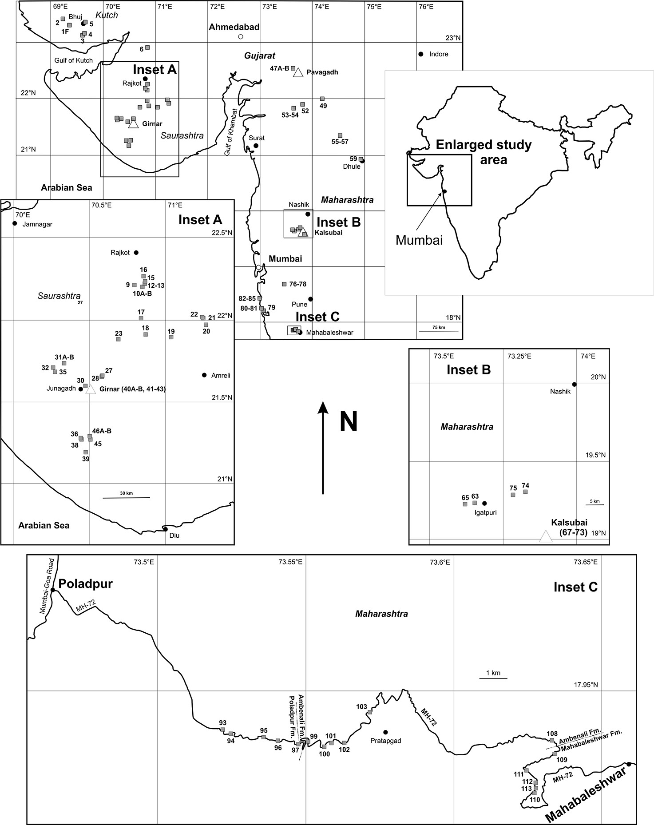
Peters and Day
A geochemical link between plume head and tail volcanism
Figure S-1 Map of northwestern India showing sampling locations included expanded views of sample locations with major geographic indicators (roads, mountain tops – Insets A to C).
Peters and Day (2017) Geochem. Persp. Let. 5, 29-34 | doi: 10.7185/geochemlet.1742
© 2017 European Association of Geochemistry
Notes:
Figure S-1 Map of northwestern India showing sampling locations included expanded views of sample locations with major geographic indicators (roads, mountain tops – Insets A to C).

