Slide 1
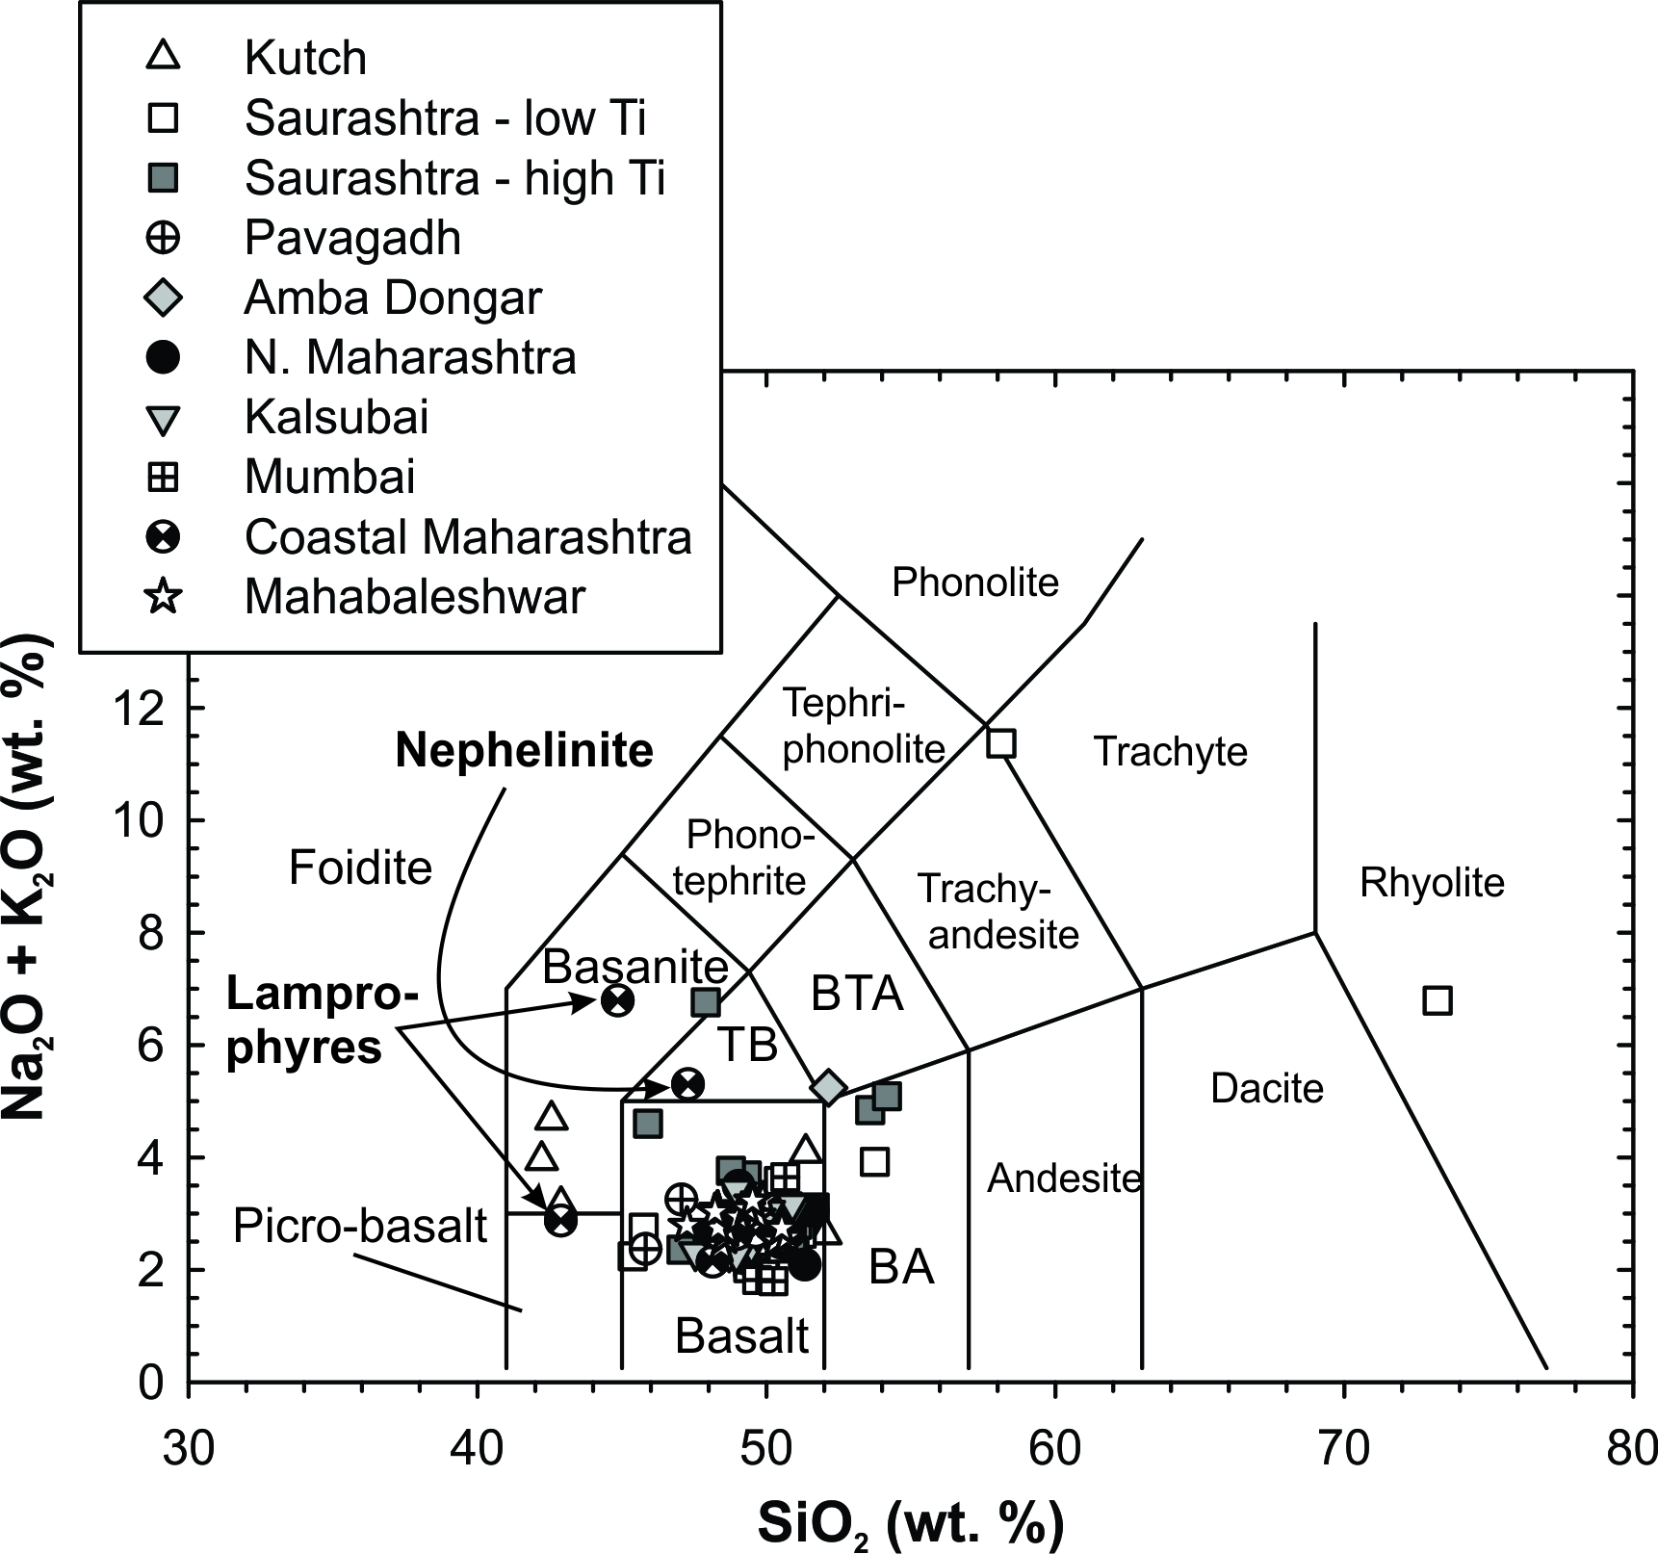
Peters and Day
A geochemical link between plume head and tail volcanism
Figure S-4 Total alkali versus silica plot for new bulk rock major element data for Deccan lavas.
Peters and Day (2017) Geochem. Persp. Let. 5, 29-34 | doi: 10.7185/geochemlet.1742
© 2017 European Association of Geochemistry
Notes:
Figure S-4 Total alkali versus silica plot for new bulk rock major element data for Deccan lavas.

