Slide 1
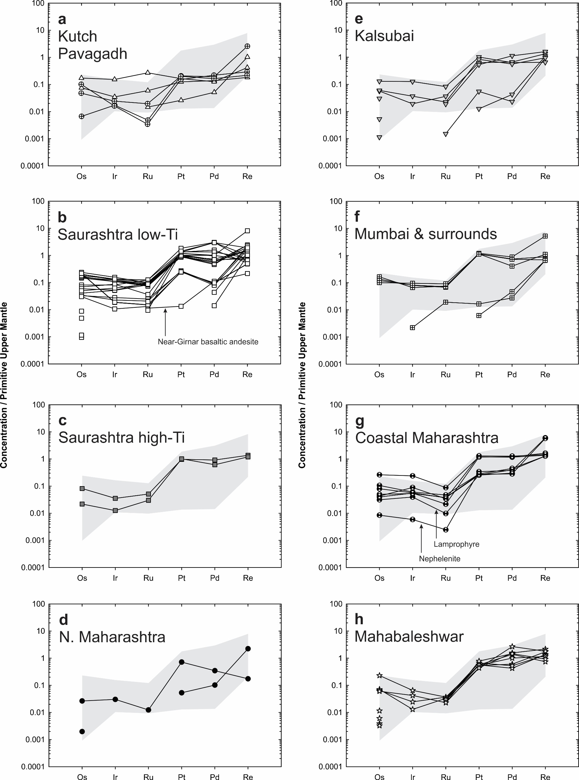
Peters and Day
A geochemical link between plume head and tail volcanism
Figure S-7 Primitive upper mantle (PUM) (Becker et al., 2006) normalised highly siderophile element patterns for Deccan lavas. Range of compositions for Saurashtra low Ti basalts (b) shown as gray region in other panels. Nearly all samples show evidence for sulphide fractionation of HSE evidenced by elevated (Pt + Pd + Re) / (Os + Ir + Ru), as evidenced by Figure S-10. Symbols as in Figure S-4.
Peters and Day (2017) Geochem. Persp. Let. 5, 29-34 | doi: 10.7185/geochemlet.1742
© 2017 European Association of Geochemistry
Notes:
Figure S-7 Primitive upper mantle (PUM) (Becker et al., 2006) normalised highly siderophile element patterns for Deccan lavas. Range of compositions for Saurashtra low Ti basalts (b) shown as gray region in other panels. Nearly all samples show evidence for sulphide fractionation of HSE evidenced by elevated (Pt + Pd + Re) / (Os + Ir + Ru), as evidenced by Figure S-10. Symbols as in Figure S-4.

