Slide 1
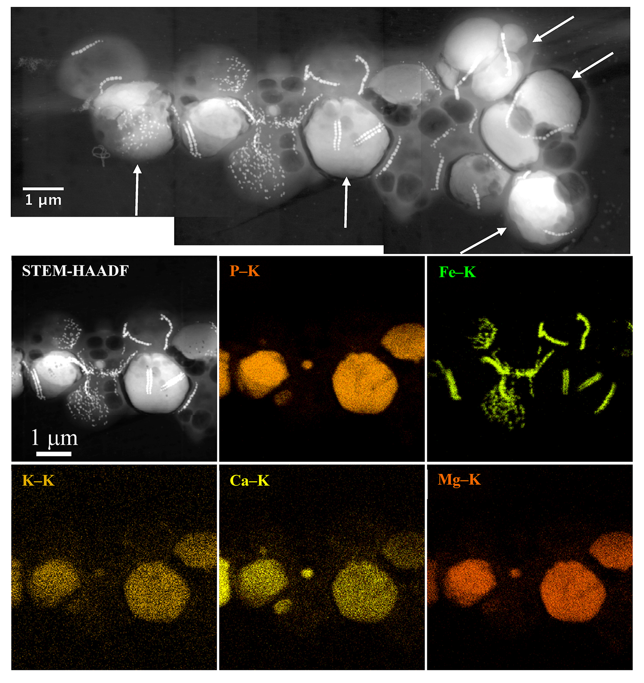
Rivas-Lamelo et al.
Magnetotactic bacteria as a new model for P sequestration in the ferruginous Lake Pavin
Figure 1 Scanning transmission electron microscopy analyses of MTB cells at the oxic-anoxic interface in Lake Pavin. Top: STEM-HAADF image showing a cluster of MTB cells. Magnetites are the brightest particles. Some cells contain two or four magnetite chains; some (bottom left) contain scattered magnetite. Polyphosphates appear as bright granules filling completely some of the cells (e.g., arrows). Bottom: EDXS maps.
Rivas-Lamelo et al. (2017) Geochem. Persp. Let. 5, 35-41 | doi: 10.7185/geochemlet.1743
© 2017 European Association of Geochemistry
Notes:
Figure 1 Scanning transmission electron microscopy analyses of MTB cells at the oxic-anoxic interface in Lake Pavin. Top: STEM-HAADF image showing a cluster of MTB cells. Magnetites are the brightest particles. Some cells contain two or four magnetite chains; some (bottom left) contain scattered magnetite. Polyphosphates appear as bright granules filling completely some of the cells (e.g., arrows). Bottom: EDXS maps.

