Slide 1
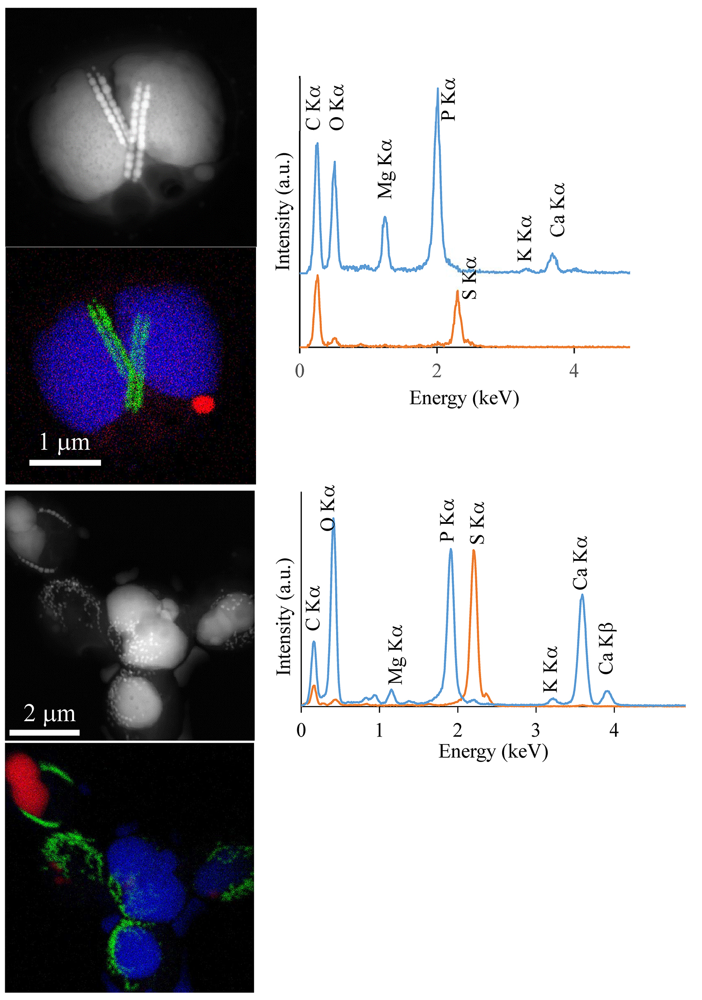
Rivas-Lamelo et al.
Magnetotactic bacteria as a new model for P sequestration in the ferruginous Lake Pavin
Figure S-2 STEM and EDXS analyses of polyphosphate and S-granules in MTB cells. Left: STEM image in HAADF mode and overlay of Fe (green), P (blue) and S (red) in two different areas. Right: EDXS spectra of S-granules (orange) and polyphosphate inclusions (blue).
Rivas-Lamelo et al. (2017) Geochem. Persp. Let. 5, 35-41 | doi: 10.7185/geochemlet.1743
© 2017 European Association of Geochemistry
Notes:
Figure S-2 STEM and EDXS analyses of polyphosphate and S-granules in MTB cells. Left: STEM image in HAADF mode and overlay of Fe (green), P (blue) and S (red) in two different areas. Right: EDXS spectra of S-granules (orange) and polyphosphate inclusions (blue).

