Slide 1
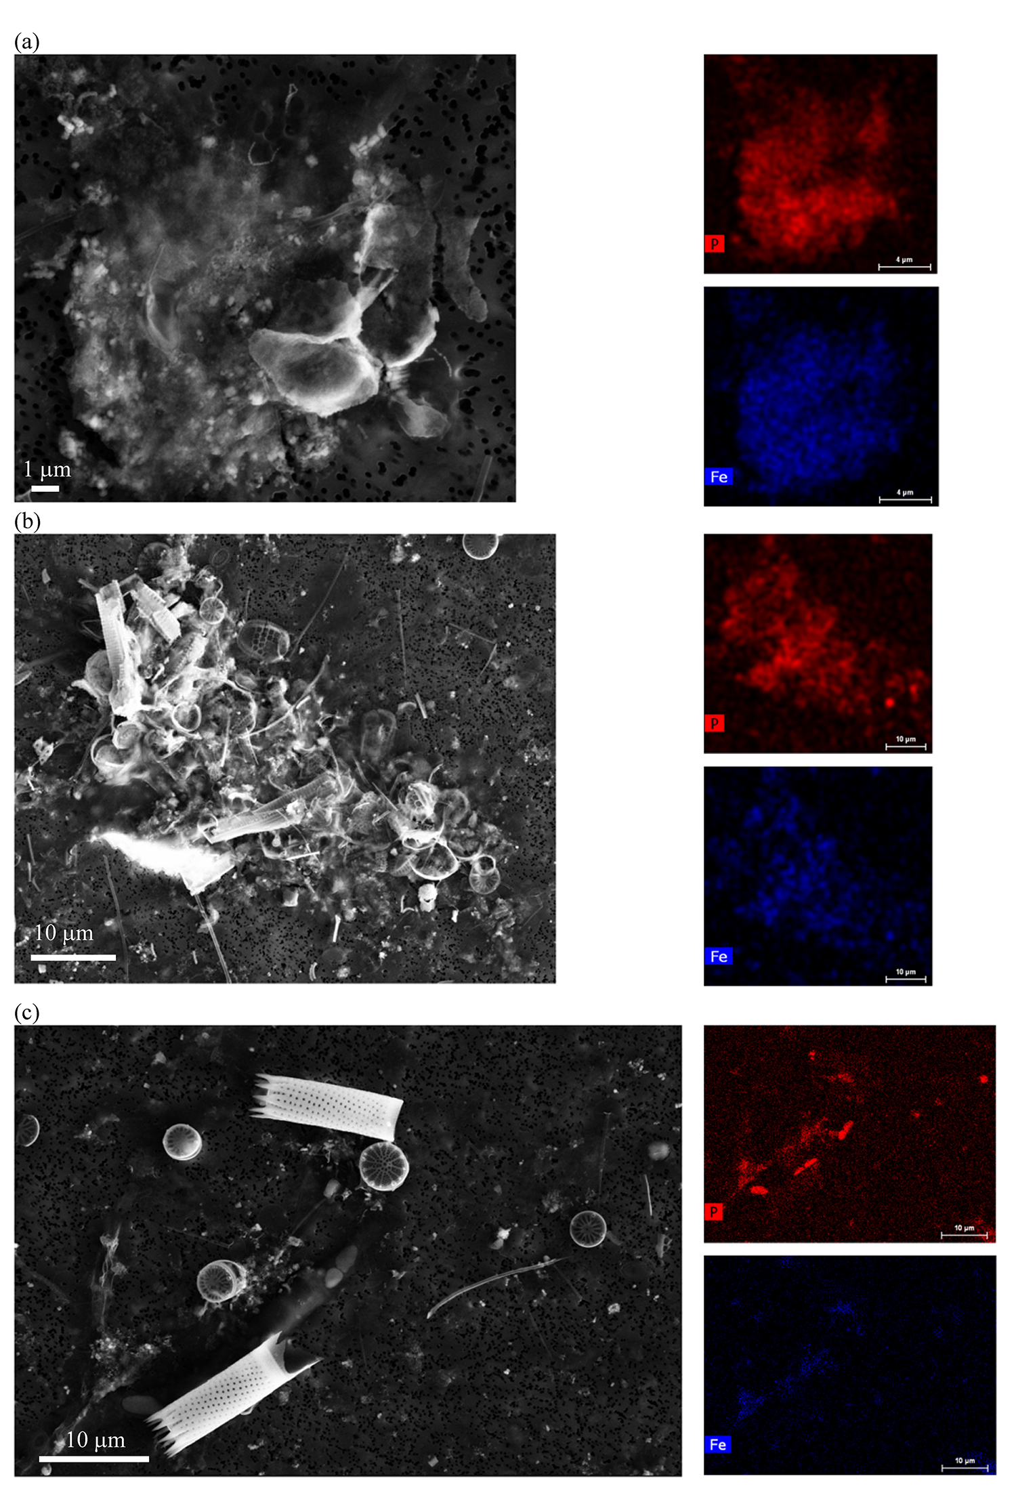
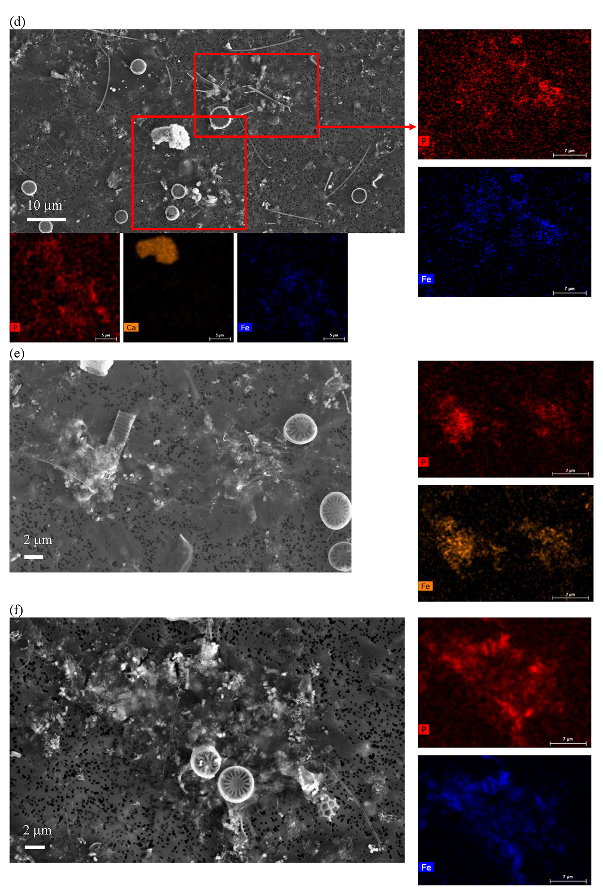
Rivas-Lamelo et al.
Magnetotactic bacteria as a new model for P sequestration in the ferruginous Lake Pavin
Figure S-5 SEM and EDXS analyses of P hotspots not related to polyP-loaded MTB cells but containing Fe phosphate phases. These areas are indicated by letters from (a) to (f) in Figure S-4.
Rivas-Lamelo et al. (2017) Geochem. Persp. Let. 5, 35-41 | doi: 10.7185/geochemlet.1743
© 2017 European Association of Geochemistry
Notes:
Figure S-5 SEM and EDXS analyses of P hotspots not related to polyP-loaded MTB cells but containing Fe phosphate phases. These areas are indicated by letters from (a) to (f) in Figure S-4.

