Slide 1
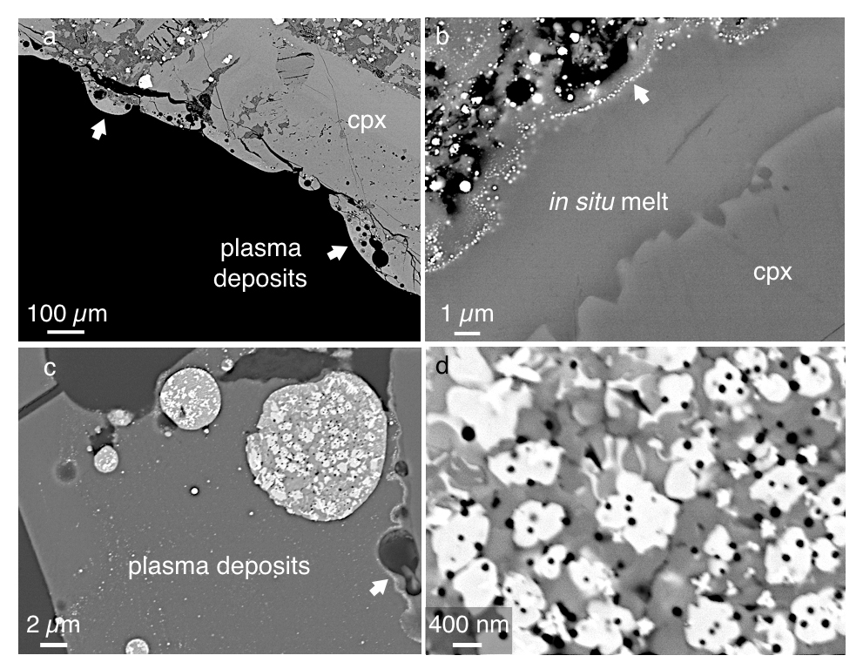
Ballhaus et al.
Ultra-high pressure and ultra-reduced minerals in ophiolites may form by lightning strikes
Figure 2 Images in BSE mode of plasma deposits. (a) Cross section of a crack covered by an up to 100 µm wide porous glass rim, resting upon a cpx phenocryst from the basaltic target rock. (b) Thermally resorbed cpx covered by inclusion-free glass (in situ melt), a chain of metal beads (arrow), and porous metal-bearing silicate glasses to the upper left (see text)…
Ballhaus et al. (2017) Geochem. Persp. Let. 5, 42-46 | doi: 10.7185/geochemlet.1744
© 2017 European Association of Geochemistry
Notes:
Figure 2 Images in BSE mode of plasma deposits. (a) Cross section of a crack covered by an up to 100 µm wide porous glass rim, resting upon a cpx phenocryst from the basaltic target rock. (b) Thermally resorbed cpx covered by inclusion-free glass (in situ melt), a chain of metal beads (arrow), and porous metal-bearing silicate glasses to the upper left (see text). (c) Larger exsolved metal globule within silicate glass; in situ glass to the right of the metal chain (arrow). (d) A metal globule in detail; bright quench phases are W-Ti metal, medium grey are Fe silicides, darker grey are SIC, and dark spherules are carbon condensates.

