Slide 1
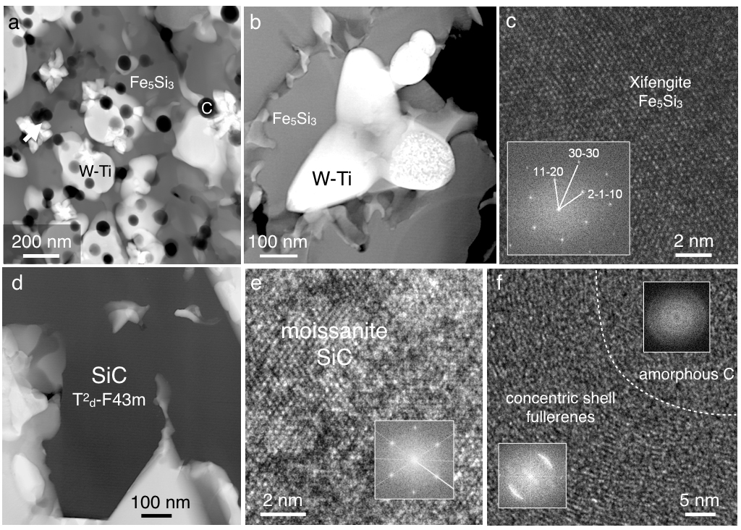
Ballhaus et al.
Ultra-high pressure and ultra-reduced minerals in ophiolites may form by lightning strikes
Figure 3 Transmission electron (TEM) images of a metal globule. (a) Overview; bright Ti bearing W metals coexisting with Fe₅Si₃ xifengite, SiC moissanite (darker grey), and black carbon spherules (C). (b) Dark field image of W-Ti alloy in contact with xifengite. (c) HRTEM image of xifengite and fast Fourier transform (FFT) as inset. (d) Beta-SiC intergrown with Fe silicides…
Ballhaus et al. (2017) Geochem. Persp. Let. 5, 42-46 | doi: 10.7185/geochemlet.1744
© 2017 European Association of Geochemistry
Notes:
Figure 3 Transmission electron (TEM) images of a metal globule. (a) Overview; bright Ti bearing W metals coexisting with Fe₅Si₃ xifengite, SiC moissanite (darker grey), and black carbon spherules (C). (b) Dark field image of W-Ti alloy in contact with xifengite. (c) HRTEM image of xifengite and fast Fourier transform (FFT) as inset. (d) Beta-SiC intergrown with Fe silicides. (e) HRTEM image of SiC with FFT as inset. (f) Amorphous carbon surrounded by graphene layers in concentric arrangement around amorphous cores, possibly shell fullerenes; FFTs as insets.

