Slide 1
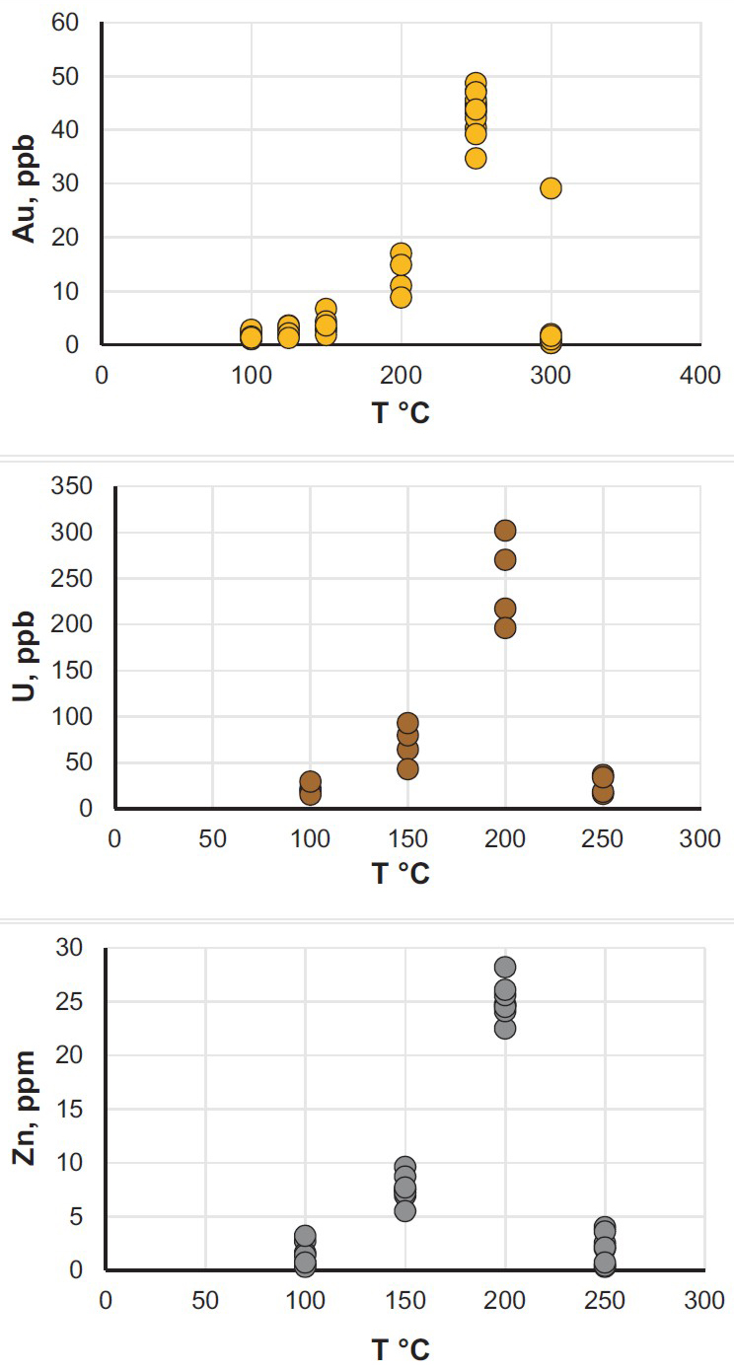
Migdisov et al.
Hydrocarbons as ore fluids
Figure 1 Solubility of metallic gold, zinc, and uranium oxide determined in a variety of crude oils during isothermal solubility experiments.
Migdisov et al. (2017) Geochem. Persp. Let. 5, 47-52 | doi: 10.7185/geochemlet.1745
© 2017 European Association of Geochemistry
Notes:
Figure 1 Solubility of metallic gold, zinc, and uranium oxide determined in a variety of crude oils during isothermal solubility experiments.

