Slide 1
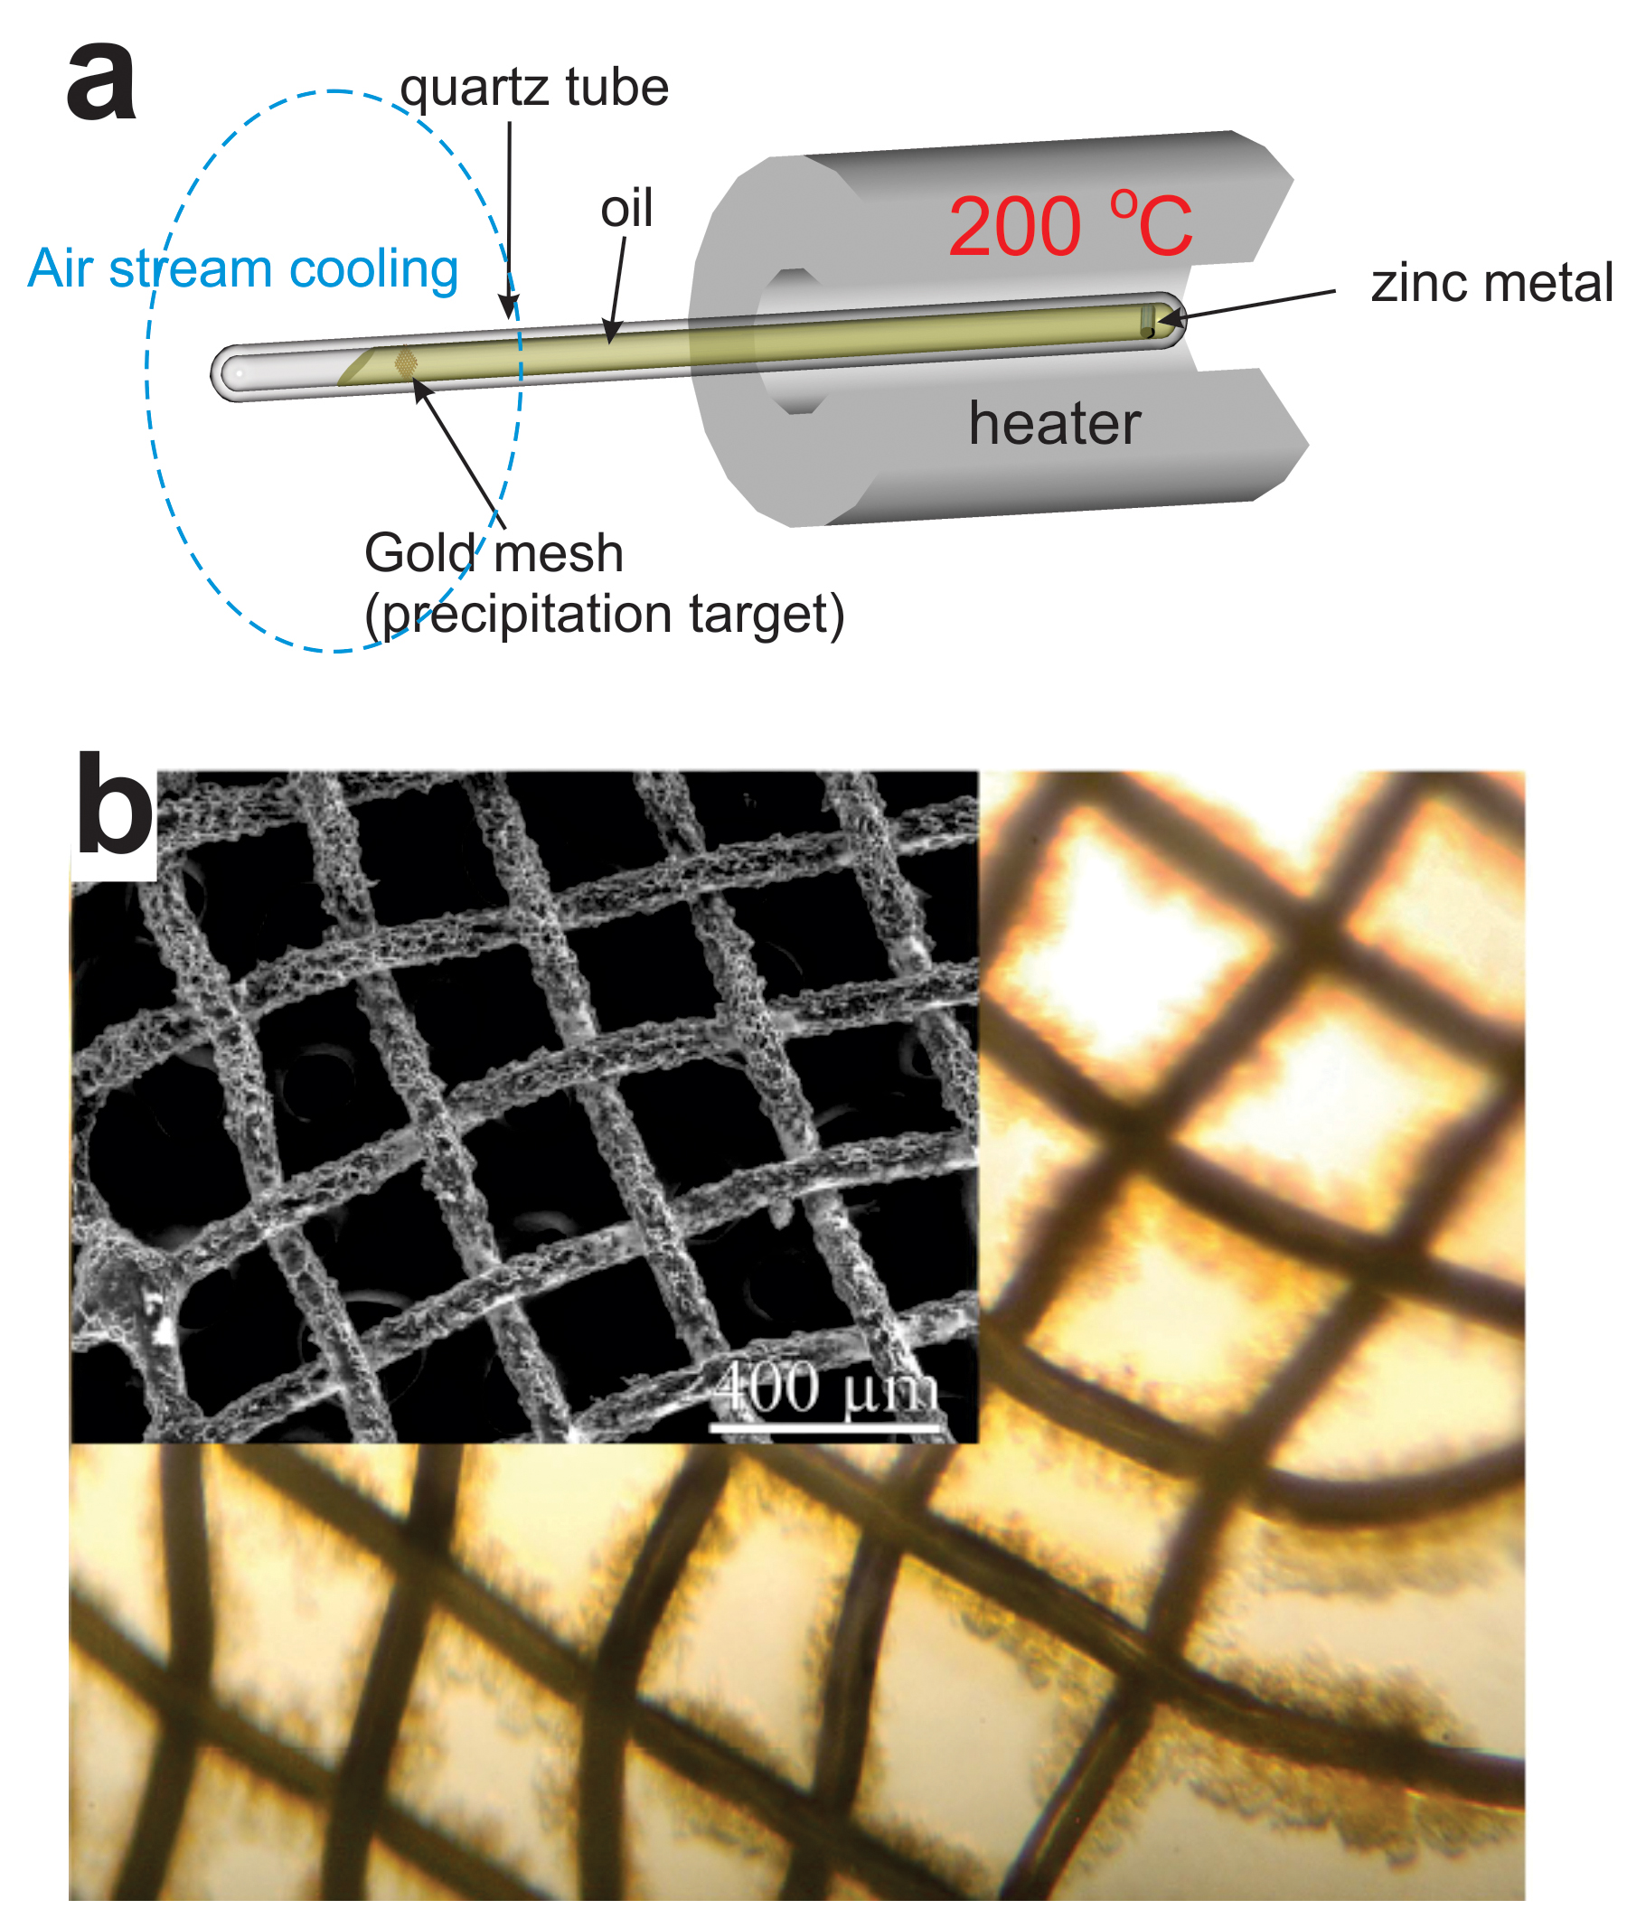
Migdisov et al.
Hydrocarbons as ore fluids
Figure 2 (a) A sketch of the experimental setup for qualitative determination of the ability of natural oils to transport metals at elevated temperatures. (b) A photo and a back scattered electron image of the precipitate discovered at the precipitation target in the experiments with Zn.
Migdisov et al. (2017) Geochem. Persp. Let. 5, 47-52 | doi: 10.7185/geochemlet.1745
© 2017 European Association of Geochemistry
Notes:
Figure 2 (a) A sketch of the experimental setup for qualitative determination of the ability of natural oils to transport metals at elevated temperatures. (b) A photo and a back scattered electron image of the precipitate discovered at the precipitation target in the experiments with Zn.

