Slide 1
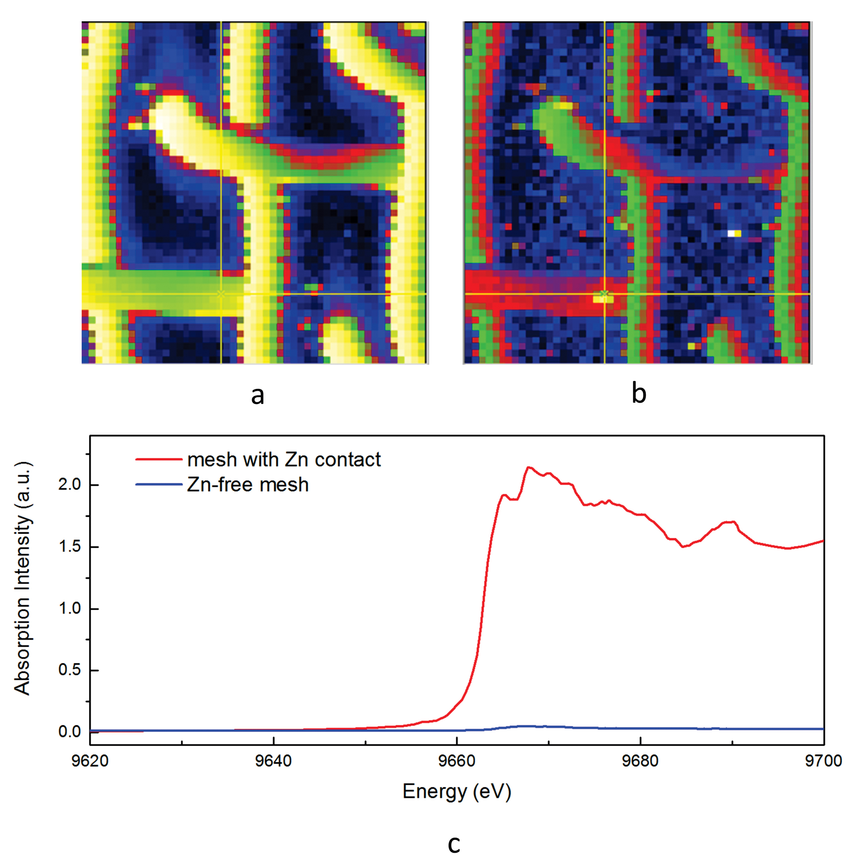
Migdisov et al.
Hydrocarbons as ore fluids
Figure 4 Synchrotron-based micro X-ray fluorescence (XRF) elemental maps showing the spatial distributions of (a) Au and (b) Zn, on a logarithmic scale of intensity (hot colours indicate higher intensity); Zn K edge X-ray absorption near edge structure (XANES) spectra (c) of Zn-bearing and Zn-free samples (the spectrum of the former was taken from the marker in (b).
Migdisov et al. (2017) Geochem. Persp. Let. 5, 47-52 | doi: 10.7185/geochemlet.1745
© 2017 European Association of Geochemistry
Notes:
Figure 4 Synchrotron-based micro X-ray fluorescence (XRF) elemental maps showing the spatial distributions of (a) Au and (b) Zn, on a logarithmic scale of intensity (hot colours indicate higher intensity); Zn K edge X-ray absorption near edge structure (XANES) spectra (c) of Zn-bearing and Zn-free samples (the spectrum of the former was taken from the marker in (b).

