Slide 1
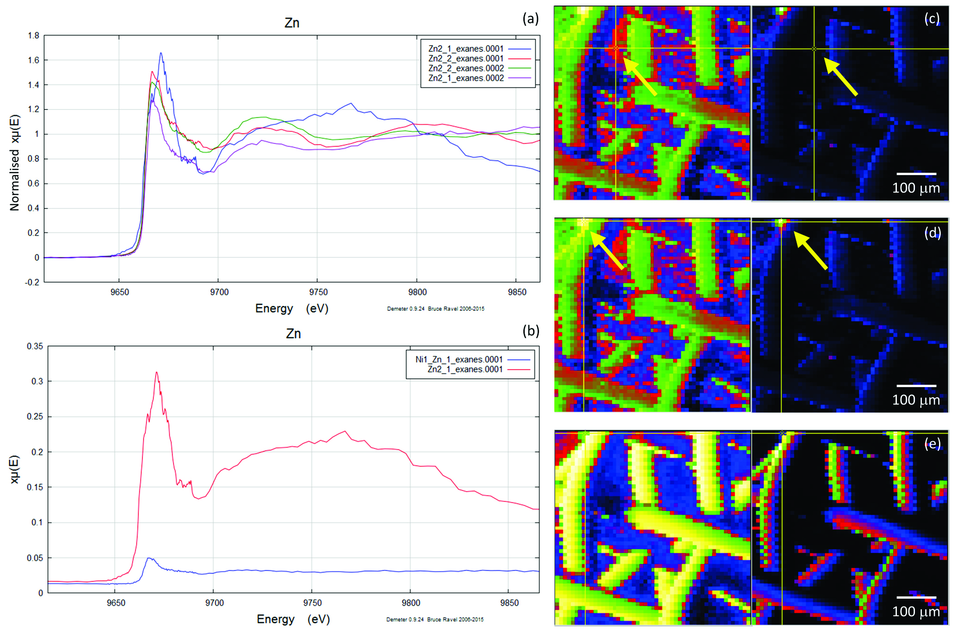
Migdisov et al.
Hydrocarbons as ore fluids
Figure S-4 Group a: (a) Zn K-edge XANES spectra of Zn precipitates, (b) comparison with the background Zn from gold meshes (blue), (c) position of Zn hot spot 1 indicated by an arrow (the left map is plotted on a log scale and the right map on a normal scale; the following maps are plotted in the same manner), (d) position of Zn hot spot 2 indicated by an arrow, (e) Au distribution of the gold mesh.
Migdisov et al. (2017) Geochem. Persp. Let. 5, 47-52 | doi: 10.7185/geochemlet.1745
© 2017 European Association of Geochemistry
Notes:
Figure S-4 Group a: (a) Zn K-edge XANES spectra of Zn precipitates, (b) comparison with the background Zn from gold meshes (blue), (c) position of Zn hot spot 1 indicated by an arrow (the left map is plotted on a log scale and the right map on a normal scale; the following maps are plotted in the same manner), (d) position of Zn hot spot 2 indicated by an arrow, (e) Au distribution of the gold mesh.

