Slide 1
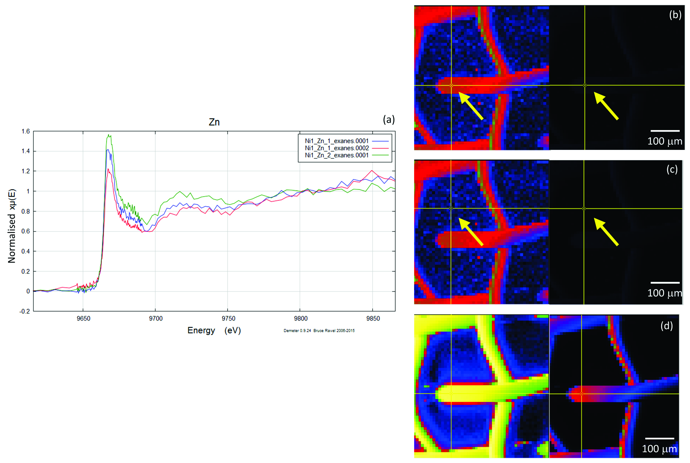
Migdisov et al.
Hydrocarbons as ore fluids
Figure S-6 Group c: (a) Zn K-edge XANES spectra showing the background Zn, (b) position of Zn spot 1 indicated by an arrow, and Zn intensity on a normal scale (right) showing the essential absence of Zn, (c) position of Zn spot 2 indicated by an arrow, (d) Au distribution of the gold grid.
Migdisov et al. (2017) Geochem. Persp. Let. 5, 47-52 | doi: 10.7185/geochemlet.1745
© 2017 European Association of Geochemistry
Notes:
Figure S-6 Group c: (a) Zn K-edge XANES spectra showing the background Zn, (b) position of Zn spot 1 indicated by an arrow, and Zn intensity on a normal scale (right) showing the essential absence of Zn, (c) position of Zn spot 2 indicated by an arrow, (d) Au distribution of the gold grid.

