Slide 1
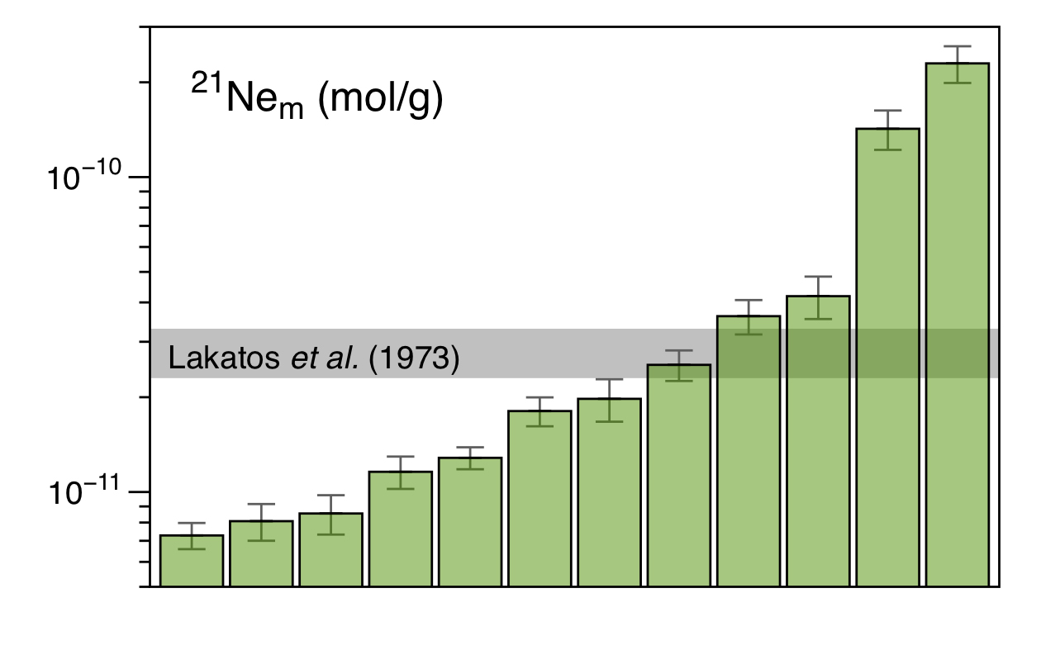
Füri et al.
Apollo 15 green glass He-Ne-Ar signatures
– In search for indigenous lunar noble gases
Figure 1 Total ²¹Ne abundances of twelve single 15426 green glass beads. The uncertainty of 8 to 15 % is controlled by the precision in determining the sample mass. The ²¹Ne concentration range reported by Lakatos et al. (1973) for five grain size fractions and two large single spherules is indicated for comparison.
© 2018 The Authors
Published by the European Association of Geochemistry
under Creative Commons License CC BY-NC-ND
Füri et al. (2018) Geochem. Persp. Let. 8, 1-5 | doi: 10.7185/geochemlet.1819
Notes:
Figure 1 Total ²¹Ne abundances of twelve single 15426 green glass beads. The uncertainty of 8 to 15 % is controlled by the precision in determining the sample mass. The ²¹Ne concentration range reported by Lakatos et al. (1973) for five grain size fractions and two large single spherules is indicated for comparison.

