Slide 1
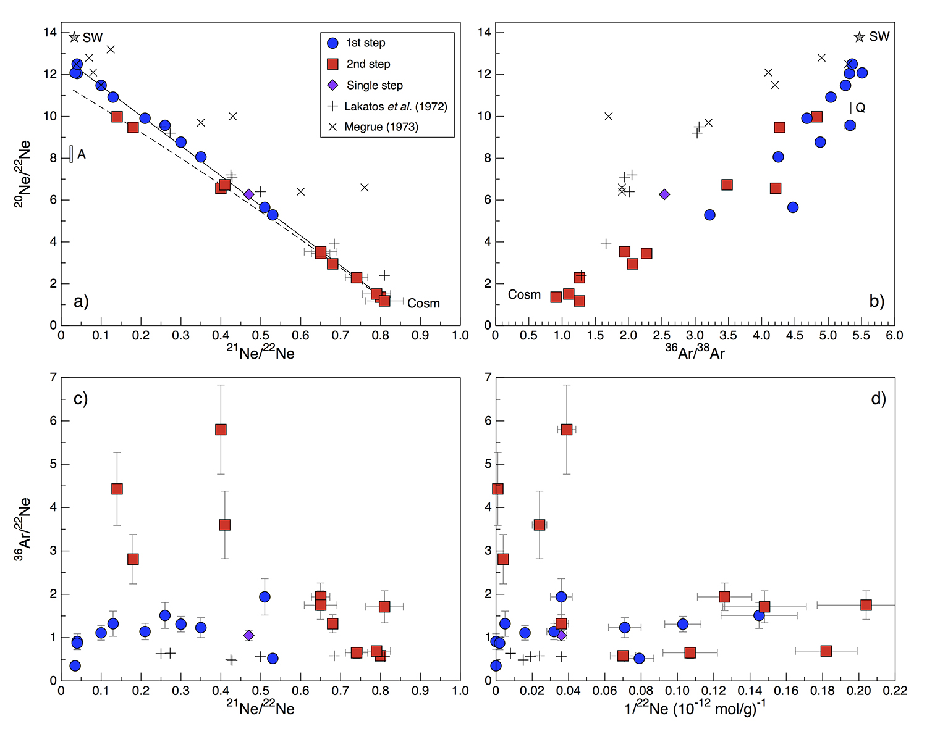
Füri et al.
Apollo 15 green glass He-Ne-Ar signatures
– In search for indigenous lunar noble gases
Figure 2 (a) Three-isotope plot of neon, (b) ²⁰Ne/²²Ne versus ³⁶Ar/³⁸Ar, (c) ³⁶Ar/²²Ne versus ²¹Ne/²²Ne, and (d) ³⁶Ar/²²Ne versus the inverse of the ²²Ne concentration measured in 15426 green glasses. Step-heating data for single glass beads from this study are shown together with results obtained by single-step heating of…
© 2018 The Authors
Published by the European Association of Geochemistry
under Creative Commons License CC-BY-NC-ND
Füri et al. (2018) Geochem. Persp. Let. 8, 1-5 | doi: 10.7185/geochemlet.1819
Notes:
Figure 2 (a) Three-isotope plot of neon, (b) ²⁰Ne/²²Ne versus ³⁶Ar/³⁸Ar, (c) ³⁶Ar/²²Ne versus ²¹Ne/²²Ne, and (d) ³⁶Ar/²²Ne versus the inverse of the ²²Ne concentration measured in 15426 green glasses. Step-heating data for single glass beads from this study are shown together with results obtained by single-step heating of different grain size fractions and two large single spherules (Lakatos et al., 1973) and by laser ablation of individual spherules (Megrue, 1973). The neon and argon isotope compositions of the cosmogenic endmember (Cosm), modern solar wind (SW; Heber et al., 2009), and the meteoritic components A and Q (Ott, 2014) are shown for comparison. Error bars for the results from this study represent 1σ uncertainties and are, in some cases, smaller than symbol sizes.

