Slide 1
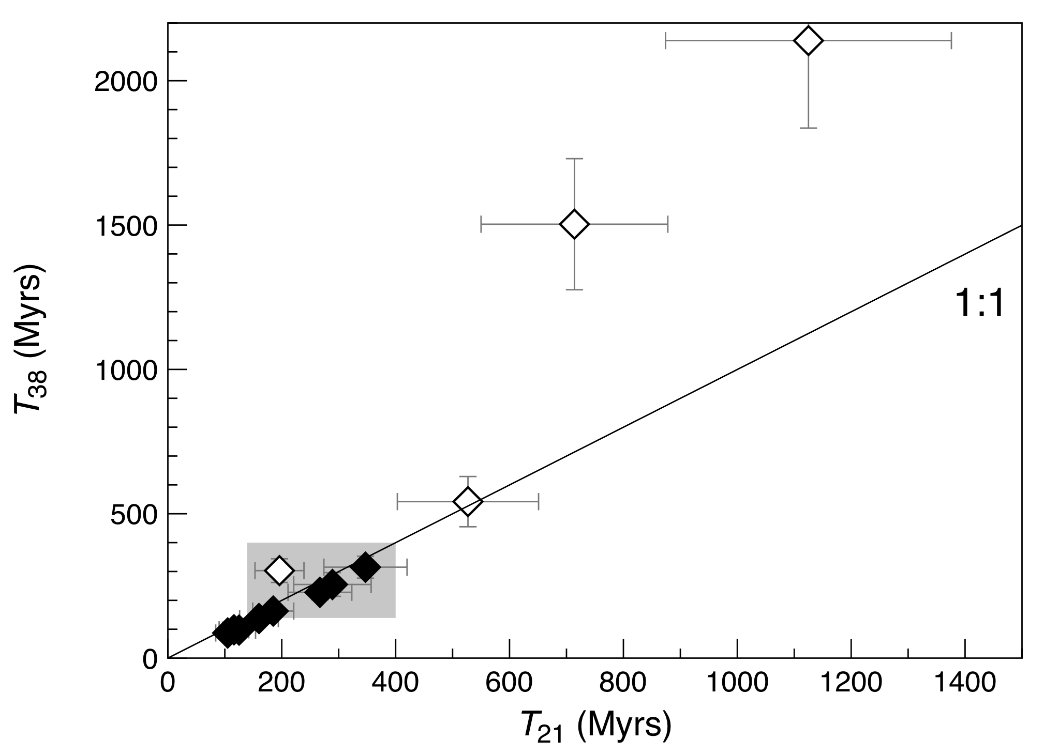
Füri et al.
Apollo 15 green glass He-Ne-Ar signatures
– In search for indigenous lunar noble gases
Figure 3 Cosmic ray exposure ages derived from the ²¹Ne_{cosm} (T₂₁) and ³⁸Ar_{cosm} (T₃₈) concentrations. Data for the four He-Ne-Ar-rich 15426 glass beads (open diamonds) and eight other spherules (filled diamonds) are shown together with the CRE ages determined previously (grey rectangle; Huneke et al., 1973; Lakatos et al., 1973; Megrue, 1973; Spangler et al., 1984).
© 2018 The Authors
Published by the European Association of Geochemistry
under Creative Commons License CC-BY-NC-ND
Füri et al. (2018) Geochem. Persp. Let. 8, 1-5 | doi: 10.7185/geochemlet.1819
Notes:
Figure 3 Cosmic ray exposure ages derived from the ²¹Ne_{cosm} (T₂₁) and ³⁸Ar_{cosm} (T₃₈) concentrations. Data for the four He-Ne-Ar-rich 15426 glass beads (open diamonds) and eight other spherules (filled diamonds) are shown together with the CRE ages determined previously (grey rectangle; Huneke et al., 1973; Lakatos et al., 1973; Megrue, 1973; Spangler et al., 1984).

