Slide 1
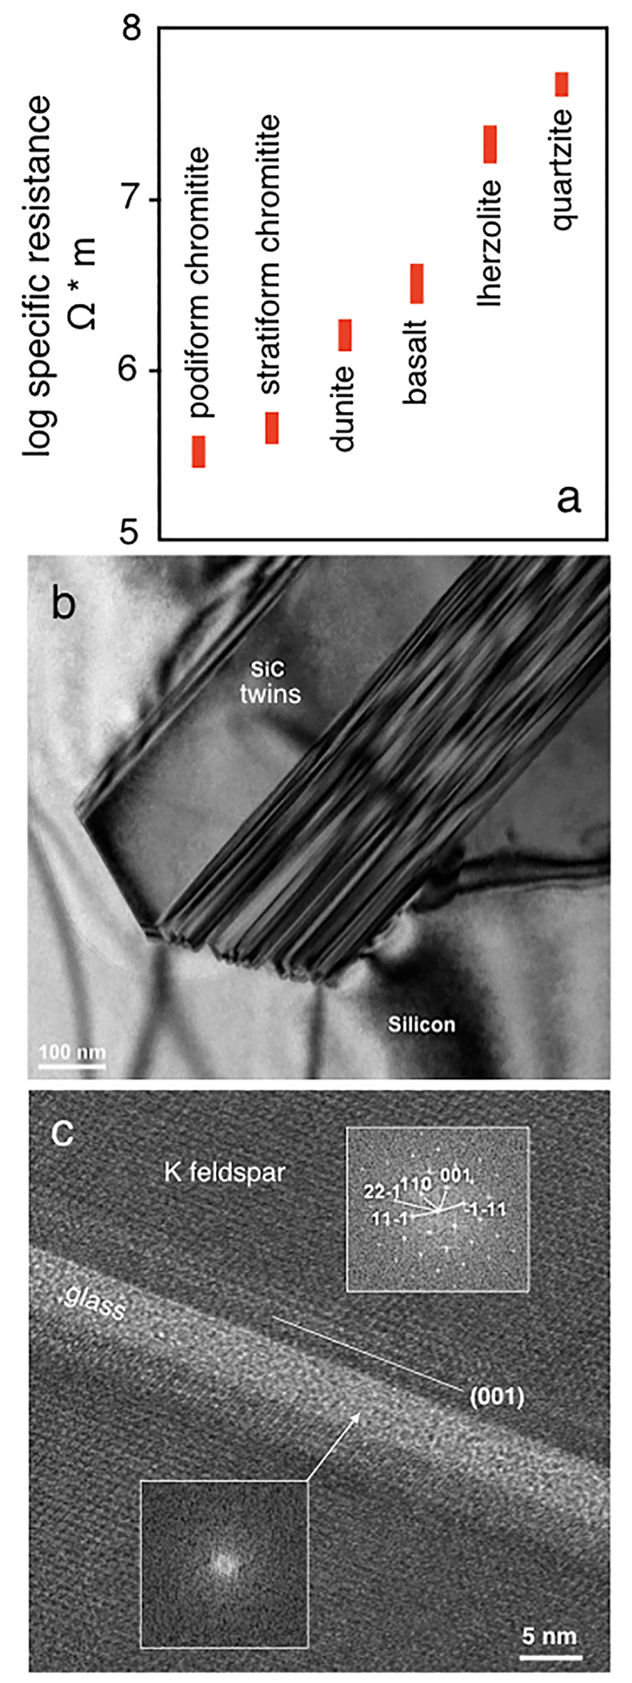
Ballhaus et al.
Reply 2 to comment on “Ultra-high pressure and ultra-reduced minerals in ophiolites may form by lightning strikes”
Figure 1 (a) Specific resistivities of various lithologies measured with an EG & G 5210 Lockin Amplifier (AC, 12 Hz). Rocks were cut to 8 cm³ sized cubes, then dried at 80 °C overnight to remove water films along grain boundaries. Electrodes were polyether-polyuretane fabrics impregnated with electrically conductive latex, pressed onto opposing sides of the rock cubes. Lithologies: podiform chromitite (serpentinised) …
© 2018 The Authors
Published by the European Association of Geochemistry
under Creative Commons License CC BY 4.0
Ballhaus et al. (2018) Geochem. Persp. Let. 8, 8-10 | doi: 10.7185/geochemlet.1821
Notes:
Figure 1 (a) Specific resistivities of various lithologies measured with an EG & G 5210 Lockin Amplifier (AC, 12 Hz). Rocks were cut to 8 cm³ sized cubes, then dried at 80 °C overnight to remove water films along grain boundaries. Electrodes were polyether-polyuretane fabrics impregnated with electrically conductive latex, pressed onto opposing sides of the rock cubes. Lithologies: podiform chromitite (serpentinised) from Cyprus; stratiform UG-1 chromitite from the Bushveld Complex, South Africa; FeO-rich dunite from the Mooihoek pipe, Bushveld Complex; primitive alkali basalt from the Eifel; fresh lherzolite xenolith from the Eifel; and a hydrothermally silicified sandstone from a Lower Cretaceous hot spring in Tunisia. (b) Bright-field image of a euhedral moissanite twin inside metallic Si to illustrate that experimentally generated ultra-reduced phases can be euhedral. (c) An amorphous glass lamella in K-feldspar parallel to (001), with Fast Fourier Transforms (FFTs) as insets.

