Slide 1
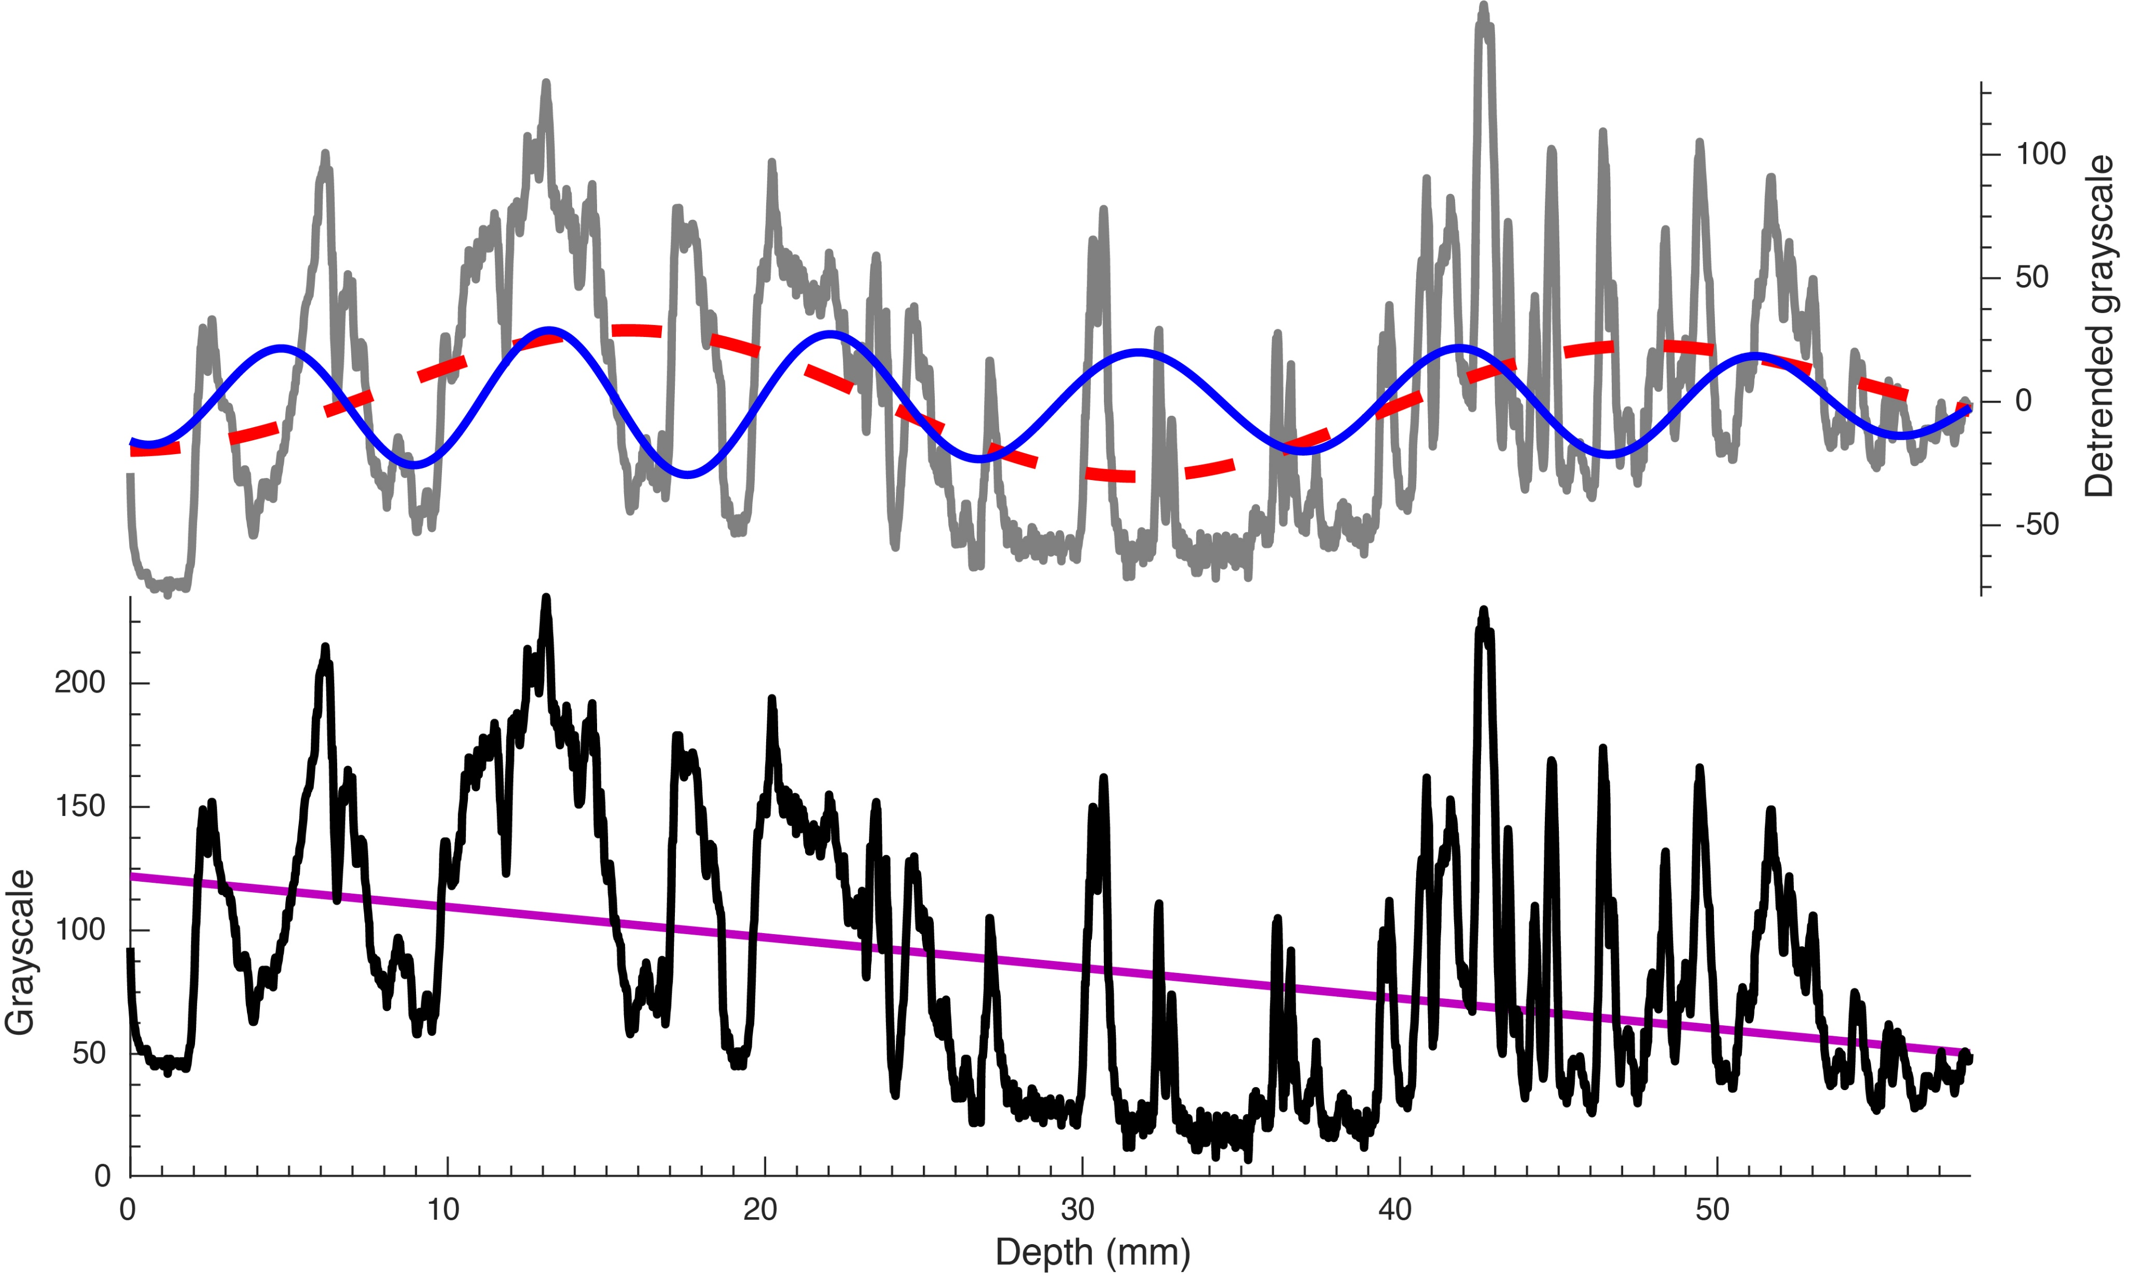
Li and Barnes
Orbitally forced sphalerite growth in the Upper Mississippi Valley District
Figure 2 Grayscale trace of a cross section of sphalerite (black) and its linear trend (purple). De-trended data (gray) are shown with its 32 mm (dashed red) and 9 mm (solid blue) Gauss bandpass filtered cycles (passband: 0.031 ± 0.008 and 0.11 ± 0.02 cycles/mm, respectively).
© 2019 The Authors
Published by the European Association of Geochemistry
under Creative Commons License CC BY-NC-ND.
Li and Barnes (2019) Geochem. Persp. Let. 12, 18-22 | doi: 10.7185/geochemlet.1929
Notes:
Figure 2 Grayscale trace of a cross section of sphalerite (black) and its linear trend (purple). De-trended data (gray) are shown with its 32 mm (dashed red) and 9 mm (solid blue) Gauss bandpass filtered cycles (passband: 0.031 ± 0.008 and 0.11 ± 0.02 cycles/mm, respectively).

