Slide 1
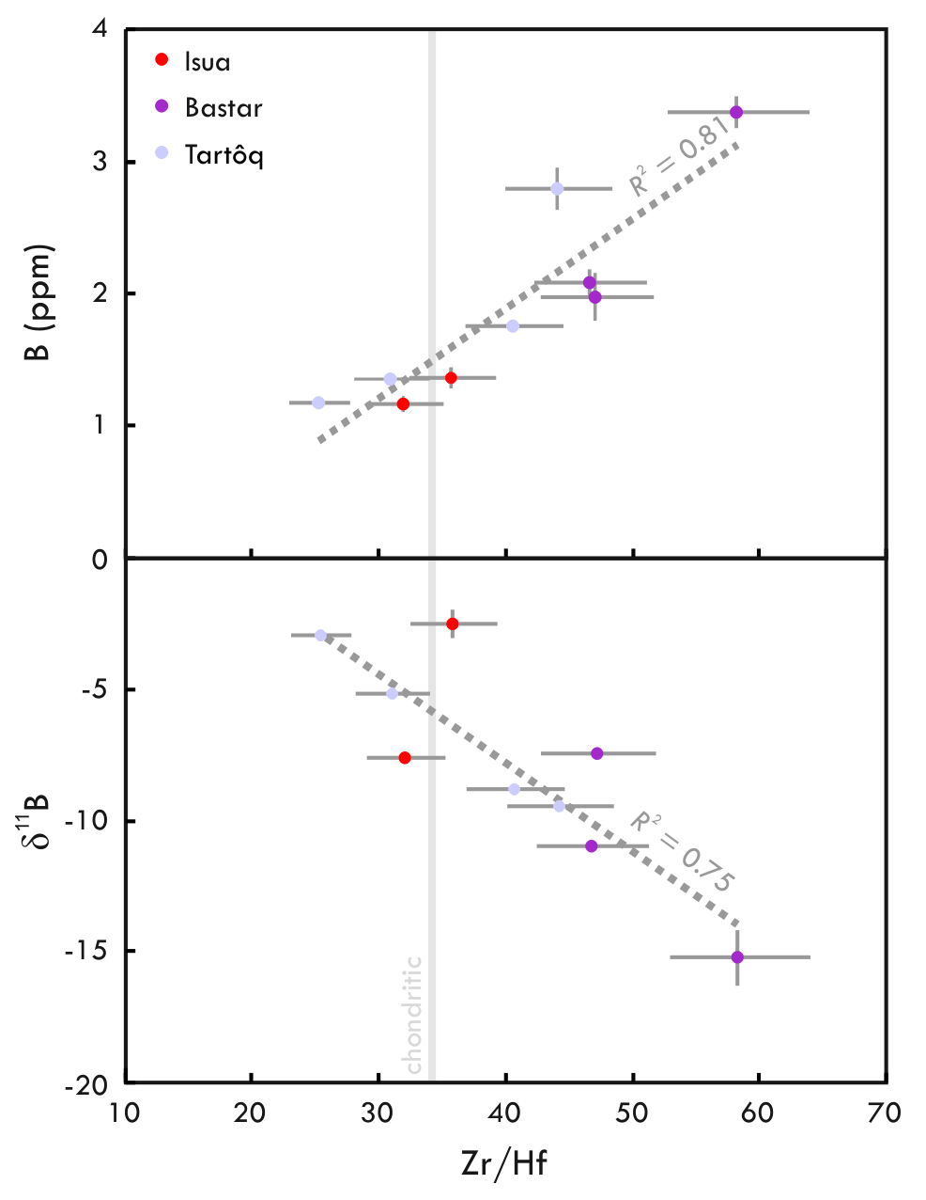
Smit et al.
Formation of Archean continental crust constrained by boron isotopes
Figure 2 (a) B and (b) δ¹¹B versus Zr/Hf with the correlation coefficients for the given regressions.
© 2019 The Authors
Published by the European Association of Geochemistry
under Creative Commons License CC BY-NC-ND.
Li and Barnes (2019) Geochem. Persp. Let. 12, 23-26 | doi: 10.7185/geochemlet.1930
Notes:
Figure 2 (a) B and (b) δ¹¹B versus Zr/Hf with the correlation coefficients for the given regressions.

