Slide 1
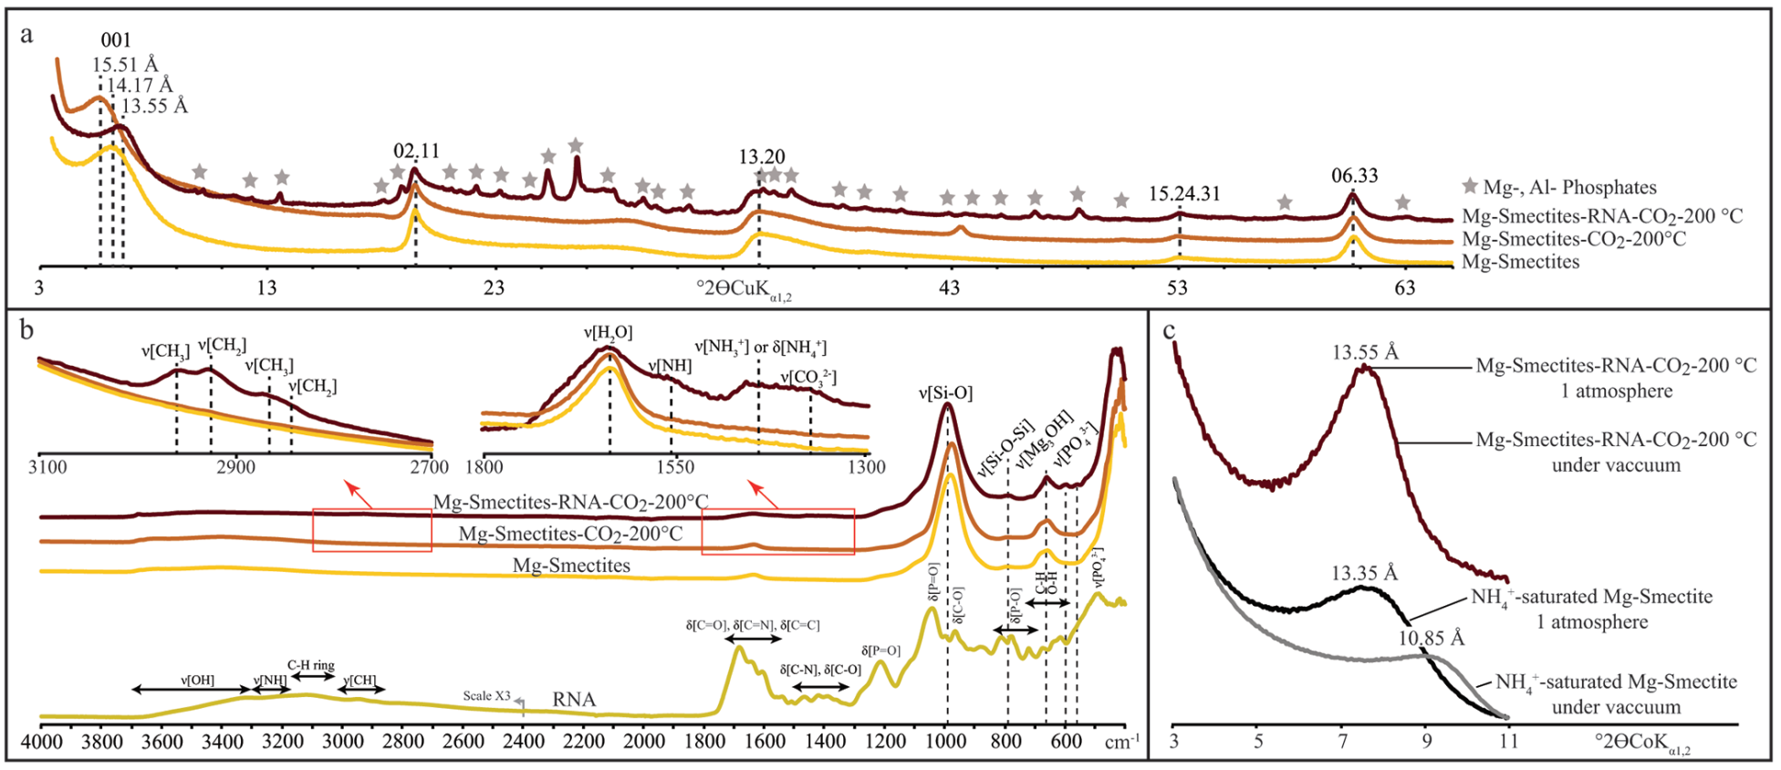
Viennet et al.
Experimental clues for detecting biosignatures on Mars
Figure 2 XRD and Mid-IR characterisation of the residues of experiments conducted under CO₂ at 200 °C in the presence or absence of RNA. (a) Powder XRD patterns of the synthetic Mg-smectites and of the experimental residues. Values correspond to hkl reflections of the Mg-smectites. (b) Mid-infrared ATR spectra of the starting materials (RNA and Mg-smectites) and of the residues. (c) XRD patterns at 1 atmosphere and under vacuum of the pristine Mg-smectites saturated with NH₄⁺ and of the residues. Values correspond to the 001 reflection.
© 2019 The Authors
Published by the European Association of Geochemistry
under Creative Commons License CC BY-NC-ND.
Viennet et al. (2019) Geochem. Persp. Let. 12, 28-33 | doi: 10.7185/geochemlet.1931
Notes:
Figure 2 XRD and Mid-IR characterisation of the residues of experiments conducted under CO₂ at 200 °C in the presence or absence of RNA. (a) Powder XRD patterns of the synthetic Mg-smectites and of the experimental residues. Values correspond to hkl reflections of the Mg-smectites. (b) Mid-infrared ATR spectra of the starting materials (RNA and Mg-smectites) and of the residues. (c) XRD patterns at 1 atmosphere and under vacuum of the pristine Mg-smectites saturated with NH₄⁺ and of the residues. Values correspond to the 001 reflection.

