Slide 1
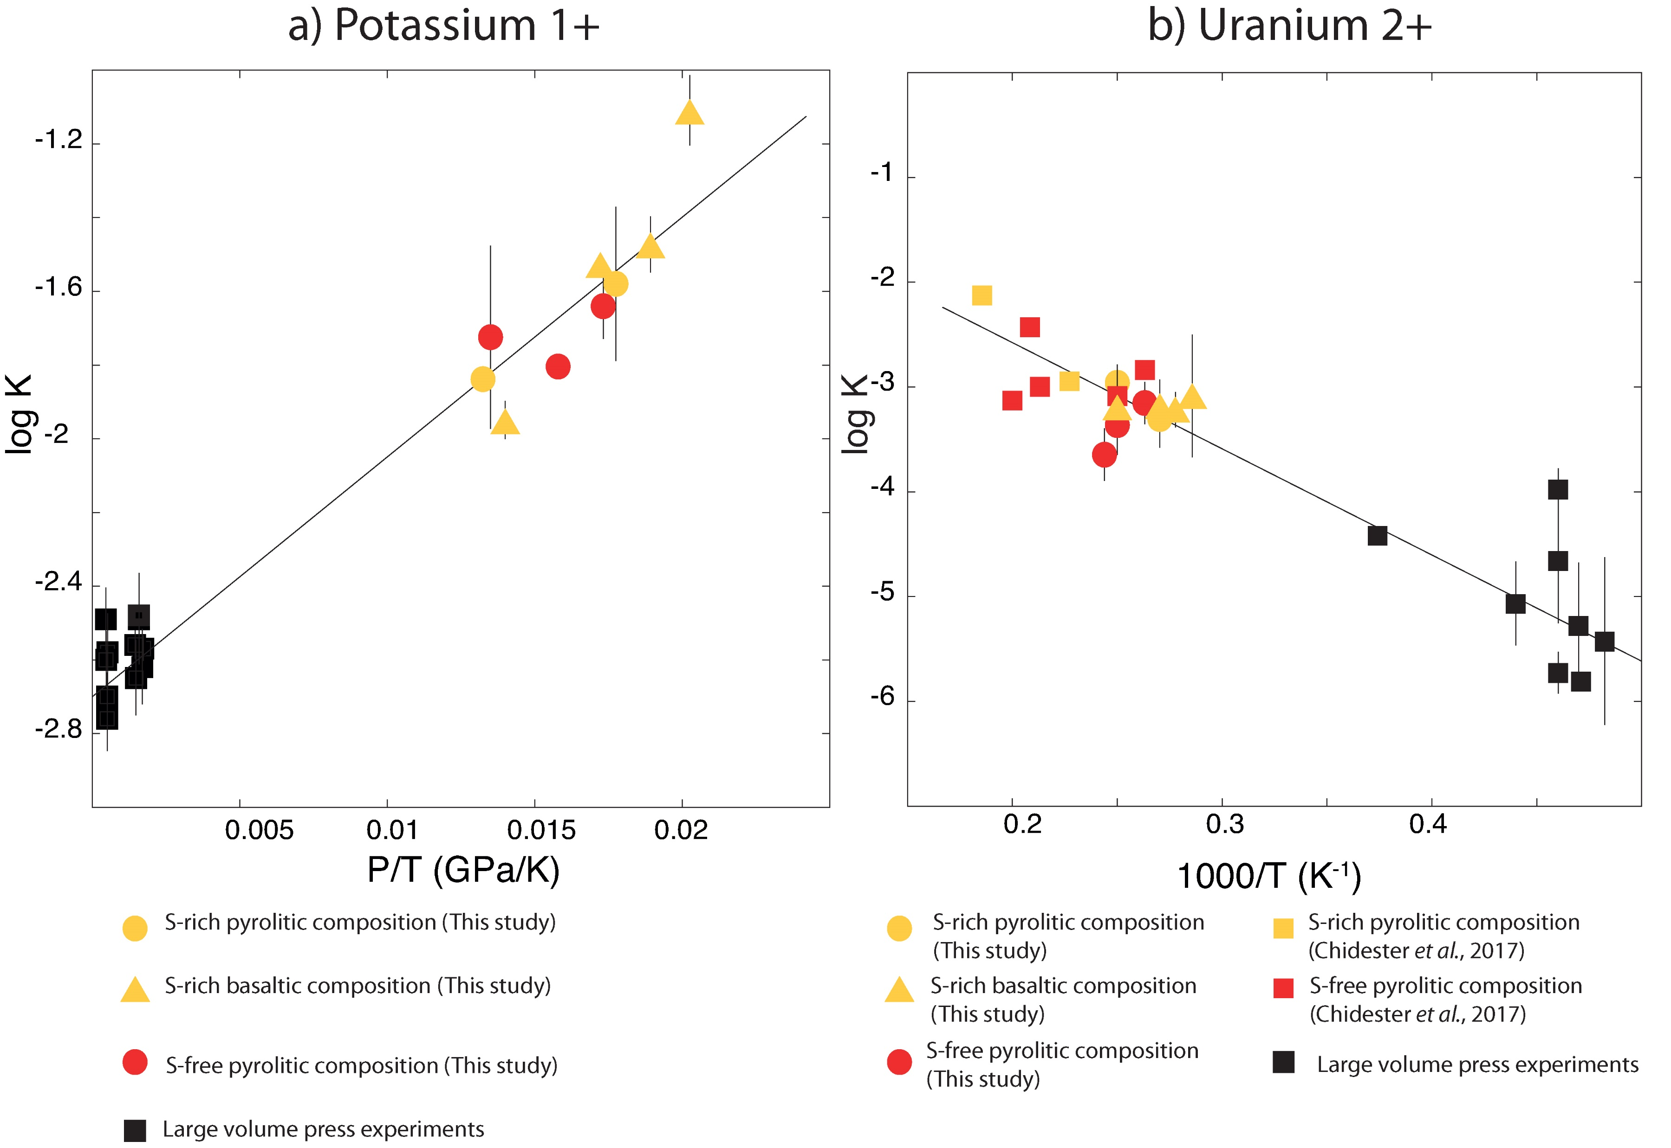
Blanchard et al.
The solubility of heat-producing elements in Earth’s core
Figure 1 Thermodynamic models of K and U partitioning between metal and silicate. (a) Equilibrium constant for potassium metal-silicate partitioning (Eq. 1) as a function of P/T. The line corresponds to the least squares fit (R² = 0.94) of the thermodynamic model (Eq. 3) with a = -2.7 ± 0.03 and c = 65 ± 2.5. (b) Equilibrium constant of uranium metal-silicate partitioning (Eq. 2) as a function of the reciprocal temperature. The line corresponds to the least squares fit (R² = 0.91) of the thermodynamic model (Eq. 4) with a = -0.55 ± 0.21, b = -10133 ± 642 and
= -31.
Blanchard et al. (2017) Geochem. Persp. Let. 5, 1-5 | doi: 10.7185/geochemlet.1737
© 2017 European Association of Geochemistry
Notes:
Figure 1 Thermodynamic models of K and U partitioning between metal and silicate. (a) Equilibrium constant for potassium metal-silicate partitioning (Eq. 1) as a function of P/T. The line corresponds to the least squares fit (R² = 0.94) of the thermodynamic model (Eq. 3) with a = -2.7 ± 0.03 and c = 65 ± 2.5. (b) Equilibrium constant of uranium metal-silicate partitioning (Eq. 2) as a function of the reciprocal temperature. The line corresponds to the least squares fit (R² = 0.91) of the thermodynamic model (Eq. 4) with a = -0.55 ± 0.21, b = -10133 ± 642 and ε_{U}^{O} = -31.

