Slide 1
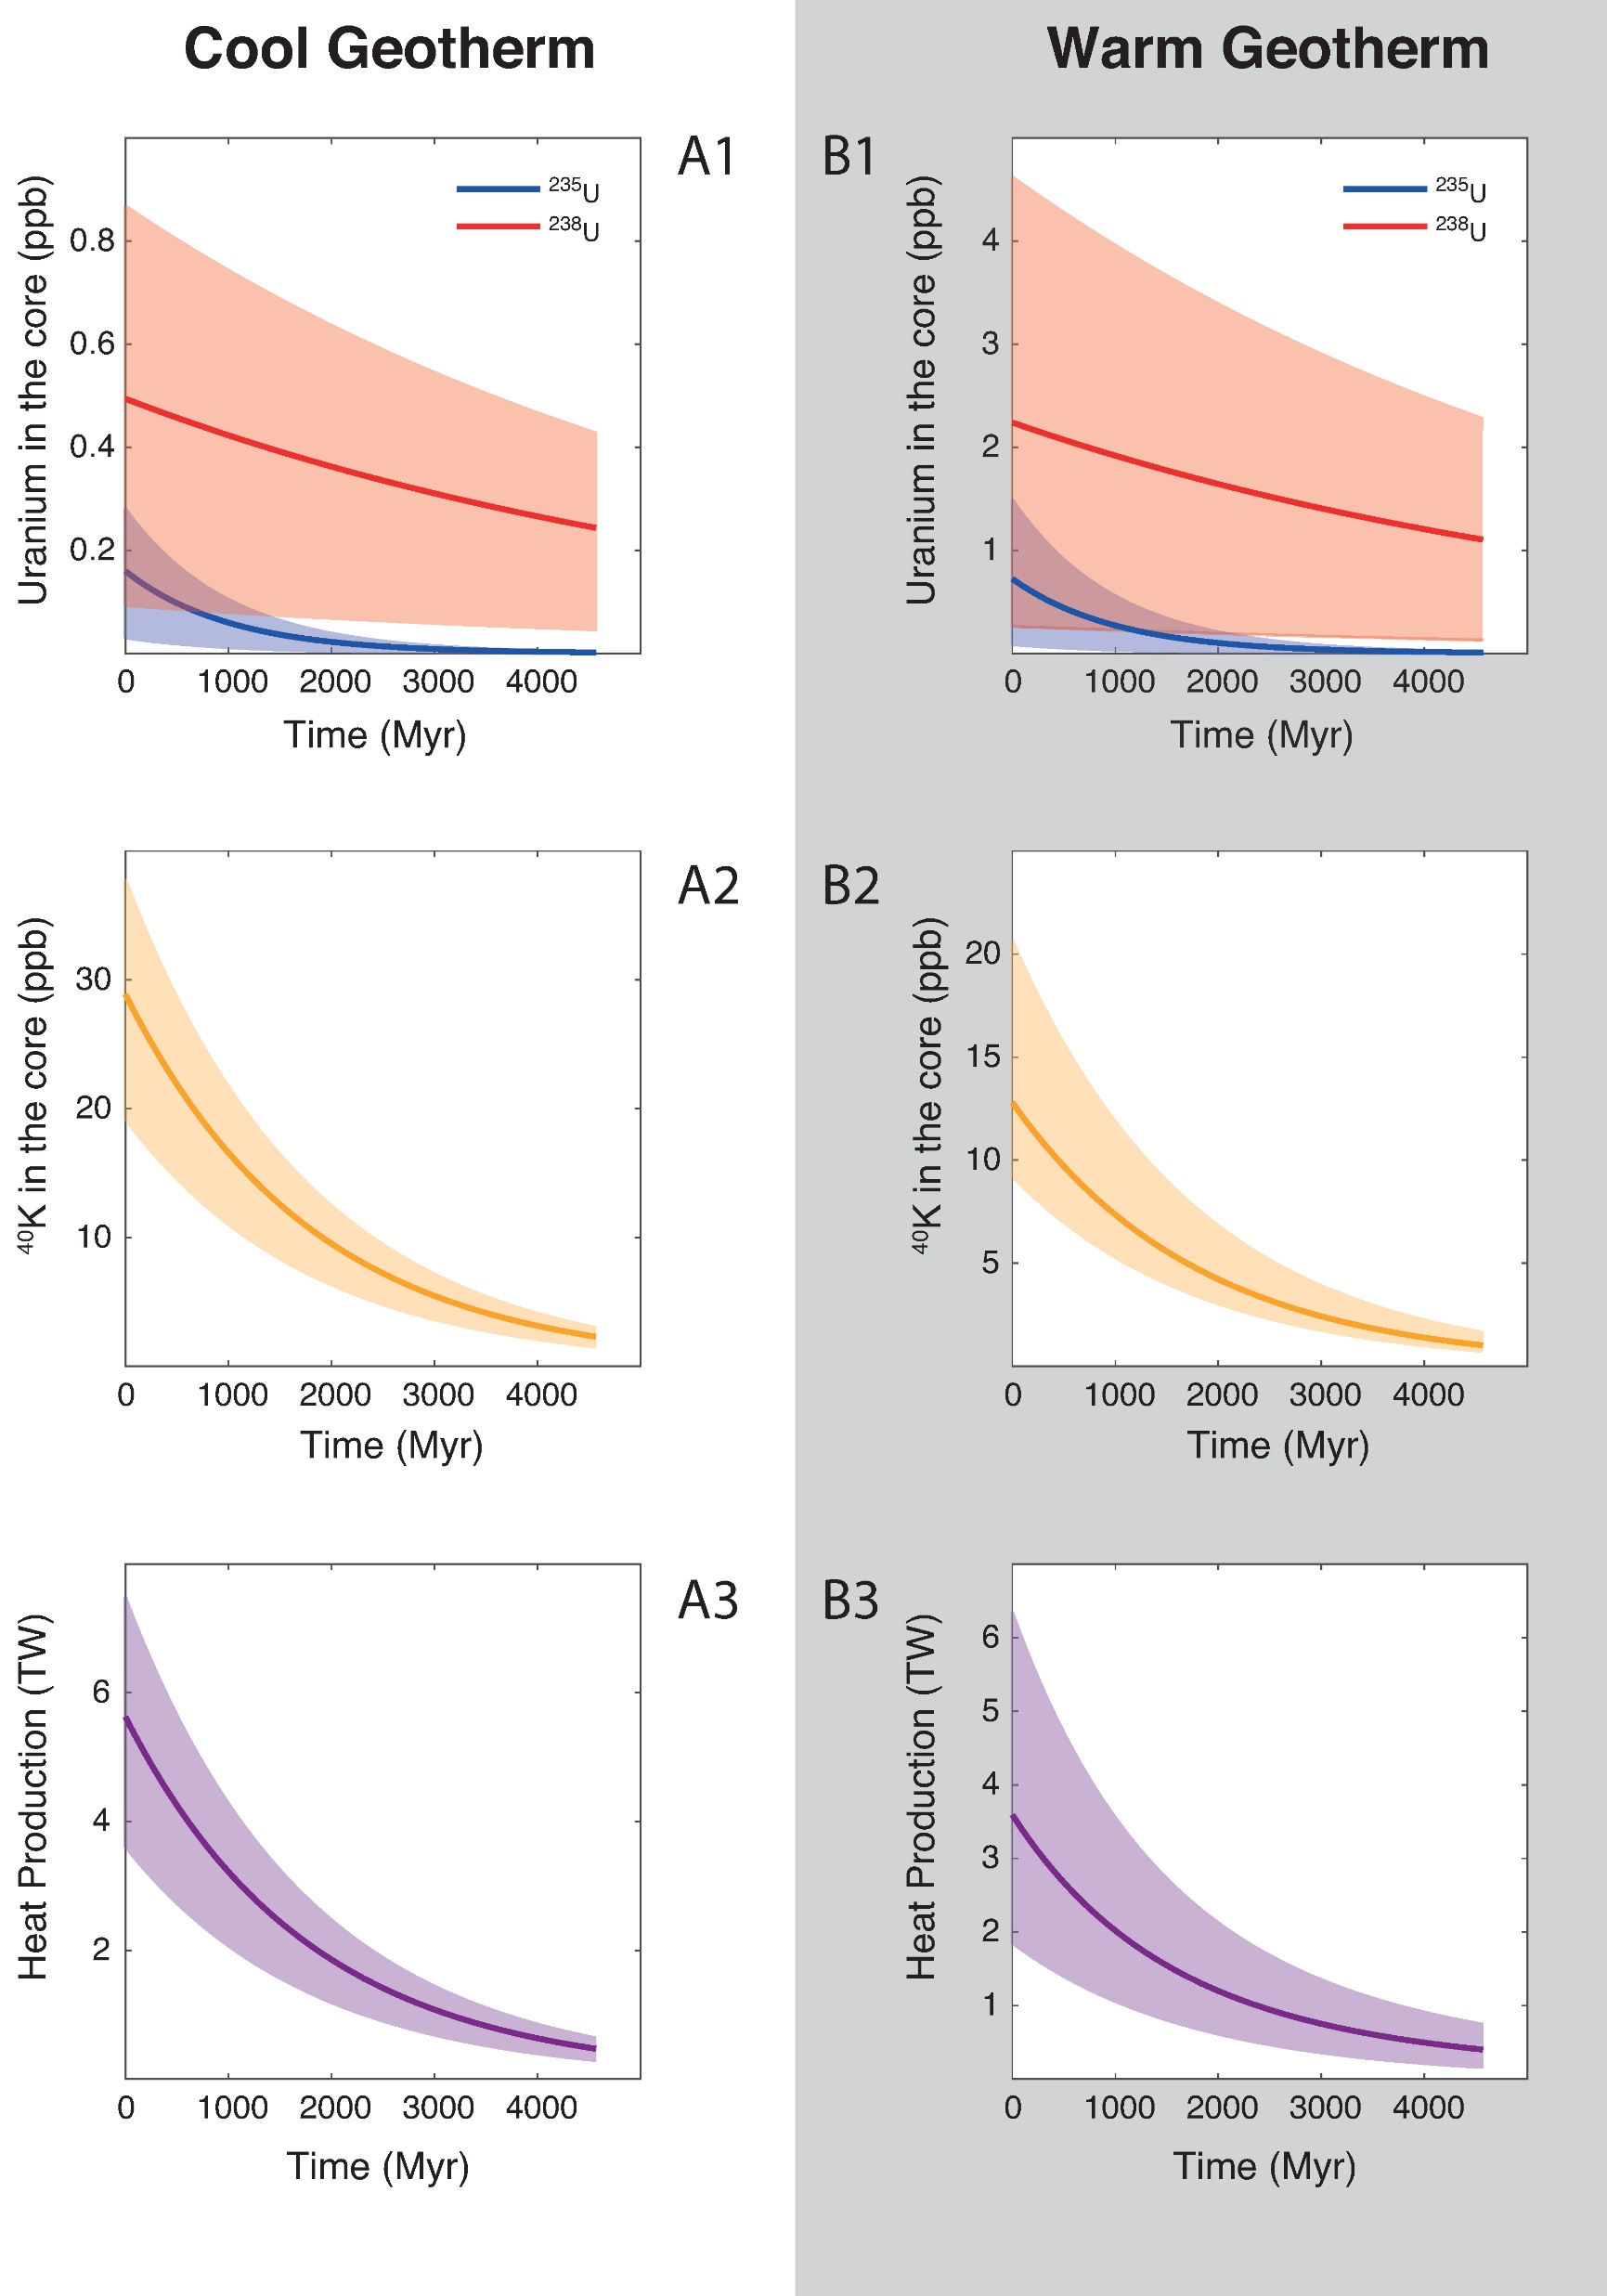
Blanchard et al.
The solubility of heat-producing elements in Earth’s core
Figure 2 Concentration of K and U in the core from continuous core-formation models, assuming two magma ocean geotherms: cool (A1,2,3) and warm (B1,2,3). The top panel is the abundance of ²³⁸U and ²³⁵U as a function of time, the middle panel corresponds to that of ⁴⁰K as a function of time, and the bottom panel is the total power produced in the core by the radioactive decay of these three radionuclides over time.
Blanchard et al. (2017) Geochem. Persp. Let. 5, 1-5 | doi: 10.7185/geochemlet.1737
© 2017 European Association of Geochemistry
Notes:
Figure 2 Concentration of K and U in the core from continuous core-formation models, assuming two magma ocean geotherms: cool (A1,2,3) and warm (B1,2,3). The top panel is the abundance of ²³⁸U and ²³⁵U as a function of time, the middle panel corresponds to that of ⁴⁰K as a function of time, and the bottom panel is the total power produced in the core by the radioactive decay of these three radionuclides over time.

