Slide 1
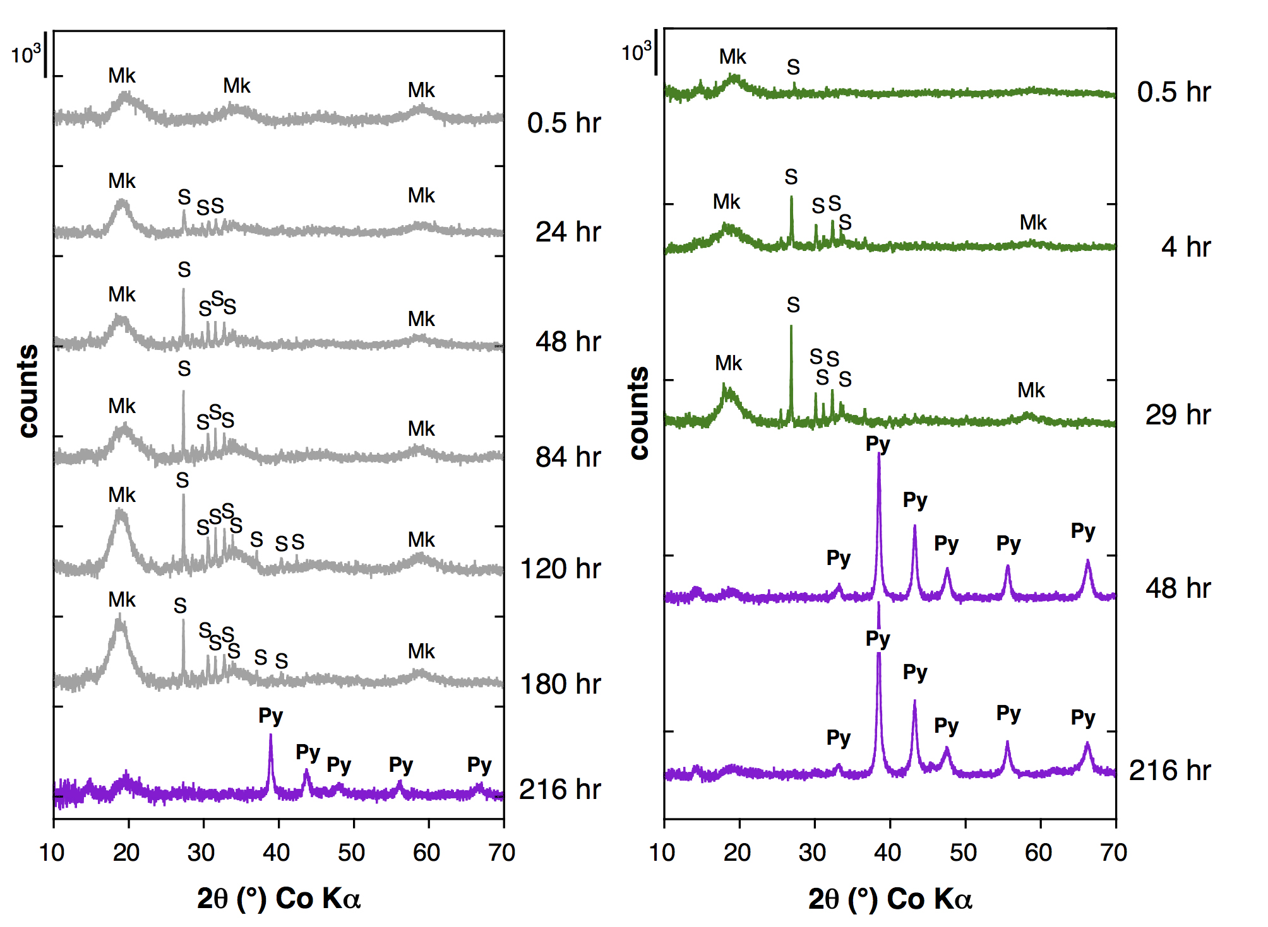
Morin et al.
Nickel accelerates pyrite nucleation at ambient temperature
Figure 1 Aqueous nickel impurity accelerates the formation of pyrite from a FeS_{(m)} precursor. Powder XRD patterns of the solids collected over the course of the pyrite synthesis experiments conducted at room temperature in the absence (left) or presence (right) of aqueous Ni in the starting solution. Mk: nano-mackinawite; S: a-sulphur; Py: pyrite.
Morin et al. (2017) Geochem. Persp. Let. 5, 6-11 | doi: 10.7185/geochemlet.1738
© 2017 European Association of Geochemistry
Notes:
Figure 1 Aqueous nickel impurity accelerates the formation of pyrite from a FeS_{(m)} precursor. Powder XRD patterns of the solids collected over the course of the pyrite synthesis experiments conducted at room temperature in the absence (left) or presence (right) of aqueous Ni in the starting solution. Mk: nano-mackinawite; S: a-sulphur; Py: pyrite.

