Slide 1
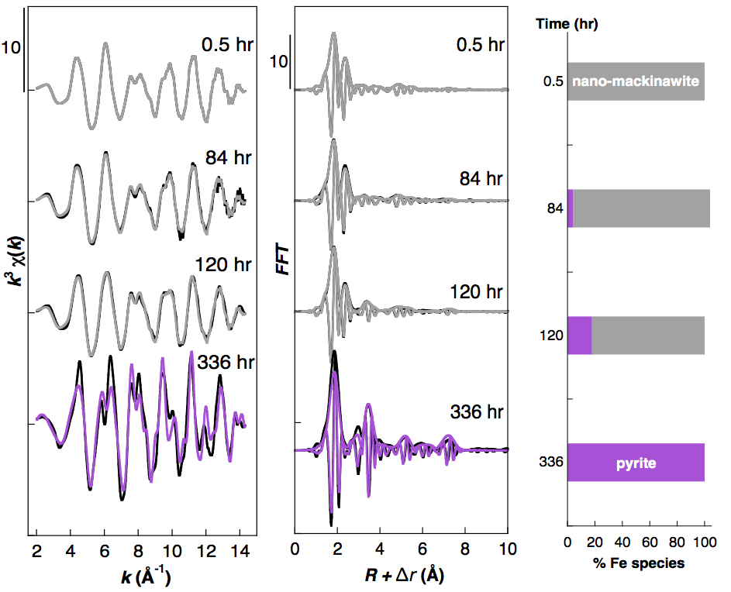
Morin et al.
Nickel accelerates pyrite nucleation at ambient temperature
Figure S-2 Fe K-edge k³-weighted EXAFS data of the solid samples collected over the course of the pyrite synthesis experiments conducted without aqueous Ni in the starting solution. Experimental k³c(k) functions (left panel) and corresponding Fast Fourier Transforms (centre panel) are displayed as black lines. Ab initio calculation of the EXAFS spectra of the pyrite end product is displayed in purple (Table S-3). Linear combination least squares (LC-LS) fits of the solid samples collected over the course of the synthesis experiments are displayed in gray curves. Proportions of the LC-LS fitting components (right panel) are reported in Table S-4.
Morin et al. (2017) Geochem. Persp. Let. 5, 6-11 | doi: 10.7185/geochemlet.1738
© 2017 European Association of Geochemistry
Notes:
Figure S-2 Fe K-edge k³-weighted EXAFS data of the solid samples collected over the course of the pyrite synthesis experiments conducted without aqueous Ni in the starting solution. Experimental k³c(k) functions (left panel) and corresponding Fast Fourier Transforms (centre panel) are displayed as black lines. Ab initio calculation of the EXAFS spectra of the pyrite end product is displayed in purple (Table S-3). Linear combination least squares (LC-LS) fits of the solid samples collected over the course of the synthesis experiments are displayed in gray curves. Proportions of the LC-LS fitting components (right panel) are reported in Table S-4.

