Slide 1
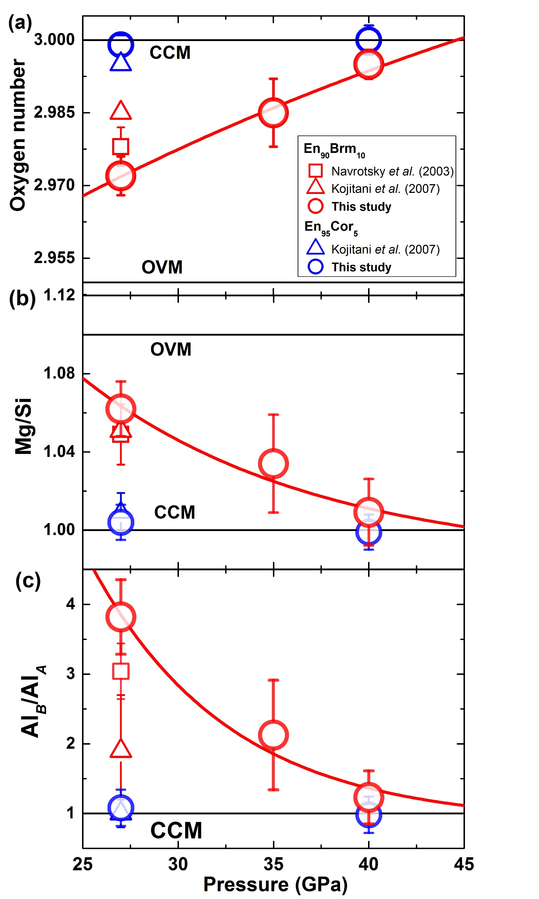
Liu et al.
Rapid decrease of MgAlO_{2.5} component in bridgmanite with pressure
Figure 3 Plots of (a) oxygen number, (b) Mg/Si ratio, and (c) Al ratio in A and B sites (Al_{B}/Al_{A}) in bridgmanite for En₉₀Brm₁₀ and En₉₅Cor₅ versus pressure. The black lines represent the compositions associated with the oxygen-vacancy substitution mechanism (OVM) and charge-coupled substitution mechanism (CCM) for bridgmanite. The red line is the least squares fitting (Mg/Si = Aexp(–P/B) + C, where P is pressure) of the present data.
Liu et al. (2017) Geochem. Persp. Let. 5, 12-18 | doi: 10.7185/geochemlet.1739
© 2017 European Association of Geochemistry
Notes:
Figure 3 Plots of (a) oxygen number, (b) Mg/Si ratio, and (c) Al ratio in A and B sites (Al_{B}/Al_{A}) in bridgmanite for En₉₀Brm₁₀ and En₉₅Cor₅ versus pressure. The black lines represent the compositions associated with the oxygen-vacancy substitution mechanism (OVM) and charge-coupled substitution mechanism (CCM) for bridgmanite. The red line is the least squares fitting (Mg/Si = Aexp(–P/B) + C, where P is pressure) of the present data.

