Slide 1
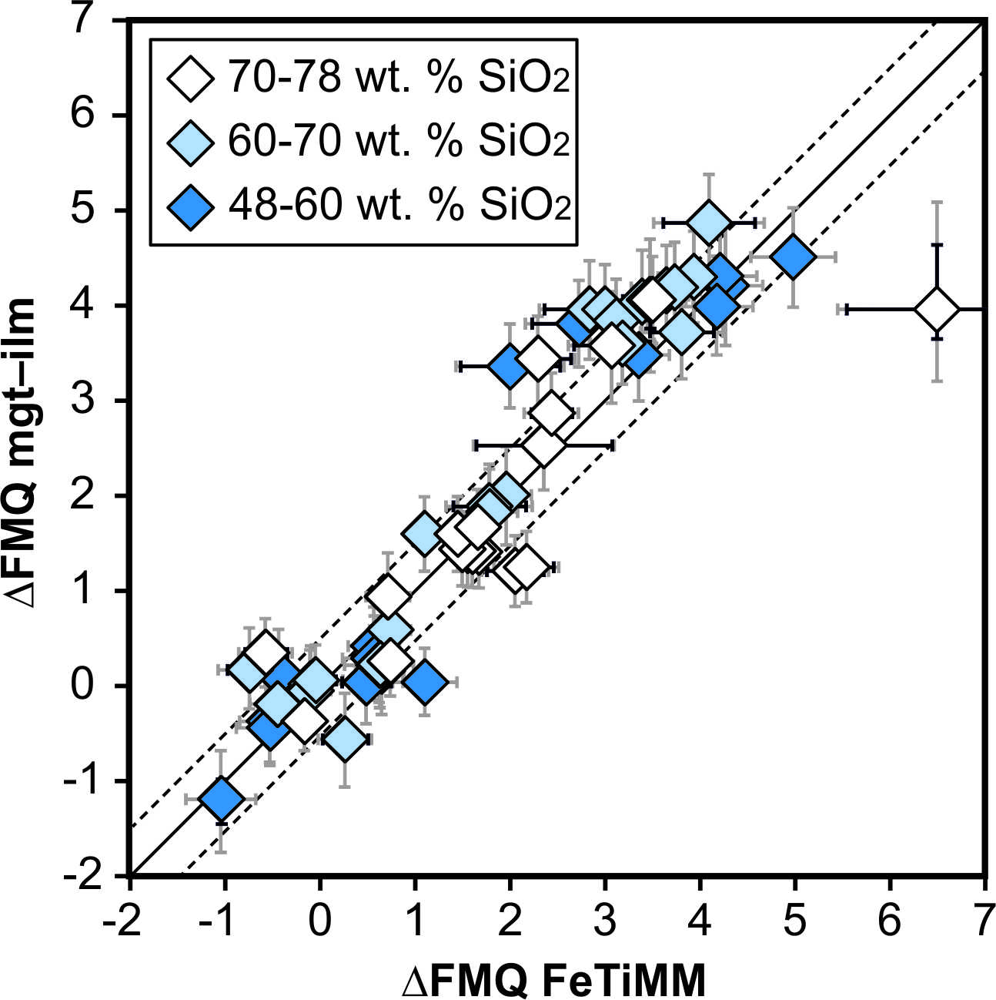
Arató and Audétat
FeTiMM – A new oxybarometer for mafic to felsic magmas
Figure 2 Performance of FeTiMM in ilmenite-saturated magmas. Oxygen fugacities (expressed in log units relative to the FMQ buffer) obtained via FeTiMM are compared with ones obtained via magnetite–ilmenite oxybarometry using the model of (Ghiorso and Evans, 2008). The data are divided into three groups of contrasting melt SiO₂…
Arató and Audétat (2017) Geochem. Persp. Let. 5, 19-23 | doi: 10.7185/geochemlet.1740
© 2017 European Association of Geochemistry
Notes:
Figure 2 Performance of FeTiMM in ilmenite-saturated magmas. Oxygen fugacities (expressed in log units relative to the FMQ buffer) obtained via FeTiMM are compared with ones obtained via magnetite–ilmenite oxybarometry using the model of (Ghiorso and Evans, 2008). The data are divided into three groups of contrasting melt SiO₂. Black error bars (in most cases smaller than symbol size) denote the analytical error, whereas the grey error bars denote the overall error that includes both the analytical scatter and the error inherent to the model. Details about the calculation of errors are provided in the Supplementary Information.

