Slide 1
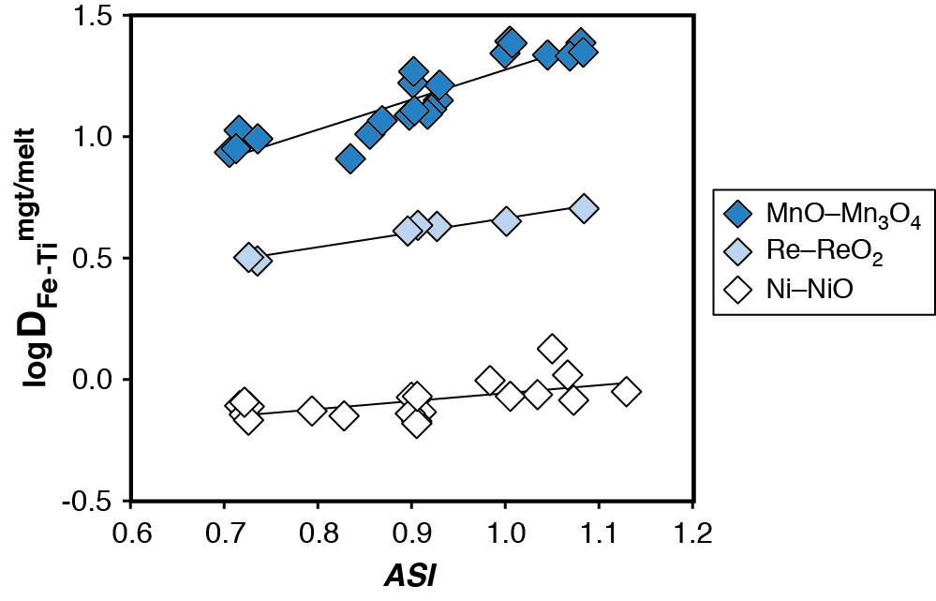
Arató and Audétat
FeTiMM – A new oxybarometer for mafic to felsic magmas
Figure S-1 Dependence of the Fe–Ti exchange coefficient between magnetite and rhyolitic melt on fO₂ and melt alumina saturation index. D_{Fe–Ti}^{mgt/melt} refers to (D_{FeOtot}^{mgt/melt})/(D_{TiO2}^{mgt/melt}), whereas ASI refers to molar Al₂O₃ /(CaO + Na₂O + K₂O). The dataset comprises magnetite–melt pairs from 50 different experiments performed …
Arató and Audétat (2017) Geochem. Persp. Let. 5, 19-23 | doi: 10.7185/geochemlet.1740
© 2017 European Association of Geochemistry
Notes:
Figure S-1 Dependence of the Fe–Ti exchange coefficient between magnetite and rhyolitic melt on fO₂ and melt alumina saturation index. D_{Fe–Ti}^{mgt/melt} refers to (D_{FeOtot}^{mgt/melt})/(D_{TiO2}^{mgt/melt}), whereas ASI refers to molar Al₂O₃ /(CaO + Na₂O + K₂O). The dataset comprises magnetite–melt pairs from 50 different experiments performed at three different oxygen fugacity buffers, temperatures of 800-1000 °C, pressures of 100-500 MPa, with melt ASI values of 0.71-1.12, and magnetite compositions of 0.2-14 wt. % TiO₂ (Arató and Audétat, 2017).

