Slide 1
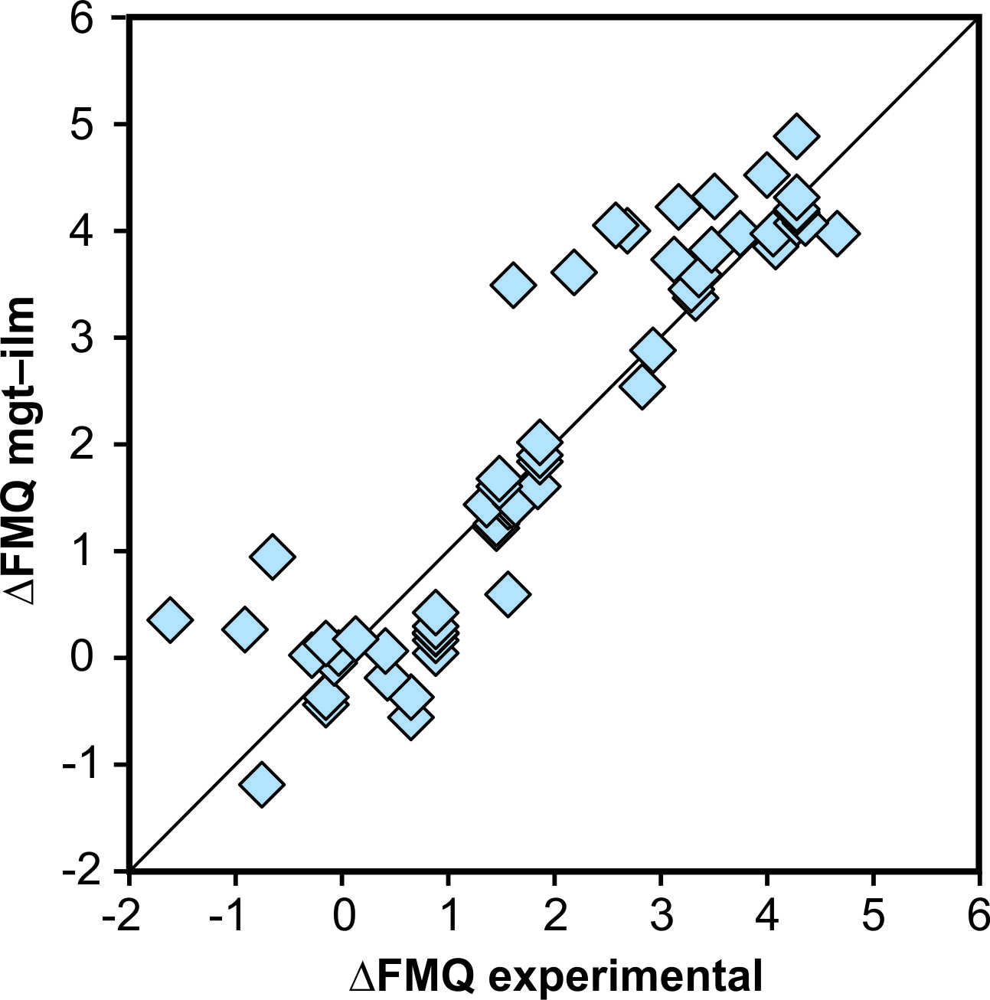
Arató and Audétat
FeTiMM – A new oxybarometer for mafic to felsic magmas
Figure S-3 Comparison of reported experimental fO₂ values with fO₂ values obtained via magnetite–ilmenite (Ghiorso and Evans, 2008) for 59 ilmenite-bearing experiments taken from the literature. Oxygen fugacities are reported in log units relative to the fayalite-magnetite-quartz (FMQ) buffer.
Arató and Audétat (2017) Geochem. Persp. Let. 5, 19-23 | doi: 10.7185/geochemlet.1740
© 2017 European Association of Geochemistry
Notes:
Figure S-3 Comparison of reported experimental fO₂ values with fO₂ values obtained via magnetite–ilmenite (Ghiorso and Evans, 2008) for 59 ilmenite-bearing experiments taken from the literature. Oxygen fugacities are reported in log units relative to the fayalite-magnetite-quartz (FMQ) buffer.

