Slide 1
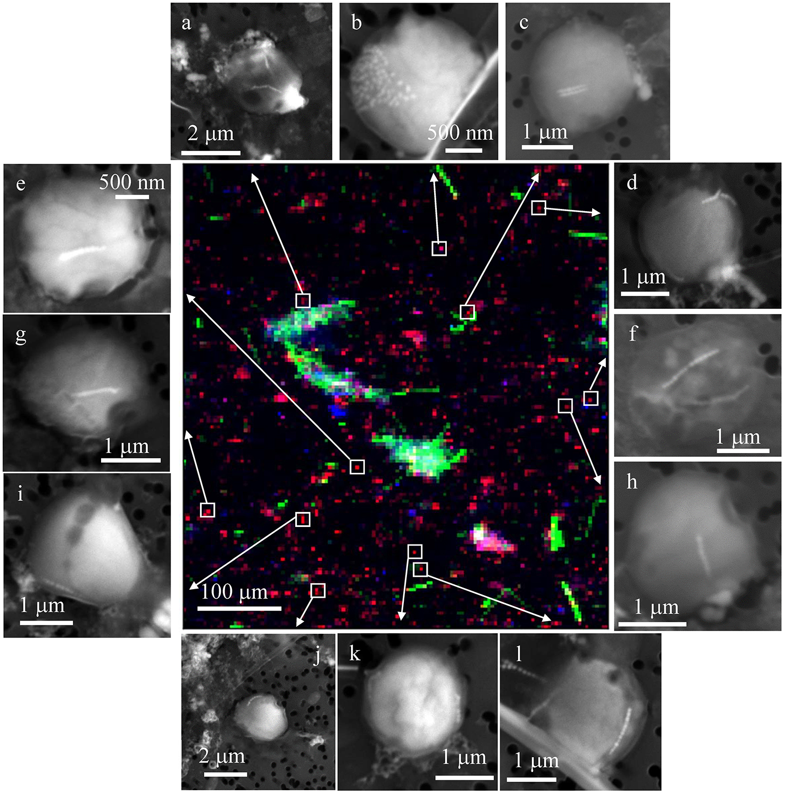
Rivas-Lamelo et al.
Magnetotactic bacteria as a new model for P sequestration in the ferruginous Lake Pavin
Figure 4 Correlative μ-XRF and SEM microscopy. Centre: XRF maps of P (red), Si (green) and S (blue). The brightest P spots were subsequently imaged by SEM. Many hotspots correspond to polyP-loaded MTB cells as shown in (a) to (l). Other hotspots were almost exclusively Fe phosphate precipitates (Fig. S-5).
Rivas-Lamelo et al. (2017) Geochem. Persp. Let. 5, 35-41 | doi: 10.7185/geochemlet.1743
© 2017 European Association of Geochemistry
Notes:
Figure 4 Correlative μ-XRF and SEM microscopy. Centre: XRF maps of P (red), Si (green) and S (blue). The brightest P spots were subsequently imaged by SEM. Many hotspots correspond to polyP-loaded MTB cells as shown in (a) to (l). Other hotspots were almost exclusively Fe phosphate precipitates (Fig. S-5).

