Slide 1
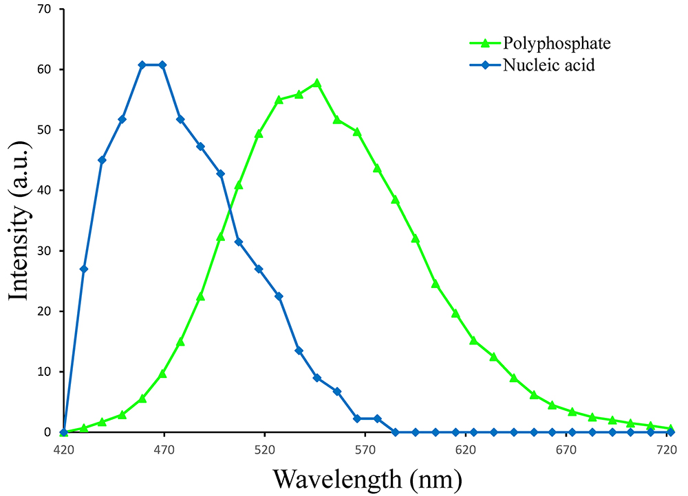
Rivas-Lamelo et al.
Magnetotactic bacteria as a new model for P sequestration in the ferruginous Lake Pavin
Figure S-3 Fluorescence spectra of DAPI-stained nucleic acid (blue) and DAPI-stained polyphosphate (green). Fluorescence maps of the two components as shown in Figure 2a are obtained by measuring fluorescence spectra on each pixel of the image and fitting the resulting spectra as linear combinations of these two reference spectra.
Rivas-Lamelo et al. (2017) Geochem. Persp. Let. 5, 35-41 | doi: 10.7185/geochemlet.1743
© 2017 European Association of Geochemistry
Notes:
Figure S-3 Fluorescence spectra of DAPI-stained nucleic acid (blue) and DAPI-stained polyphosphate (green). Fluorescence maps of the two components as shown in Figure 2a are obtained by measuring fluorescence spectra on each pixel of the image and fitting the resulting spectra as linear combinations of these two reference spectra.

