Slide 1
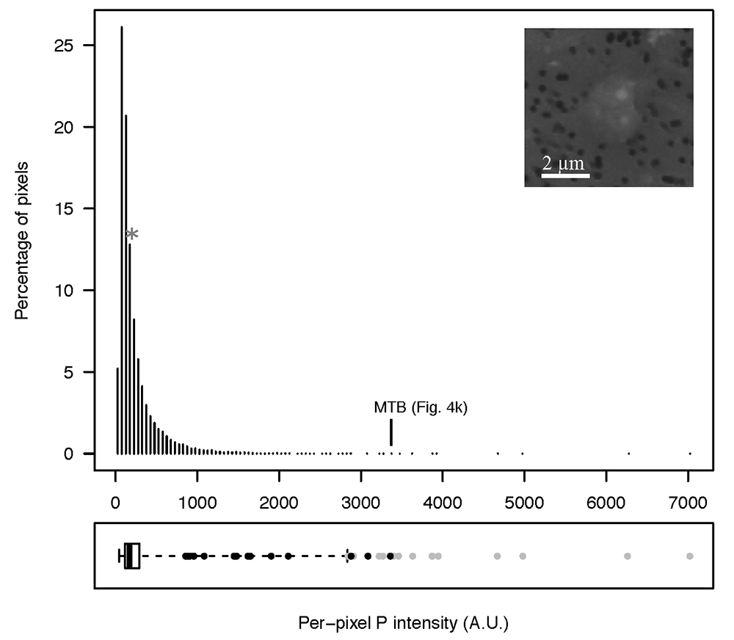
Rivas-Lamelo et al.
Magnetotactic bacteria as a new model for P sequestration in the ferruginous Lake Pavin
Figure S-6 Distribution of the per pixel P intensity on the μ-XRF map shown in Figure 4. Most of the P-containing pixels have a per pixel intensity below 144.3 (median value, indicated by a bold vertical line in the bottom box). The MTB-containing pixel with the highest P content (Fig. 4k) is labelled. Below the histogram, the box boundaries indicate the first and third quartiles (per pixel intensities of 88.7 and 265.9, respectively). …
Rivas-Lamelo et al. (2017) Geochem. Persp. Let. 5, 35-41 | doi: 10.7185/geochemlet.1743
© 2017 European Association of Geochemistry
Notes:
Figure S-6 Distribution of the per pixel P intensity on the μ-XRF map shown in Figure 4. Most of the P-containing pixels have a per pixel intensity below 144.3 (median value, indicated by a bold vertical line in the bottom box). The MTB-containing pixel with the highest P content (Fig. 4k) is labelled. Below the histogram, the box boundaries indicate the first and third quartiles (per pixel intensities of 88.7 and 265.9, respectively). The horizontal dashed line extending to the right encompasses 99.9 % of the P-containing pixels (up to 2826.9). Outliers are represented by individual points. P intensities of the MTB-containing pixels identified by SEM (Fig. 4) are represented by single black dots. On the right, SEM picture of non-MTB microbial cell contained in a pixel with a P intensity of 181.8 (indicated by a grey star above the corresponding histogram bin), i.e. slightly above the median.

