Slide 1
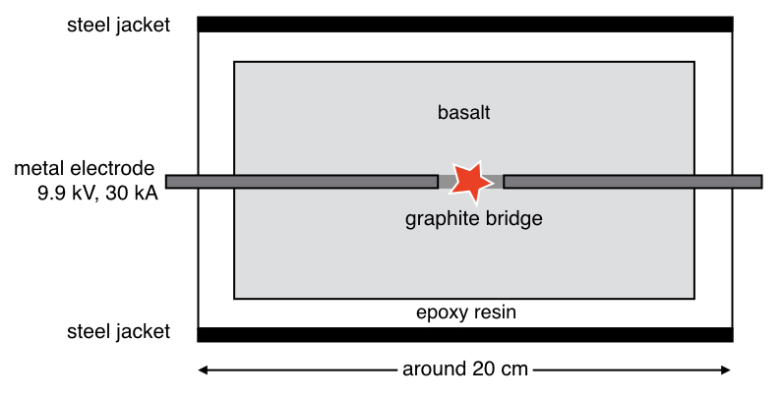
Ballhaus et al.
Ultra-high pressure and ultra-reduced minerals in ophiolites may form by lightning strikes
Figure 1 Experimental arrangement. A basalt cuboid surrounded by a 7 mm thick steel sleeve. The epoxy resin serves as electric insulator to prevent the current from short circuiting around the sample through the steel sleeve. Current pulses are generated with a pulse generator of the type SSG 10 kV/100 kJ (Haefely). The capacity of the pulse generator is 2140 µF. It can be charged to 10 kV. The energy achievable is 100 kJ. The pulse width depends on the load and is of the order of a few hundred microseconds.
Ballhaus et al. (2017) Geochem. Persp. Let. 5, 42-46 | doi: 10.7185/geochemlet.1744
© 2017 European Association of Geochemistry
Notes:
Figure 1 Experimental arrangement. A basalt cuboid surrounded by a 7 mm thick steel sleeve. The epoxy resin serves as electric insulator to prevent the current from short circuiting around the sample through the steel sleeve. Current pulses are generated with a pulse generator of the type SSG 10 kV/100 kJ (Haefely). The capacity of the pulse generator is 2140 µF. It can be charged to 10 kV. The energy achievable is 100 kJ. The pulse width depends on the load and is of the order of a few hundred microseconds.

