Slide 1
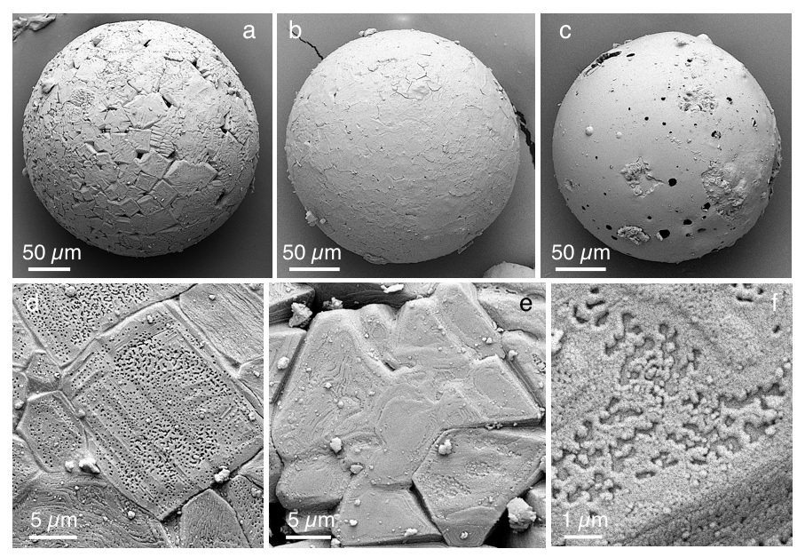
Ballhaus et al.
Ultra-high pressure and ultra-reduced minerals in ophiolites may form by lightning strikes
Figure 4 Images of plasma spherules in secondary electron (SEM) mode, sputtered with Au. (a) and (b) Oxide spherules; surfaces composed of porous Fe-O oxide platelets. (c) Silicate glass spherule. (d) and (e) Surface crystals of Fe oxide spherules (? wüstite) in detail. (f) A quench oxide crystal on edge, apparently composed of multiple layers of nano-spherules…
Ballhaus et al. (2017) Geochem. Persp. Let. 5, 42-46 | doi: 10.7185/geochemlet.1744
© 2017 European Association of Geochemistry
Notes:
Figure 4 Images of plasma spherules in secondary electron (SEM) mode, sputtered with Au. (a) and (b) Oxide spherules; surfaces composed of porous Fe-O oxide platelets. (c) Silicate glass spherule. (d) and (e) Surface crystals of Fe oxide spherules (? wüstite) in detail. (f) A quench oxide crystal on edge, apparently composed of multiple layers of nano-spherules. Note that all spherules shown are from an experiment where metallic Fe metal electrodes were used instead of W metal.

