Slide 1
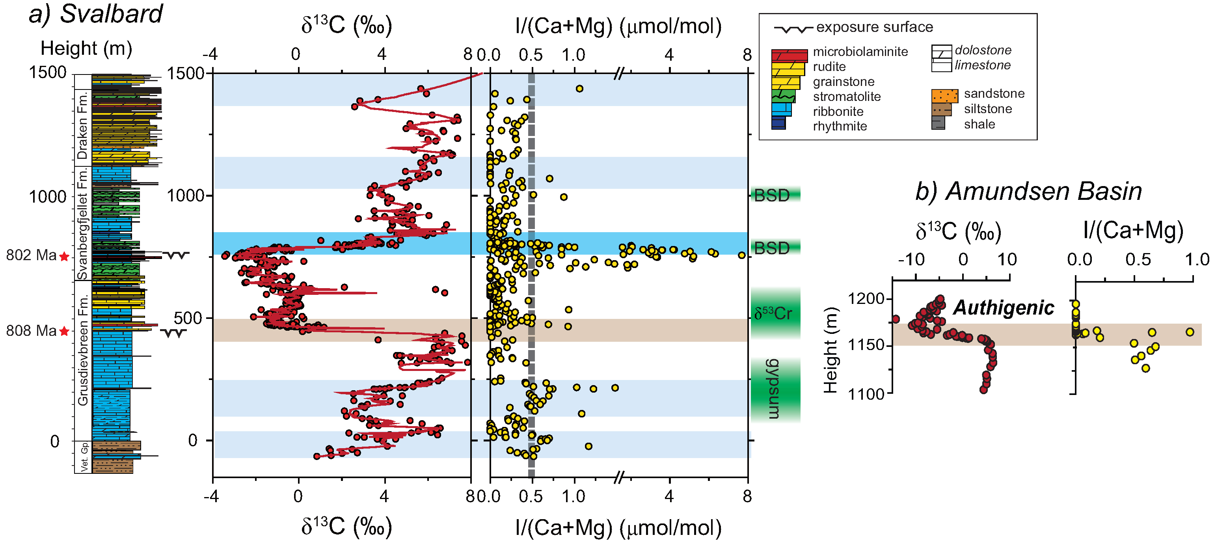
Lu et al.
Iodine proxy evidence for increased ocean oxygenation during the Bitter Springs Anomaly
Figure 2 I/(Ca + Mg) data from (a) Svalbard and (b) Amundsen basin. Values above 0.5 μmol/mol (Fig. 1) are most commonly associated with the rise in δ¹³C (blue bar). Darker blue bar highlights the recovery phase of BSA with a major increase in δ¹³C. The decrease in δ¹³C that defines the base of the BSA is indicated with a brown bar, and data from Svalbard and the Amundsen Basin are lined up accordingly. …
Lu et al. (2017) Geochem. Persp. Let. 5, 53-57 | doi: 10.7185/geochemlet.1746
© 2017 European Association of Geochemistry
Notes:
Figure 2 I/(Ca + Mg) data from (a) Svalbard and (b) Amundsen basin. Values above 0.5 μmol/mol (Fig. 1) are most commonly associated with the rise in δ¹³C (blue bar). Darker blue bar highlights the recovery phase of BSA with a major increase in δ¹³C. The decrease in δ¹³C that defines the base of the BSA is indicated with a brown bar, and data from Svalbard and the Amundsen Basin are lined up accordingly. Note the axis for I/(Ca + Mg) is broken at 1.50 to better illustrate stratigraphic trends below 2 μmol/mol. Green boxes show the timing of increases in O₂ levels as stratigraphically correlated to the Svalbard section. Gypsum evaporite deposits are from Turner and Bekker (2016). δ⁵³Cr signature is from Planavsky et al. (2014). BSD stands for bacterial sulphur disproportionation, as recorded in multiple sulphur isotope data (Kunzmann et al., 2017).

