Slide 1
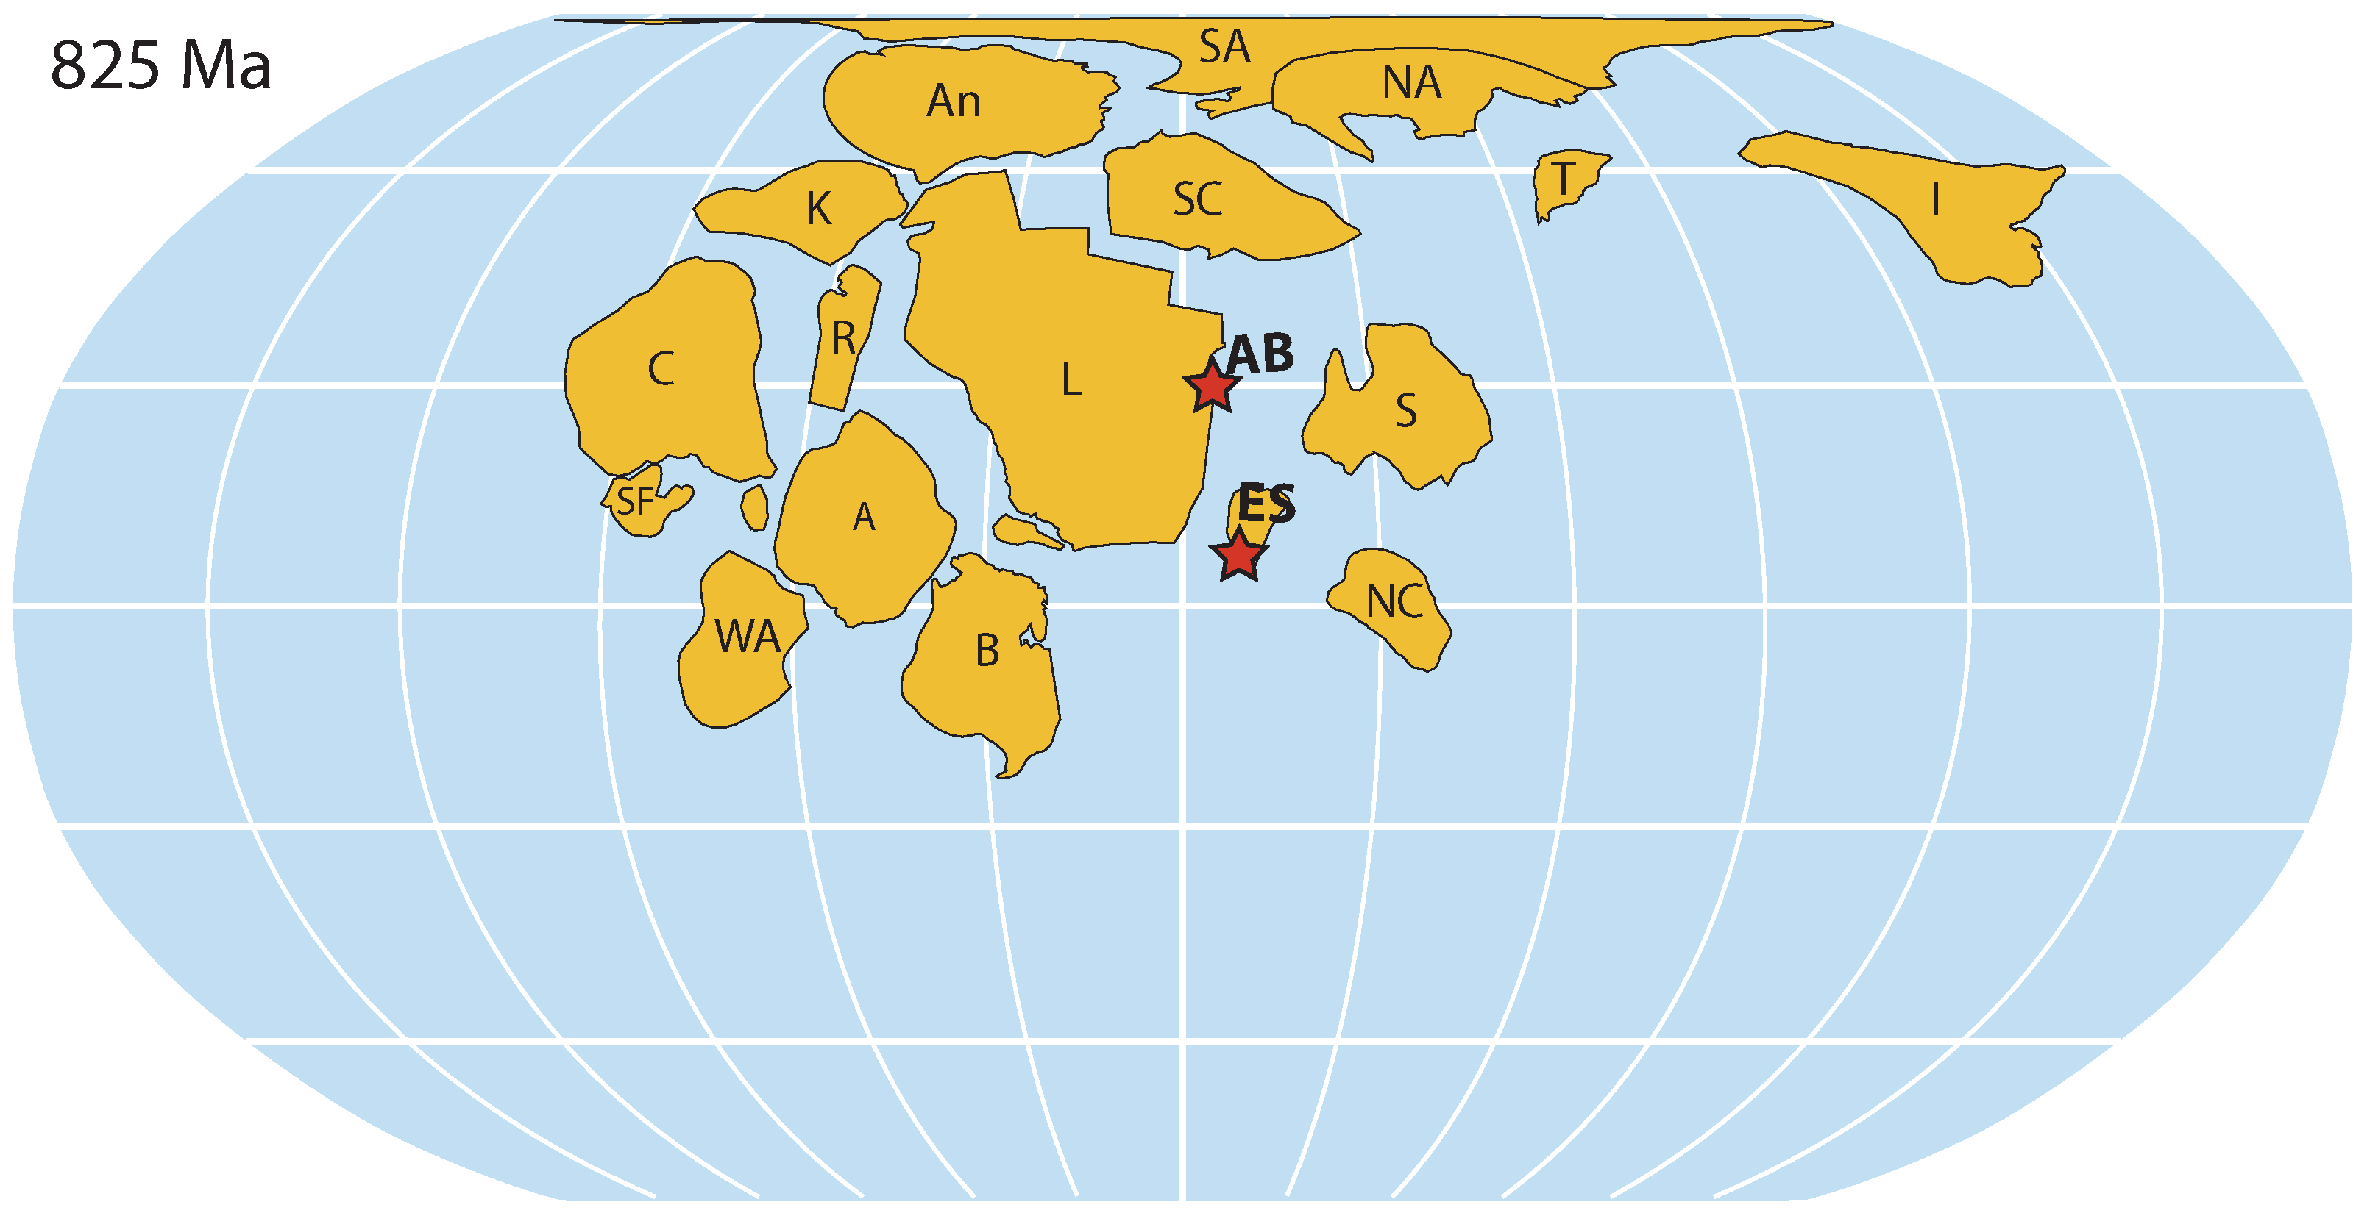
Lu et al.
Iodine proxy evidence for increased ocean oxygenation during the Bitter Springs Anomaly
Figure S-1 Palaeogeographic reconstruction for 825 Ma (modified from Li et al., 2013). Stars mark sampled locations (ES = East Svalbard; AB = Amundsen Basin). Craton names: A = Amazon; An = Antarctica; B = Baltica; C = Congo; I = India; K = Kalahari; NA = northern Australia; R = Rio Plata; S = Siberia; SA = southern Australia; SC = South China; T = Tarim; WA = West Africa.
Lu et al. (2017) Geochem. Persp. Let. 5, 53-57 | doi: 10.7185/geochemlet.1746
© 2017 European Association of Geochemistry
Notes:
Figure S-1 Palaeogeographic reconstruction for 825 Ma (modified from Li et al., 2013). Stars mark sampled locations (ES = East Svalbard; AB = Amundsen Basin). Craton names: A = Amazon; An = Antarctica; B = Baltica; C = Congo; I = India; K = Kalahari; NA = northern Australia; R = Rio Plata; S = Siberia; SA = southern Australia; SC = South China; T = Tarim; WA = West Africa.

