Slide 1
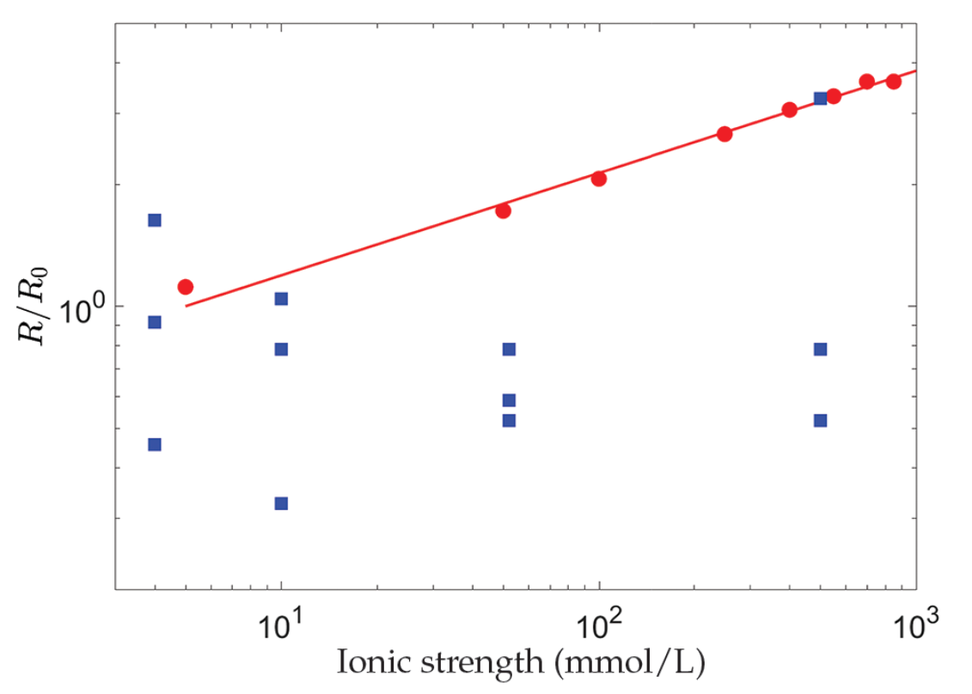
Le Merrer and Colombani
Comment on “Repulsion between calcite crystals and grain detachment during water-rock interaction” by Levenson and Emmanuel, 2017
Figure 1 Evolution with the ionic strength, I, of the dissolution rate, R, of polished, polycrystalline calcite, renormalised by its value at I = 5 mmol/L (red dots) (Colombani, 2016) and the chemical dissolution rate, R, measured in the grain detachment experiments renormalised by the average of its values at I = 4 mmol/L (blue squares) (Levenson and Emmanuel, 2017). The straight line corresponds to R ∝ I^{0.25}.
Le Merrer and Colombani (2017) Geochem. Persp. Let. 6, 1-2 | doi: 10.7185/geochemlet.1747
© 2017 The Authors
Published by the European Association of Geochemistry
under Creative Commons License CC BY 4.0
Notes:
Figure 1 Evolution with the ionic strength, I, of the dissolution rate, R, of polished, polycrystalline calcite, renormalised by its value at I = 5 mmol/L (red dots) (Colombani, 2016) and the chemical dissolution rate, R, measured in the grain detachment experiments renormalised by the average of its values at I = 4 mmol/L (blue squares) (Levenson and Emmanuel, 2017). The straight line corresponds to R ∝ I^{0.25}.

