Slide 1
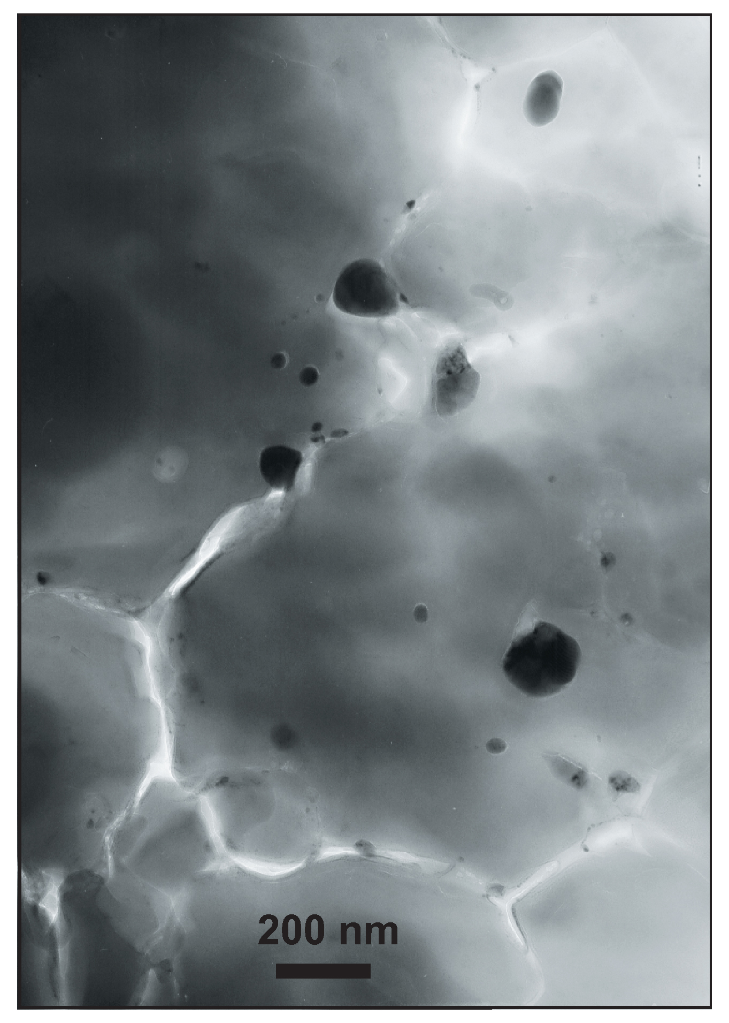
Andrault et al.
Large oxygen excess in the primitive mantle could be the source of the Great Oxygenation Event
Figure 1 Micrograph of an Al-bearing (Mg,Fe)SiO₃ bridgmanite. The starting material consisting of a mixture of (Mg,Fe)SiO₃ pyroxene and Al₂O₃ corundum was compressed to 40 GPa and heated to 2500 K, using the LH-DAC. …
© 2018 The Authors
Published by the European Association of Geochemistry
under Creative Commons License CC BY-NC-ND 4.0
Andrault et al. (2018) Geochem. Persp. Let. 6, 5-10 | doi: 10.7185/geochemlet.1801
Notes:
Figure 1 Micrograph of an Al-bearing (Mg,Fe)SiO₃ bridgmanite. The starting material consisting of a mixture of (Mg,Fe)SiO₃ pyroxene and Al₂O₃ corundum was compressed to 40 GPa and heated to 2500 K, using the LH-DAC. The reaction between the two phases induced the Fe²⁺ disproportionation into a mixture of Fe³⁺-rich, Al-bearing bridgmanite (large grey areas) and metallic Fe⁰ (dark droplets). Early in the Earth’s history, core segregation drained the metallic Fe⁰ away from the Fe³⁺-rich Bg, thus leaving the deep mantle with a large oxygen excess.

