Slide 1
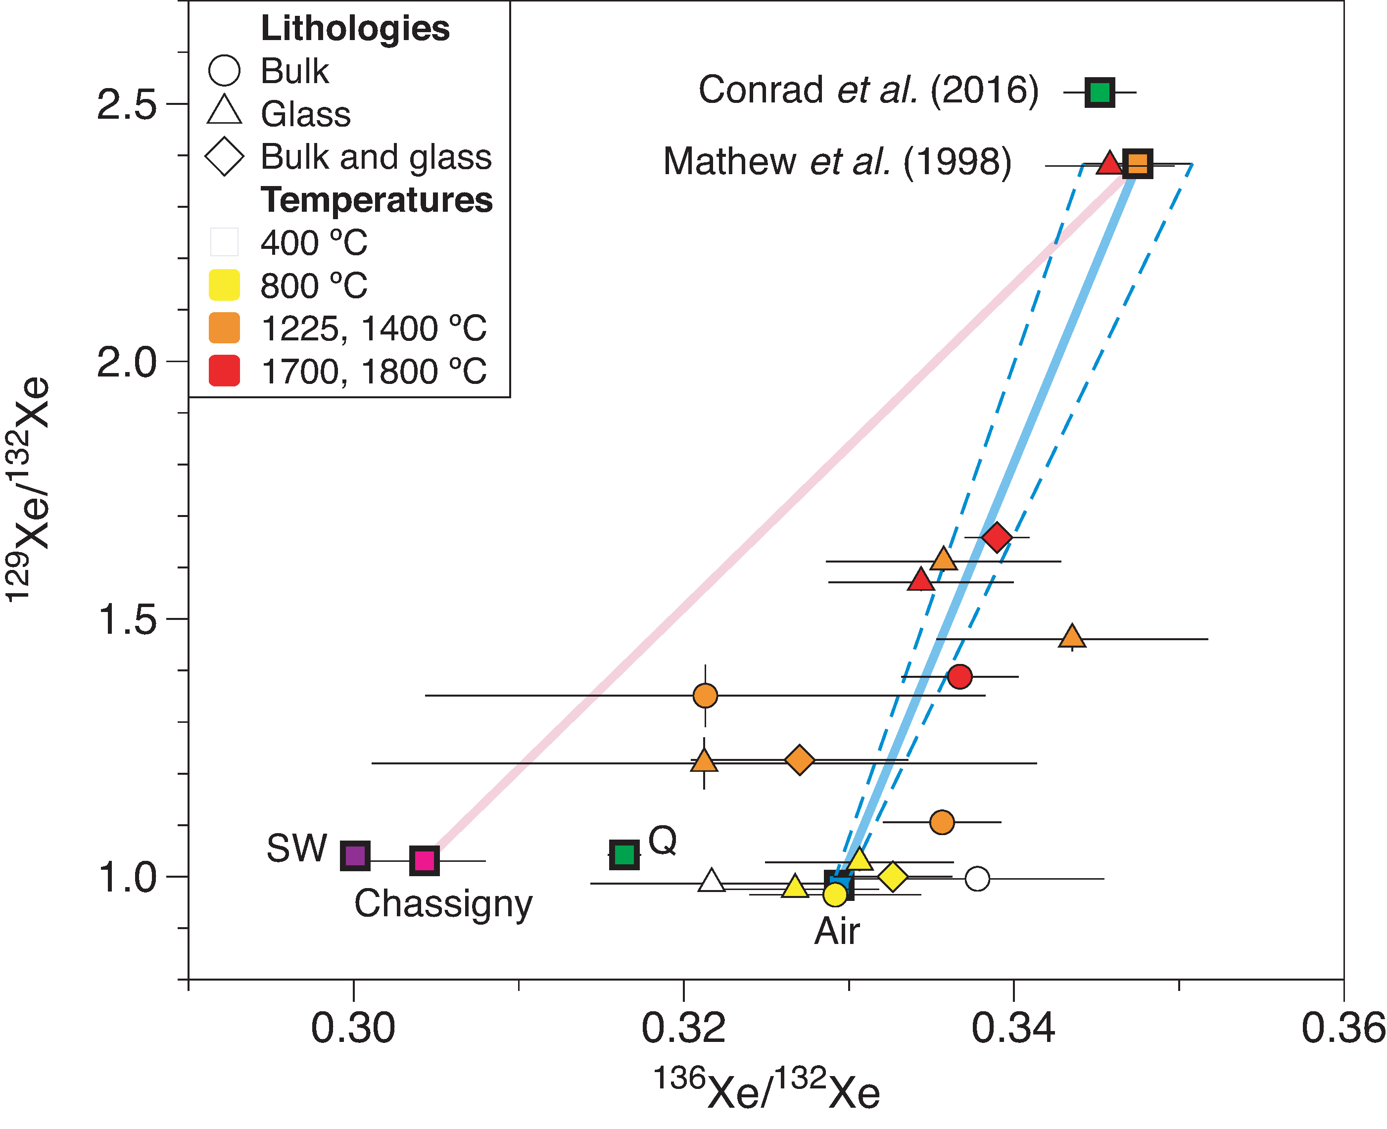
Avice et al.
Noble gases and nitrogen in Tissint reveal the composition of the Mars atmosphere
Figure 2 Three isotope plot of Xe measured in Tissint samples. Data define a mixing trend between the terrestrial (Ozima and Podosek, 2002) and Martian atmospheres (Mathew et al., 1998). Chassigny is from Ott (1988) and is comparable to SW-Xe (Meshik et al., 2014). Chondritic (Q-Xe) from Busemann et al. (2000). New results from the MSL ...
© 2018 The Authors
Published by the European Association of Geochemistry
under Creative Commons License CC BY-NC-ND 4.0
Avice et al. (2018) Geochem. Persp. Let. 6, 11-16 | doi: 10.7185/geochemlet.1802
Notes:
Figure 2 Three isotope plot of Xe measured in Tissint samples. Data define a mixing trend between the terrestrial (Ozima and Podosek, 2002) and Martian atmospheres (Mathew et al., 1998). Chassigny is from Ott (1988) and is comparable to SW-Xe (Meshik et al., 2014). Chondritic (Q-Xe) from Busemann et al. (2000). New results from the MSL mission (Conrad et al., 2016) have similar ¹³⁶Xe/¹³²Xe but higher ¹²⁹Xe/¹³²Xe than previous studies. Errors correspond to 1σ.

