Slide 1
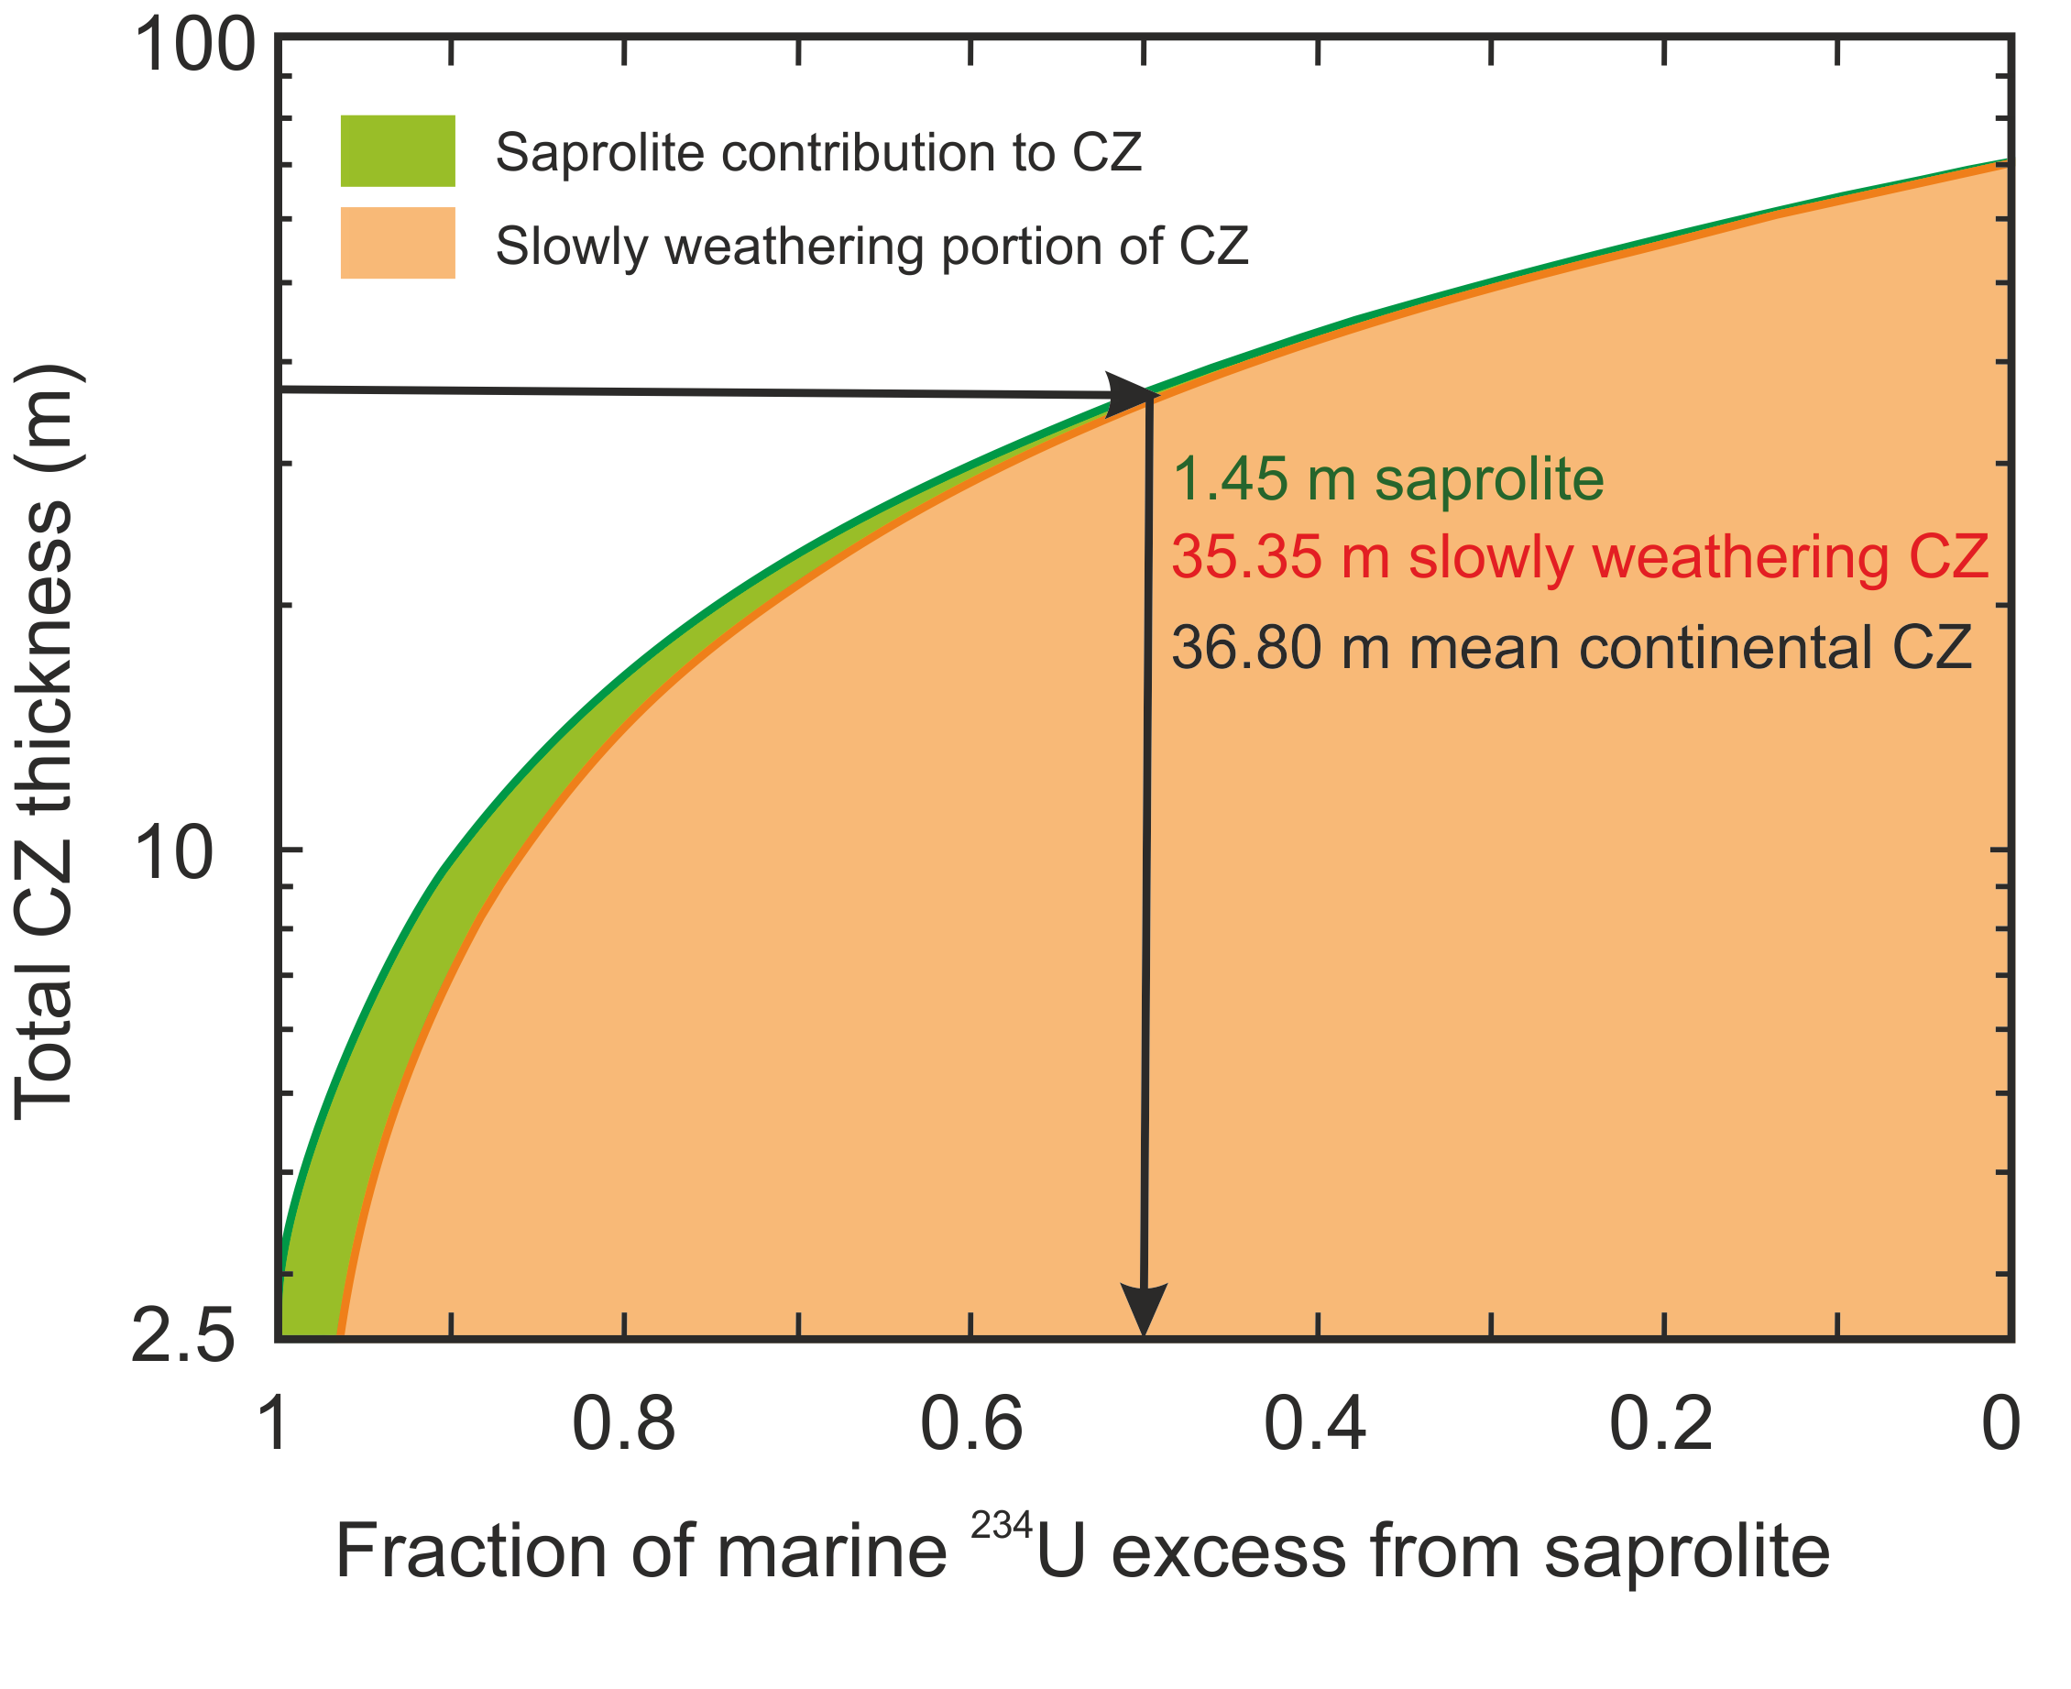
Suhr et al.
Th/U and U series systematics of saprolite: importance for the oceanic ²³⁴U excess
Figure 4 Total CZ thickness vs. fraction of marine ²³⁴U excess from saprolite. For example, only 1.45 m of saprolite with (²³⁴U/²³⁸U) of ca. 0.76 is needed in steady state to contribute equally to the oceanic ²³⁴U excess (50 %) as the more strongly weathered CZ (35.35 m) with (²³⁴U/²³⁸U) of ca. 0.99.
© 2018 The Authors
Published by the European Association of Geochemistry
under Creative Commons License CC BY-NC-ND 4.0
Suhr et al. (2018) Geochem. Persp. Let. 6, 17-22 | doi: 10.7185/geochemlet.1803
Notes:
Figure 4 Total CZ thickness vs. fraction of marine ²³⁴U excess from saprolite. For example, only 1.45 m of saprolite with (²³⁴U/²³⁸U) of ca. 0.76 is needed in steady state to contribute equally to the oceanic ²³⁴U excess (50 %) as the more strongly weathered CZ (35.35 m) with (²³⁴U/²³⁸U) of ca. 0.99.

