Slide 1
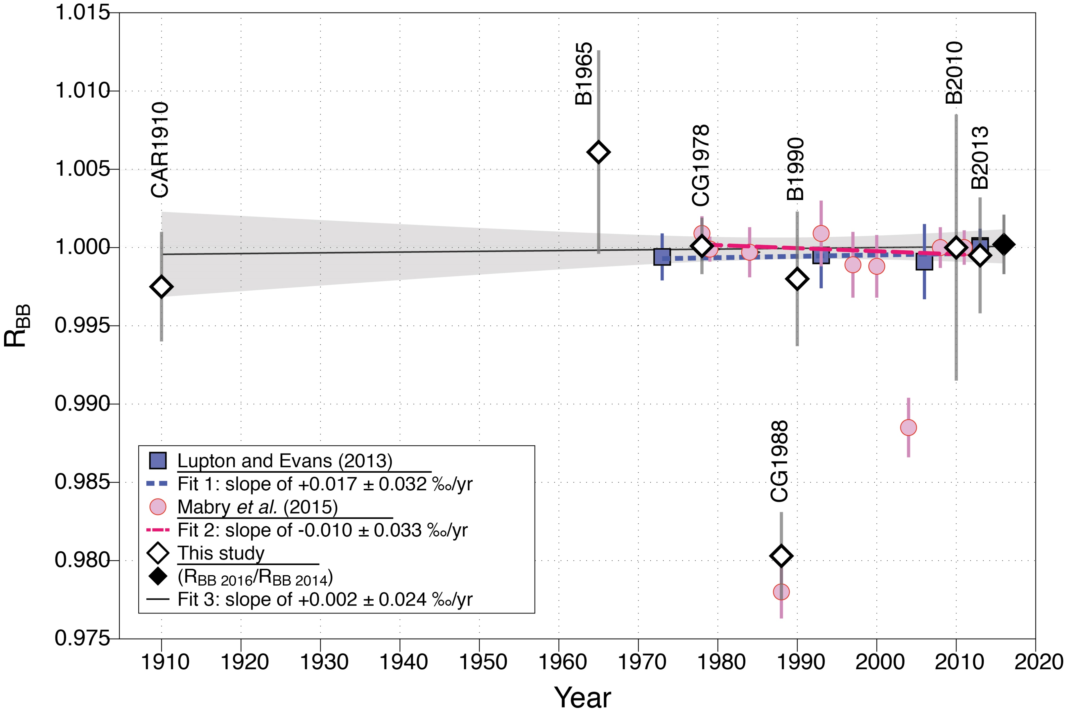
Boucher et al.
Atmospheric helium isotopic ratio from 1910 to 2016 recorded in stainless steel containers
Figure 2 Error-weighted mean (x̅) of the He isotope ratios, expressed as R_{BB} (diamond points; CG = Cape Grim; B = pétanque ball, CAR = carburettor), over time. Mabry et al. (2015) data (pink dots) are also normalised to BB air. Lupton and Evans (2013) data (blue squares) are normalised to 2013 La Jolla air (California, USA). The weighted…
© 2018 The Authors
Published by the European Association of Geochemistry
under Creative Commons License CC BY-NC-ND 4.0
Boucher et al. (2018) Geochem. Persp. Let. 6, 23-27 | doi: 10.7185/geochemlet.1804
Notes:
Figure 2 Error-weighted mean (x̅) of the He isotope ratios, expressed as R_{BB} (diamond points; CG = Cape Grim; B = pétanque ball, CAR = carburettor), over time. Mabry et al. (2015) data (pink dots) are also normalised to BB air. Lupton and Evans (2013) data (blue squares) are normalised to 2013 La Jolla air (California, USA). The weighted linear regression fits 1, 2 and 3 are obtained using data of Lupton and Evans (2013), Mabry et al. (2015) and the combination of our data with those of Mabry et al. (2015), respectively. The uncertainty envelope of fit 3 is shown in grey shaded area. Results are reported at 95 % CI (equivalent to 2σ).

